Slide 1

THROWS

Slide 2
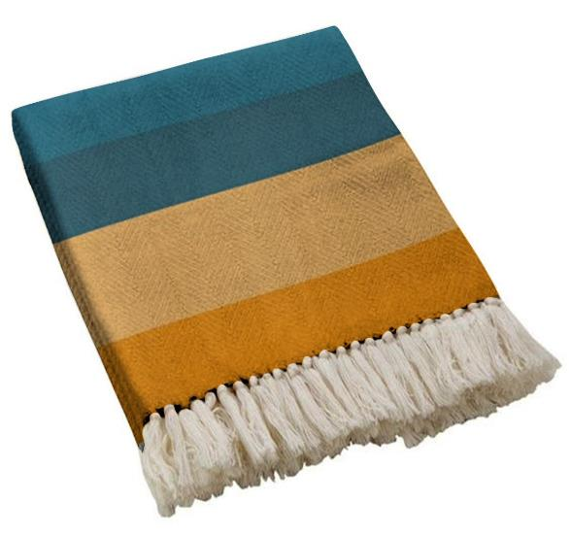
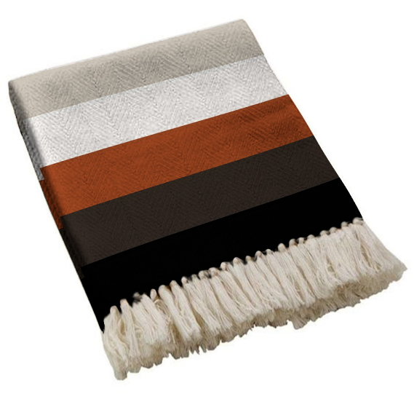
RT-TH-260502
Size – 125x150 cms
Price – US$
Composition – 80% COTTON + 20% OTHER FIBRE (recycled)
Quality – 450 GSM
RT-TH-260503
Size – 125x150 cms
Price – US$
Composition – 80% COTTON + 20% OTHER FIBRE (recycled)
Quality – 450 GSM

Slide 3
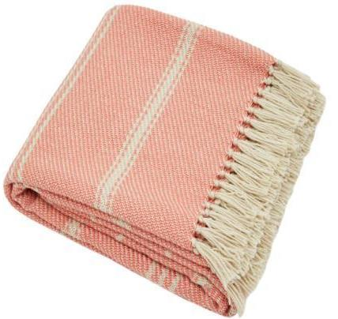
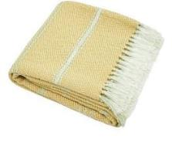
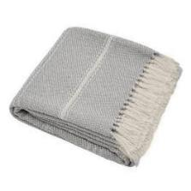
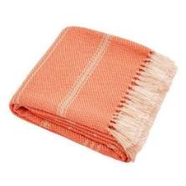
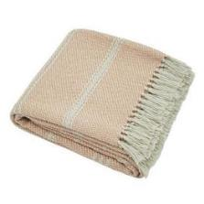
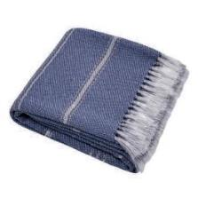
COLORWAYS
RT-TH-260501
Size – 125x150 cms
Price – US$
Composition – 80% COTTON + 20% OTHER FIBRE (recycled)
Quality – 450 GSM

Slide 4
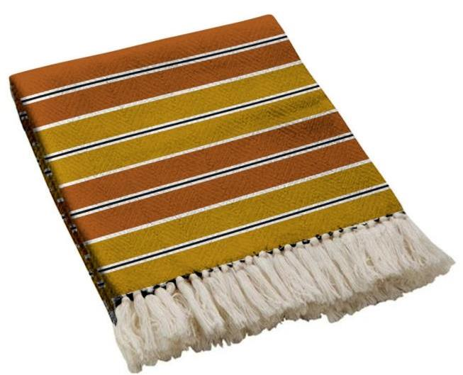
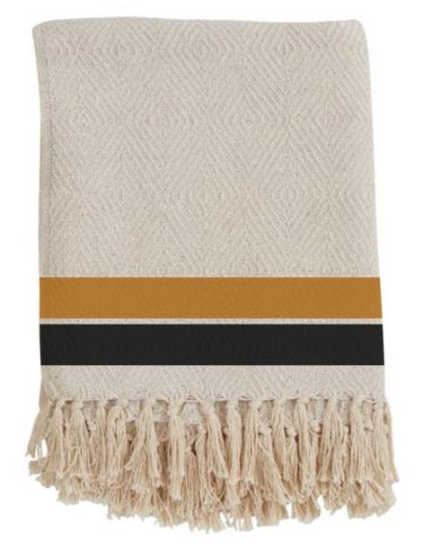
RT-TH-260504
Size – 125x150 cms
Price – US$
Composition – 80% COTTON + 20% OTHER FIBRE (recycled)
Quality – 450 GSM
RT-TH-260505
Size – 125x150 cms
Price – US$
Composition – 80% COTTON + 20% OTHER FIBRE (recycled)
Quality – 450 GSM

Slide 5
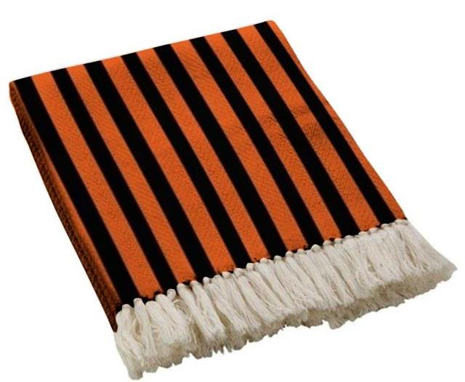
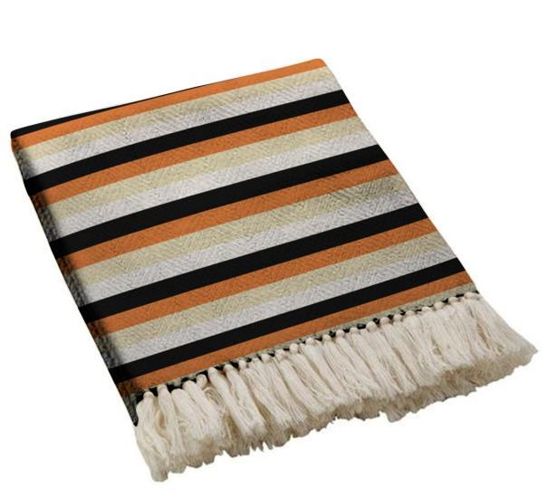
RT-TH-260506
Size – 125x150 cms
Price – US$
Composition – 80% COTTON + 20% OTHER FIBRE (recycled)
Quality – 450 GSM
RT-TH-260507
Size – 125x150 cms
Price – US$
Composition – 80% COTTON + 20% OTHER FIBRE (recycled)
Quality – 450 GSM

Slide 6
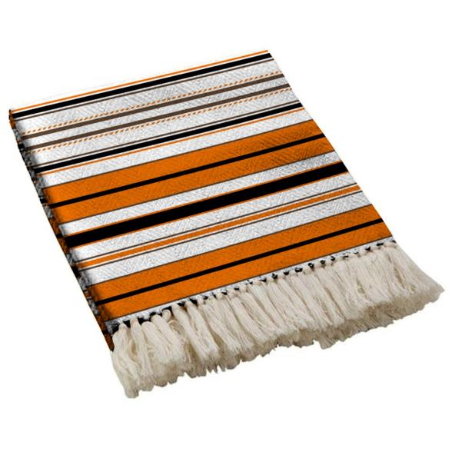
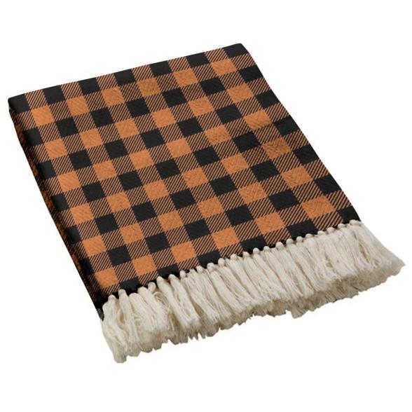
RT-TH-260508
Size – 125x150 cms
Price – US$
Composition – 80% COTTON + 20% OTHER FIBRE (recycled)
Quality – 450 GSM
RT-TH-260509
Size – 125x150 cms
Price – US$
Composition – 80% COTTON + 20% OTHER FIBRE (recycled)
Quality – 450 GSM

Slide 7
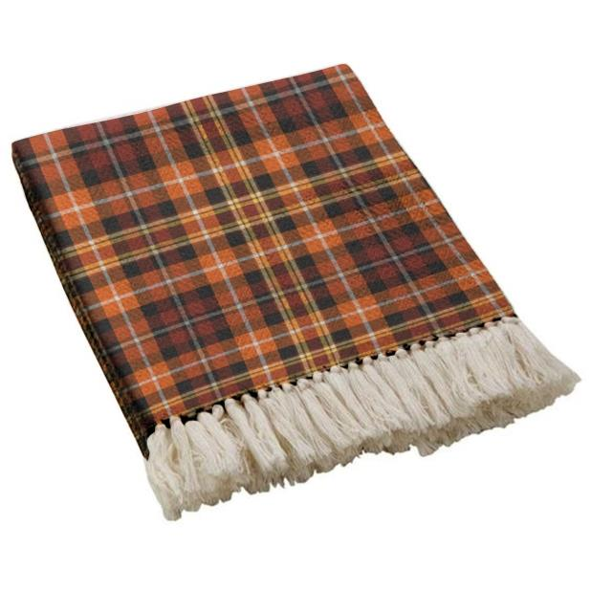
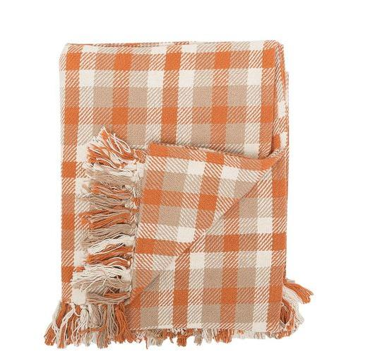
RT-TH-260510
Size – 125x150 cms
Price – US$
Composition – 80% COTTON + 20% OTHER FIBRE (recycled)
Quality – 450 GSM
RT-TH-260511
Size – 125x150 cms
Price – US$
Composition – 80% COTTON + 20% OTHER FIBRE (recycled)
Quality – 450 GSM

Slide 8
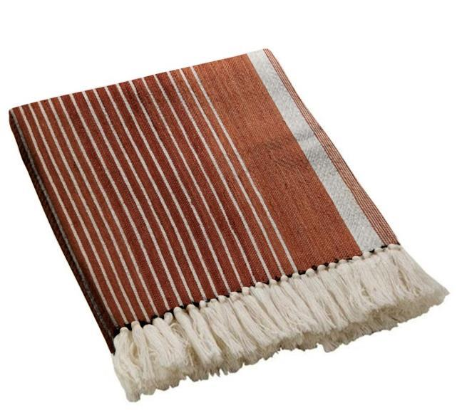
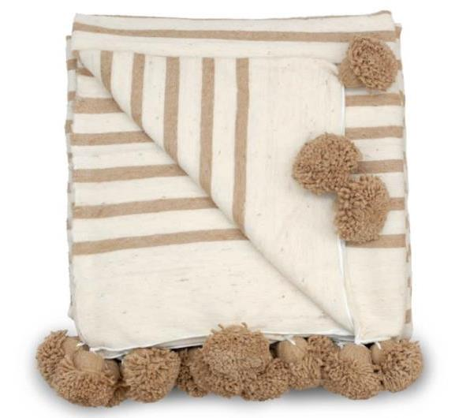
RT-TH-260512
Size – 125x150 cms
Price – US$
Composition – 80% COTTON + 20% OTHER FIBRE (recycled)
Quality – 450 GSM
RT-TH-260513
Size – 125x150 cms
Price – US$
Composition – 70% COTTON + 30% polyester
Quality – 450 GSM

Slide 9
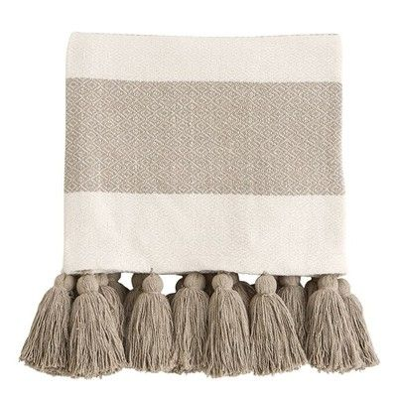
RT-TH-260514
Size – 125x150 cms
Price – US$
Composition – 80% COTTON + 20% OTHER FIBRE (recycled)
Quality – 450 GSM

Slide 10
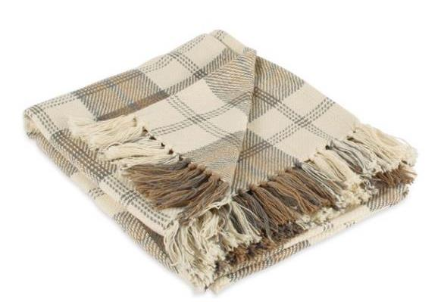
RT-TH-260515
Size – 125x150 cms
Price – US$
Composition – 80% COTTON + 20% OTHER FIBRE (recycled)
Quality – 450 GSM

Slide 11
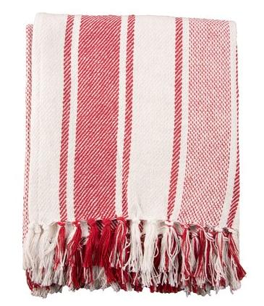
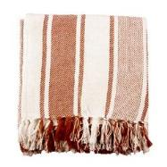
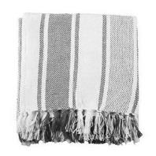
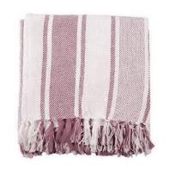
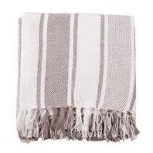
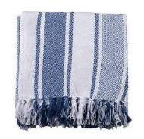
COLORWAYS
RT-TH-260516
Size – 125x150 cms
Price – US$
Composition – 80% COTTON + 20% OTHER FIBRE (recycled)
Quality – 450 GSM

Slide 12
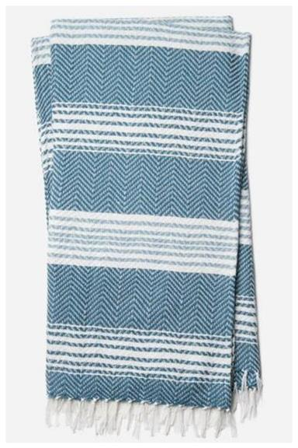
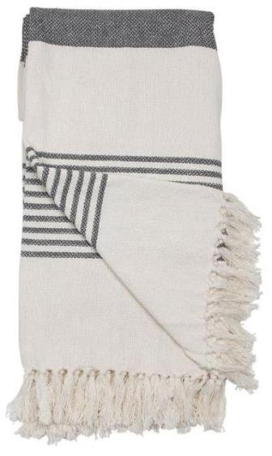
RT-TH-260517
Size – 125x150 cms
Price – US$
Composition – 80% COTTON + 20% OTHER FIBRE (recycled)
Quality – 450 GSM
RT-TH-260518
Size – 125x150 cms
Price – US$
Composition – 80% COTTON + 20% OTHER FIBRE (recycled)
Quality – 550 GSM

Slide 13
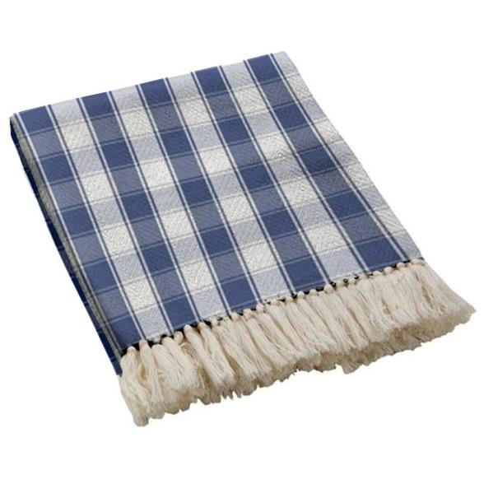
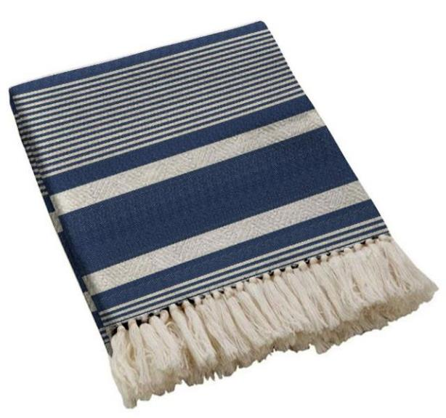
RT-TH-260519
Size – 125x150 cms
Price – US$
Composition – 80% COTTON + 20% OTHER FIBRE (recycled)
Quality – 450 GSM
RT-TH-260520
Size – 125x150 cms
Price – US$
Composition – 80% COTTON + 20% OTHER FIBRE (recycled)
Quality – 450 GSM

Slide 14
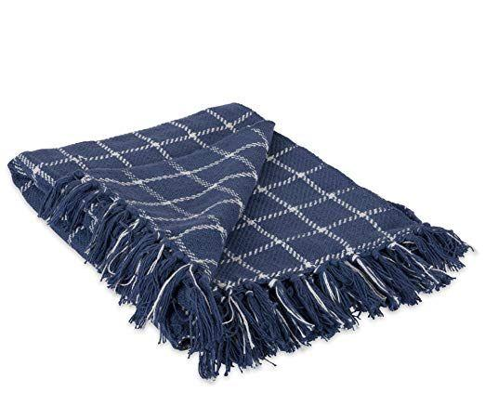
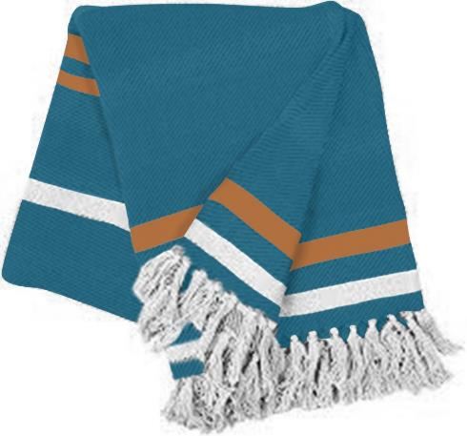
RT-TH-260521
Size – 125x150 cms
Price – US$
Composition – 80% COTTON + 20% OTHER FIBRE (recycled)
Quality – 450 GSM
RT-TH-260522
Size – 125x150 cms
Price – US$
Composition – 80% COTTON + 20% OTHER FIBRE (recycled)
Quality – 450 GSM

Slide 15
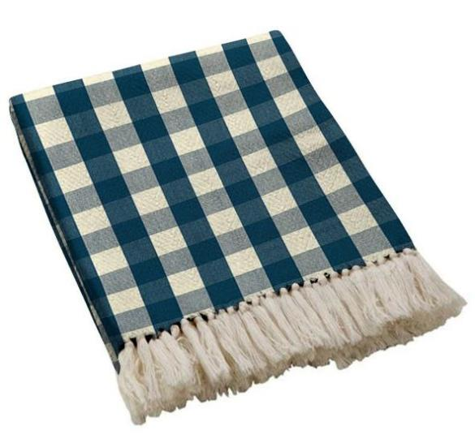
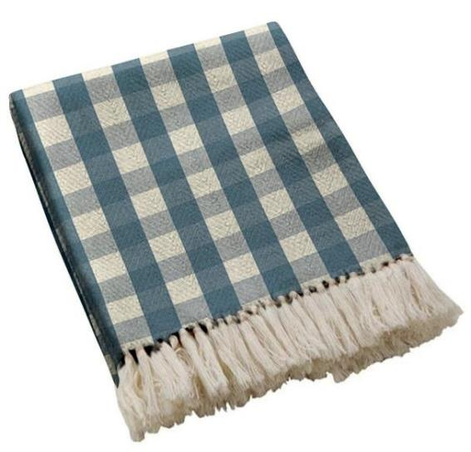
RT-TH-260523
Size – 125x150 cms
Price – US$
Composition – 80% COTTON + 20% OTHER FIBRE (recycled)
Quality – 450 GSM
RT-TH-260524
Size – 125x150 cms
Price – US$
Composition – 80% COTTON + 20% OTHER FIBRE (recycled)
Quality – 450 GSM

Slide 16
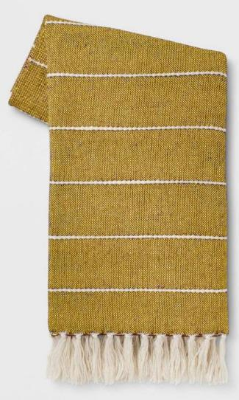
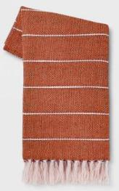
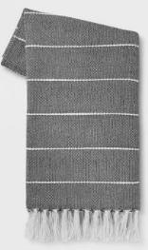
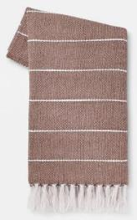
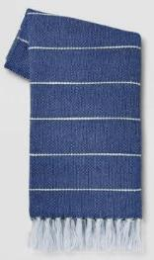
COLORWAYS
RT-TH-260525
Size – 125x150 cms
Price – US$
Composition – 80% COTTON + 20% OTHER FIBRE (recycled)
Quality – 450 GSM

Slide 17
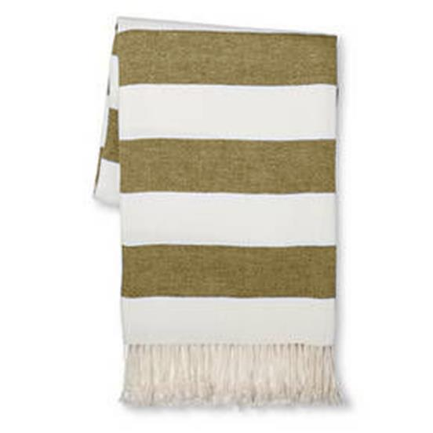
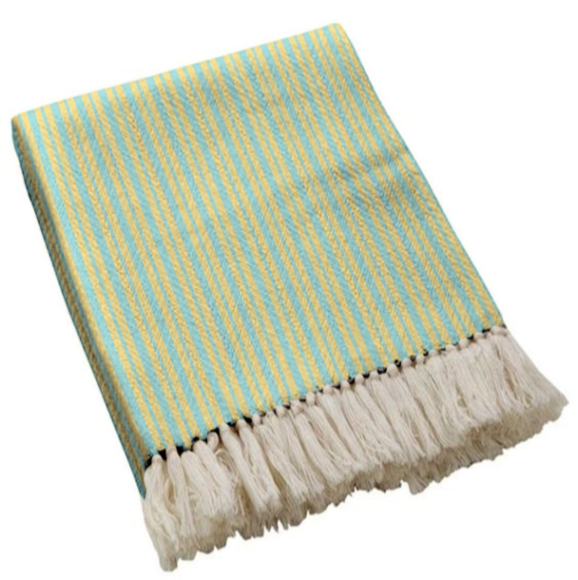
RT-TH-260526
Size – 125x150 cms
Price – US$
Composition – 80% COTTON + 20% OTHER FIBRE (recycled)
Quality – 450 GSM
RT-TH-260527
Size – 125x150 cms
Price – US$
Composition – 80% COTTON + 20% OTHER FIBRE (recycled)
Quality – 450 GSM

Slide 18
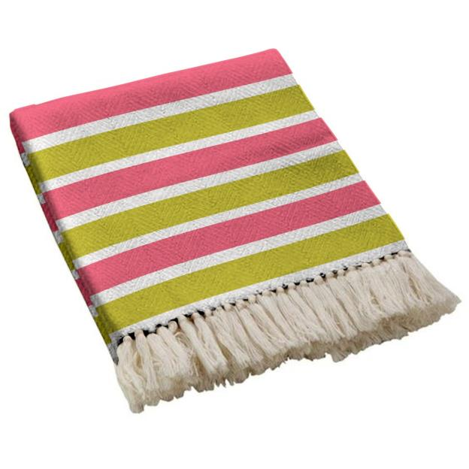
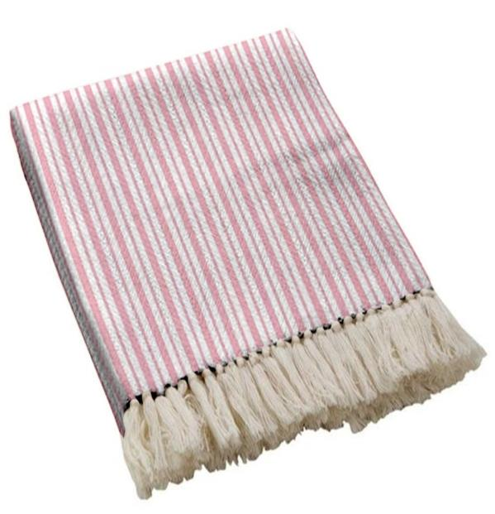
RT-TH-260528
Size – 125x150 cms
Price – US$
Composition – 80% COTTON + 20% OTHER FIBRE (recycled)
Quality – 450 GSM
RT-TH-260529
Size – 125x150 cms
Price – US$
Composition – 80% COTTON + 20% OTHER FIBRE (recycled)
Quality – 450 GSM

Slide 19
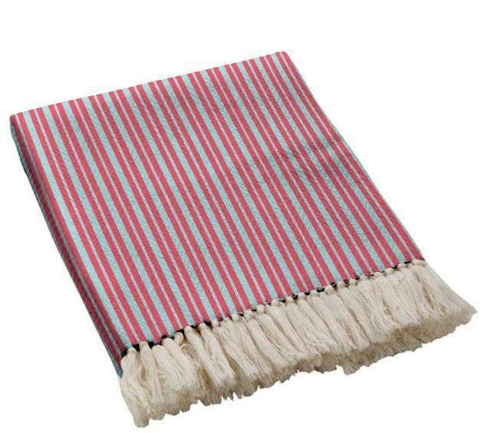
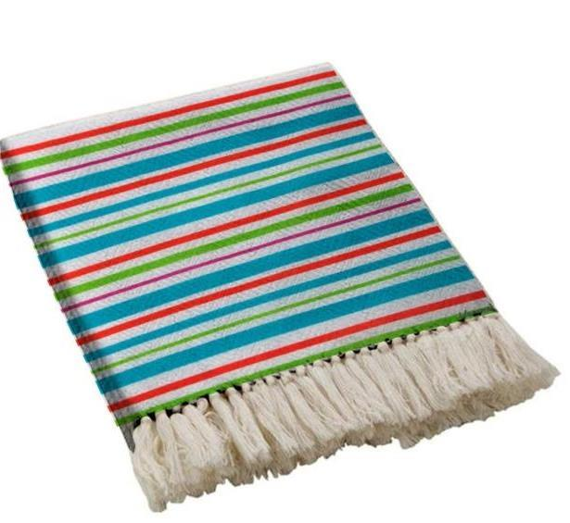
RT-TH-260530
Size – 125x150 cms
Price – US$
Composition – 80% COTTON + 20% OTHER FIBRE (recycled)
Quality – 450 GSM
RT-TH-260531
Size – 125x150 cms
Price – US$
Composition – 80% COTTON + 20% OTHER FIBRE (recycled)
Quality – 450 GSM

Slide 20
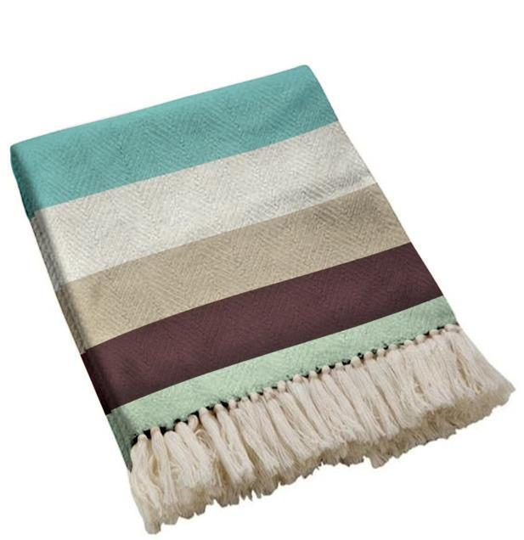
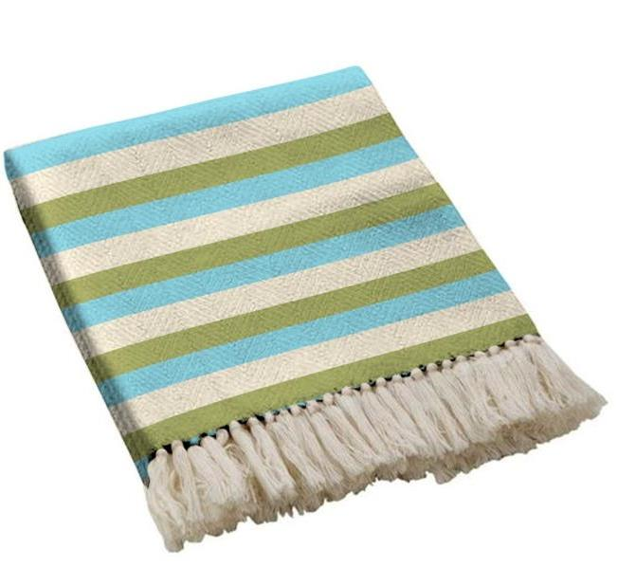
RT-TH-260532
Size – 125x150 cms
Price – US$
Composition – 80% COTTON + 20% OTHER FIBRE (recycled)
Quality – 450 GSM
RT-TH-260533
Size – 125x150 cms
Price – US$
Composition – 80% COTTON + 20% OTHER FIBRE (recycled)
Quality – 450 GSM

Slide 21
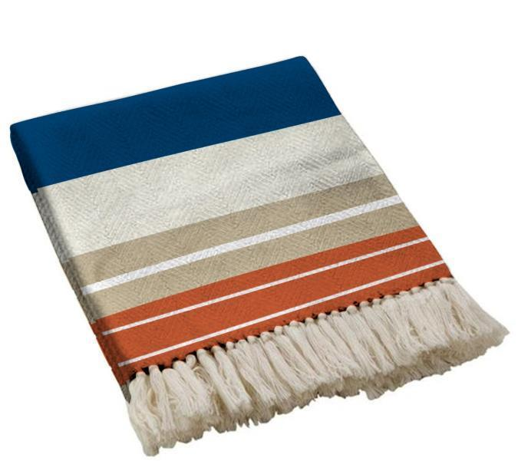
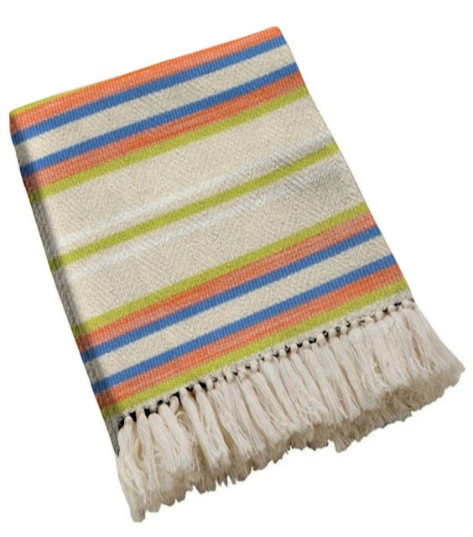
RT-TH-260534
Size – 125x150 cms
Price – US$
Composition – 80% COTTON + 20% OTHER FIBRE (recycled)
Quality – 450 GSM
RT-TH-260535
Size – 125x150 cms
Price – US$
Composition – 80% COTTON + 20% OTHER FIBRE (recycled)
Quality – 450 GSM

