Slide 1
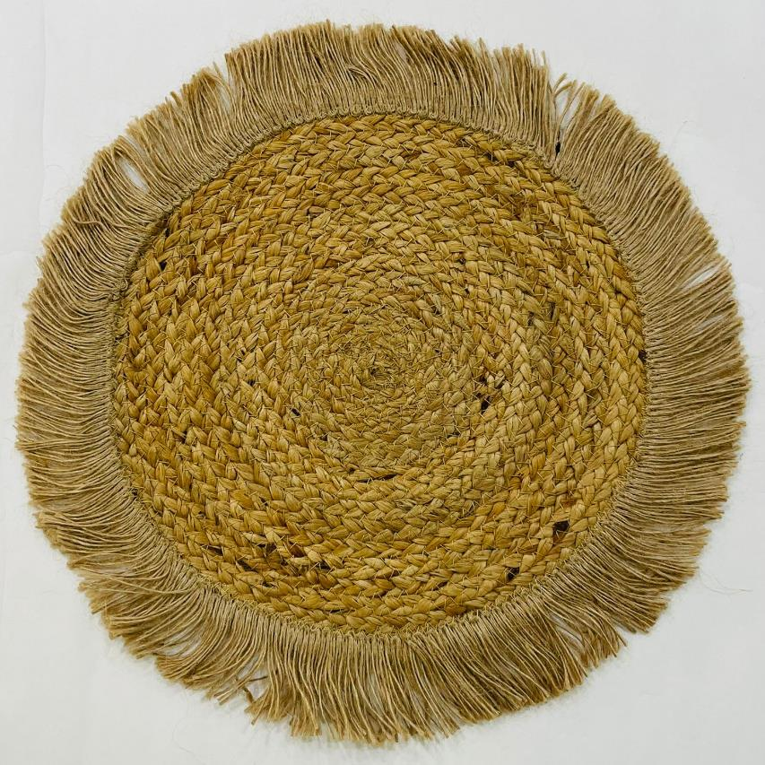
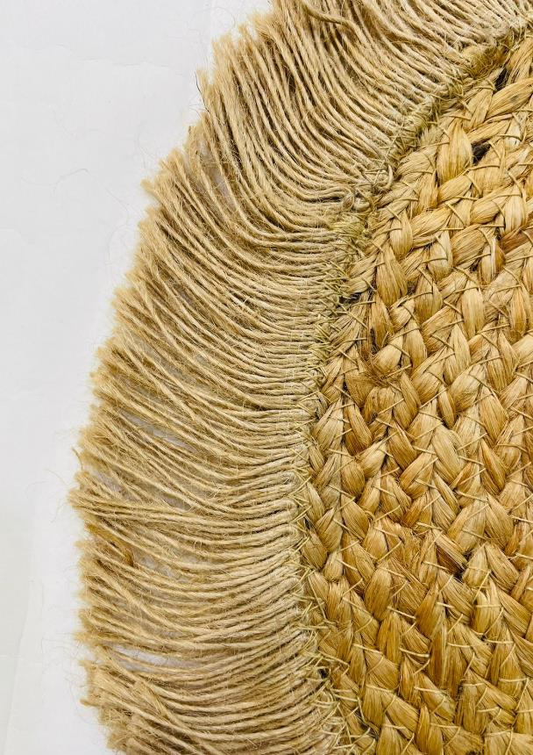
Article no : RT-PM-0400
Article : Jute Braided Place Mat (Front and Back Same )
Size: 38 cm Round including Fringes
Composition : Jute
Price : 92 cents
Close View

Slide 2
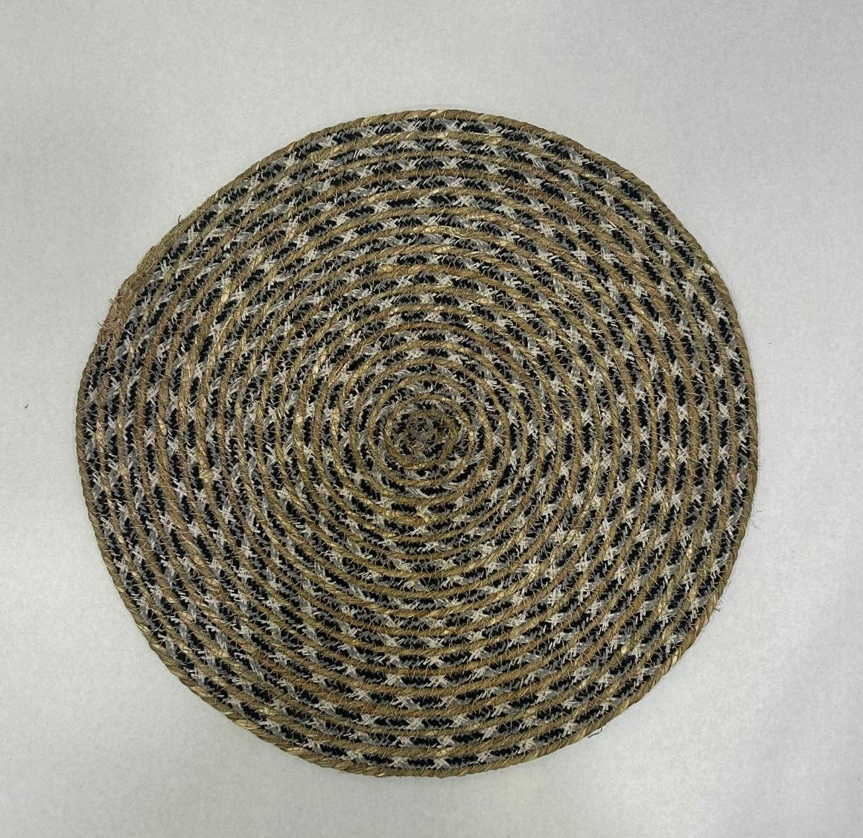
Article No: RT-PM-0450A
Article : Place Mat
Composition : Seagrass + Cotton
Size : 38 CM Round

Slide 3
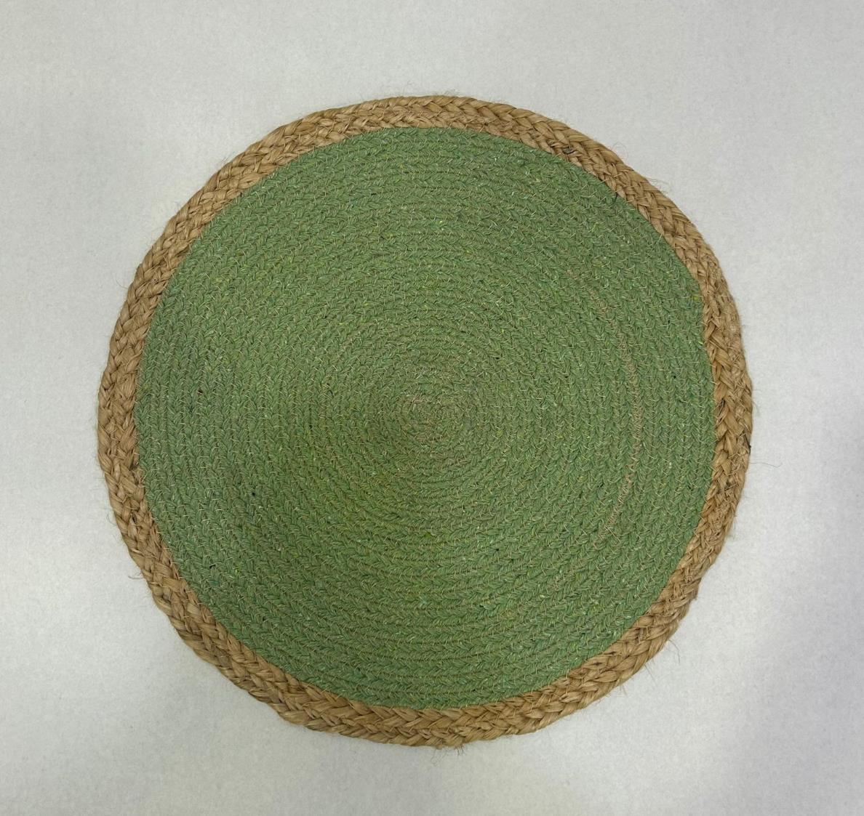
Article No: RT-PM-0400A
Article : Place Mat
Composition : Jute + Cotton
Size : 38 cm Round

Slide 4
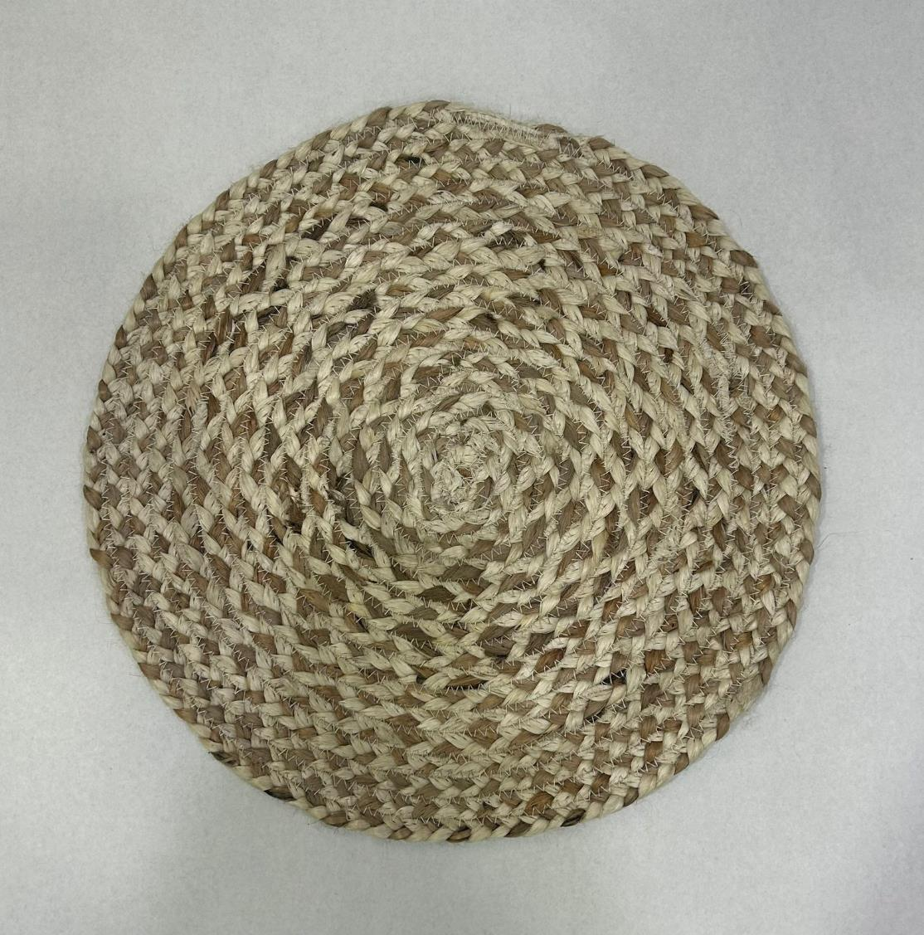
Article No: RT-PM-0720A
Article : Place Mat
Composition : Jute
Size : 38 cm Round

Slide 5
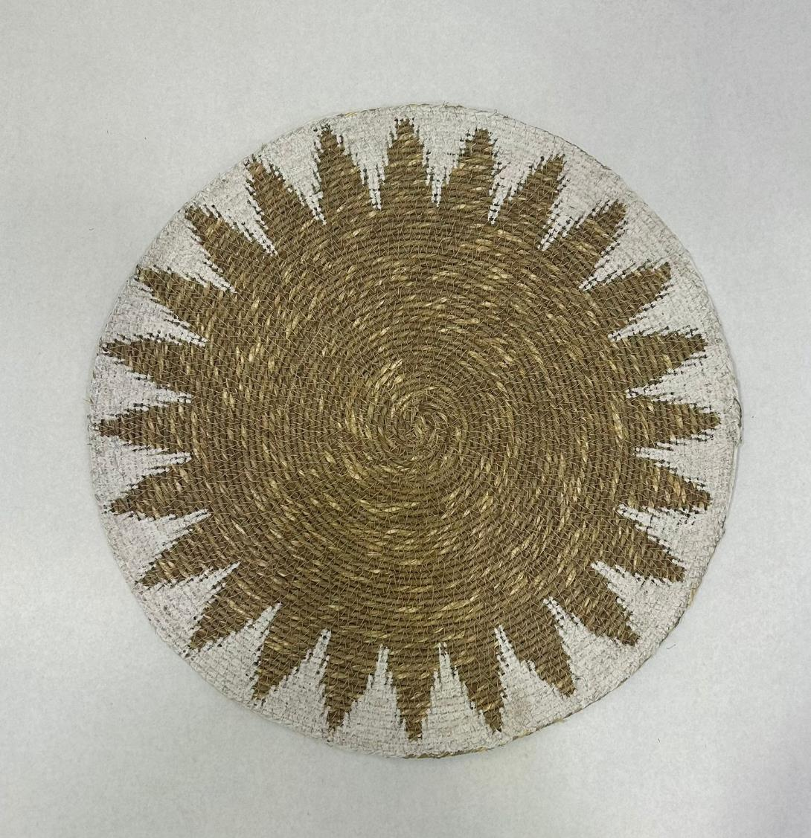
Article No: RT-PM-0520A
Article : Place Mat with Khadi Print
Composition : Seagrass
Size : 38 cm Round

Slide 6
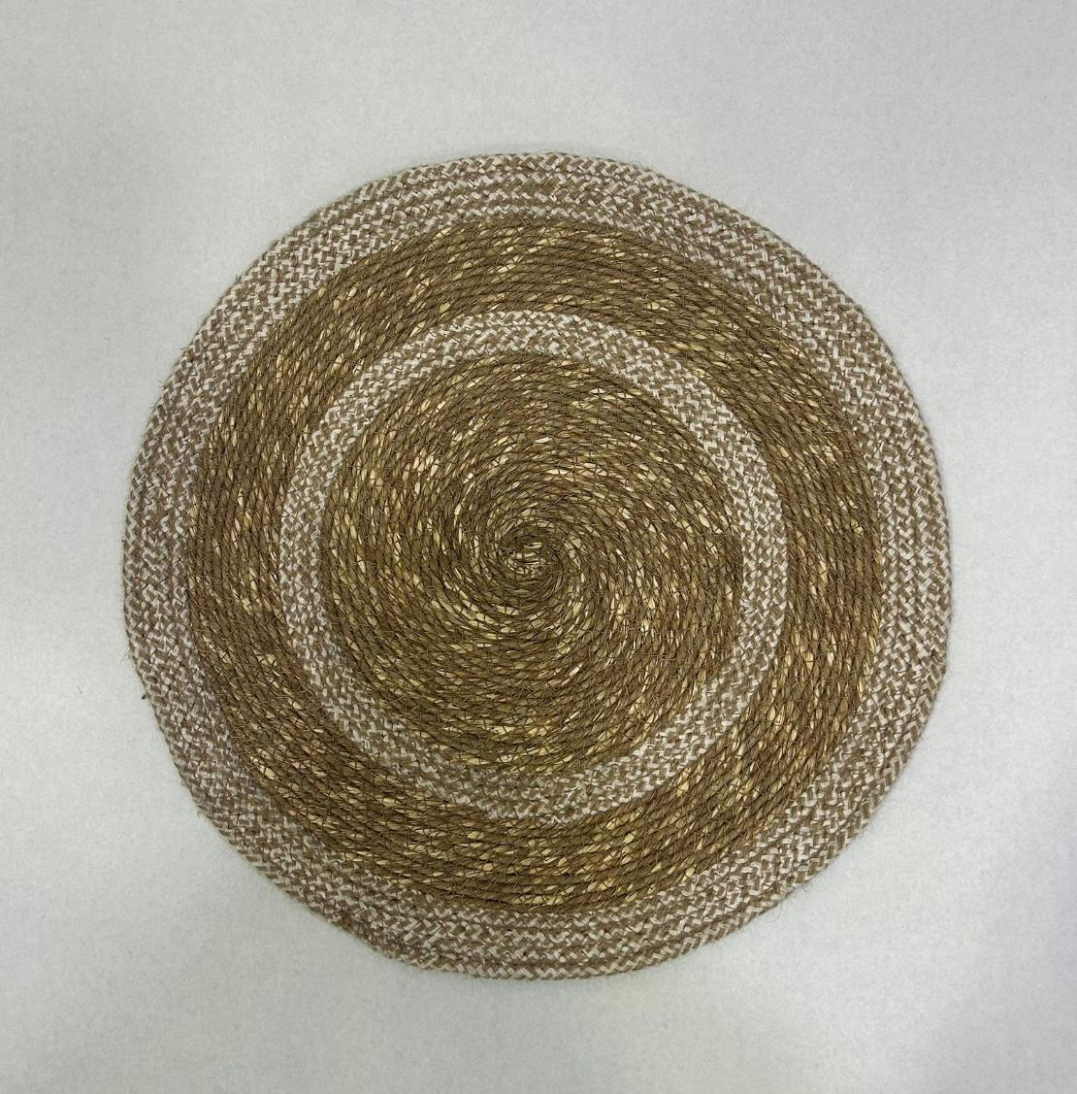
Article No: RT-PM-0520B
Article : Place Mat
Composition : Seagrass + Cotton
Size : 38 cm Round

Slide 7
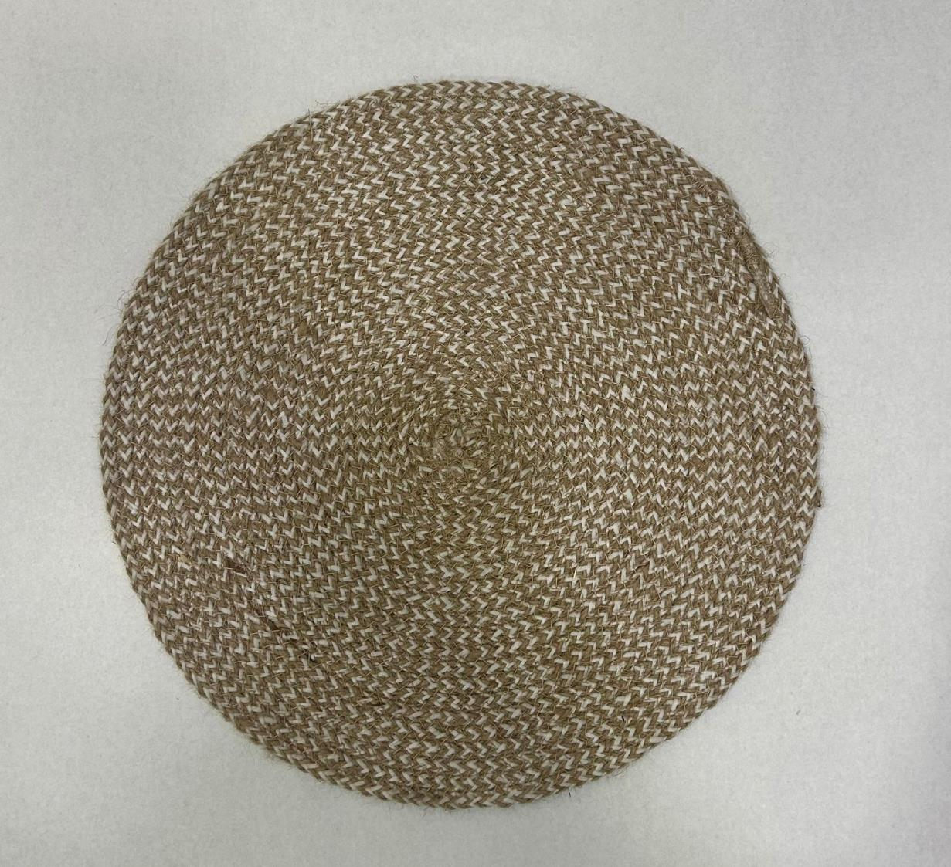
Article No: RT-PM-0460A
Article : Place Mat
Composition : Jute + Pet Yarn
Size : 38 cm Round

Slide 8
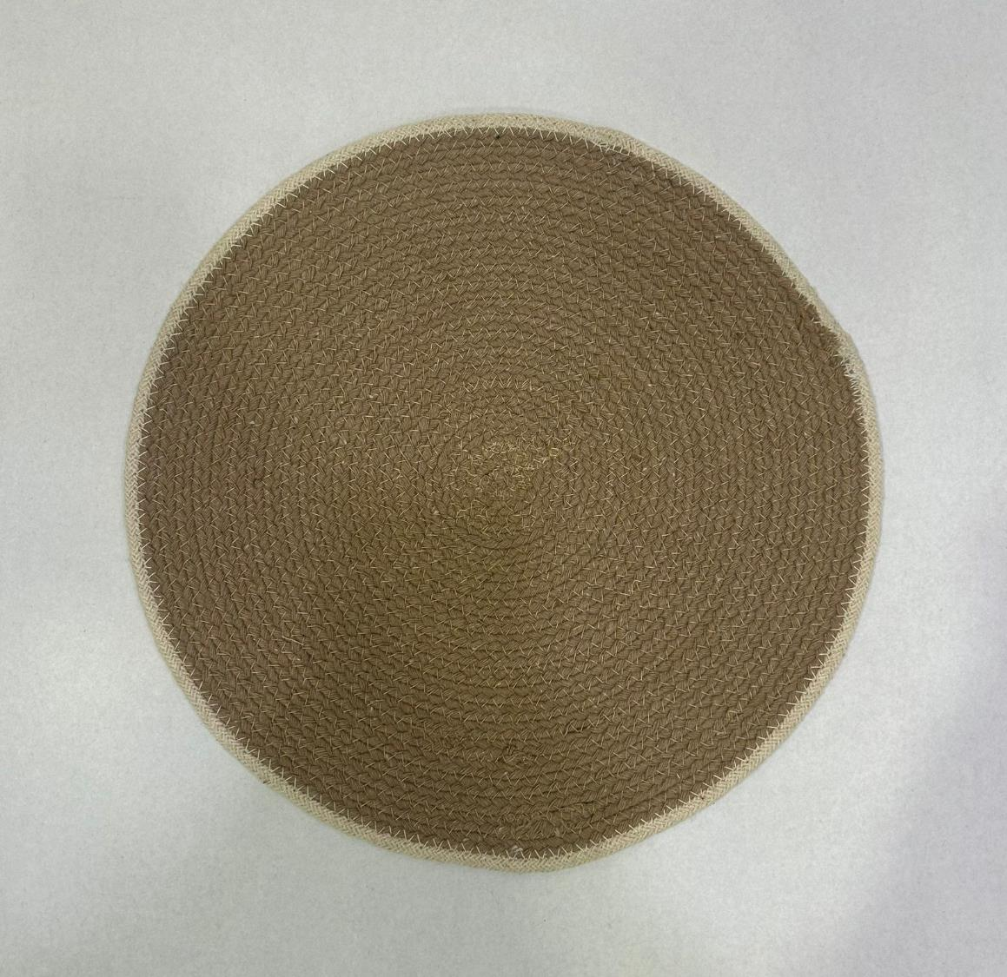
Article No: RT-PM-0380A
Article : Place Mat
Composition : Cotton
Size : 38 cm Round

Slide 9
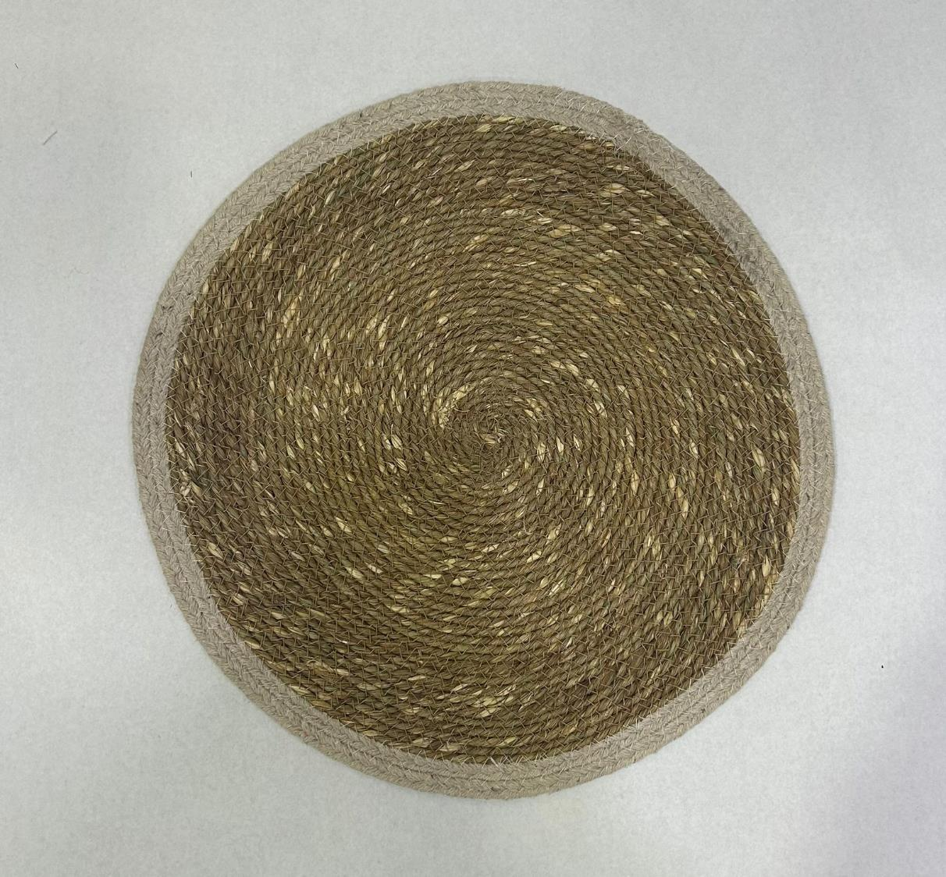
Article No: RT-PM-0460B
Article : Place Mat
Composition : Seagrass + Cotton
Size : 38 cm Round

Slide 10
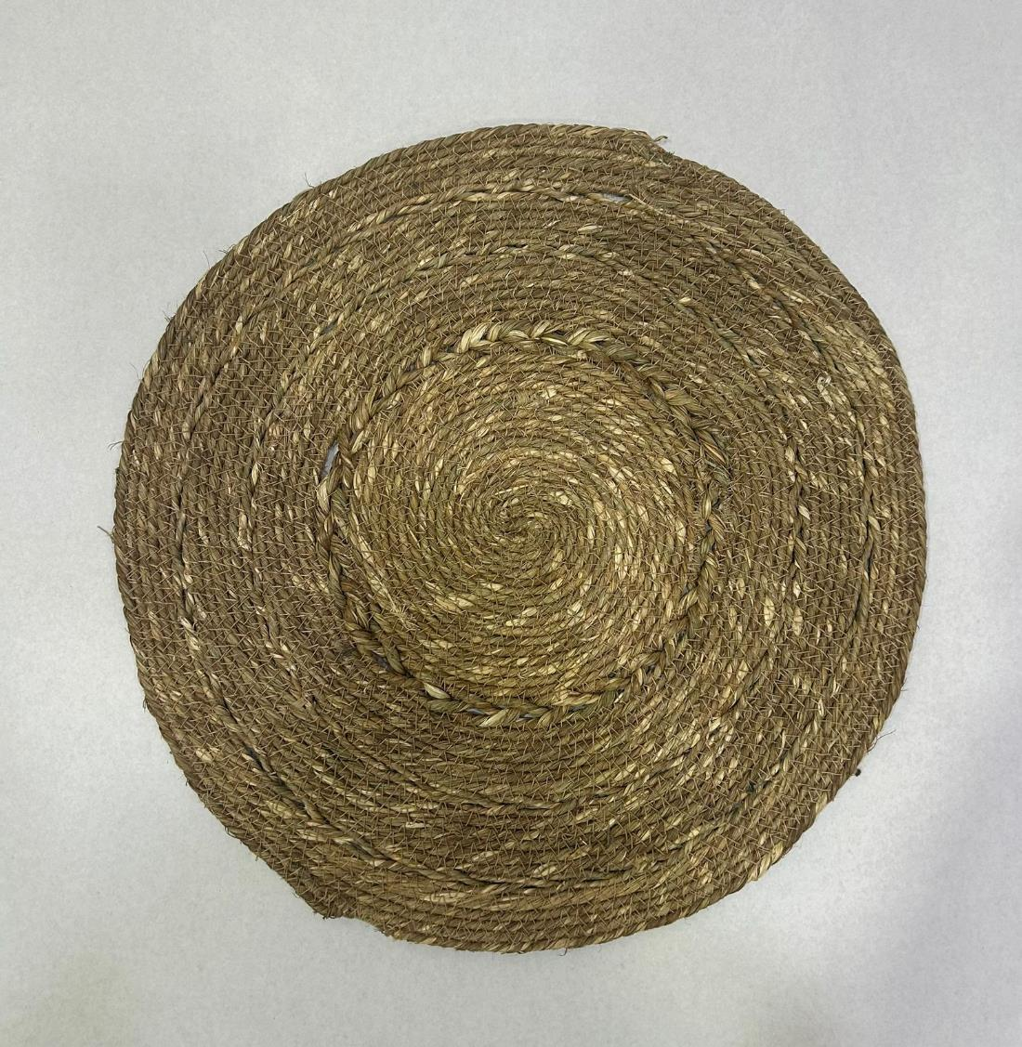
Article No: RT-PM-0600A
Article : Place Mat
Composition : Seagrass
Size : 38 cm Round

Slide 11
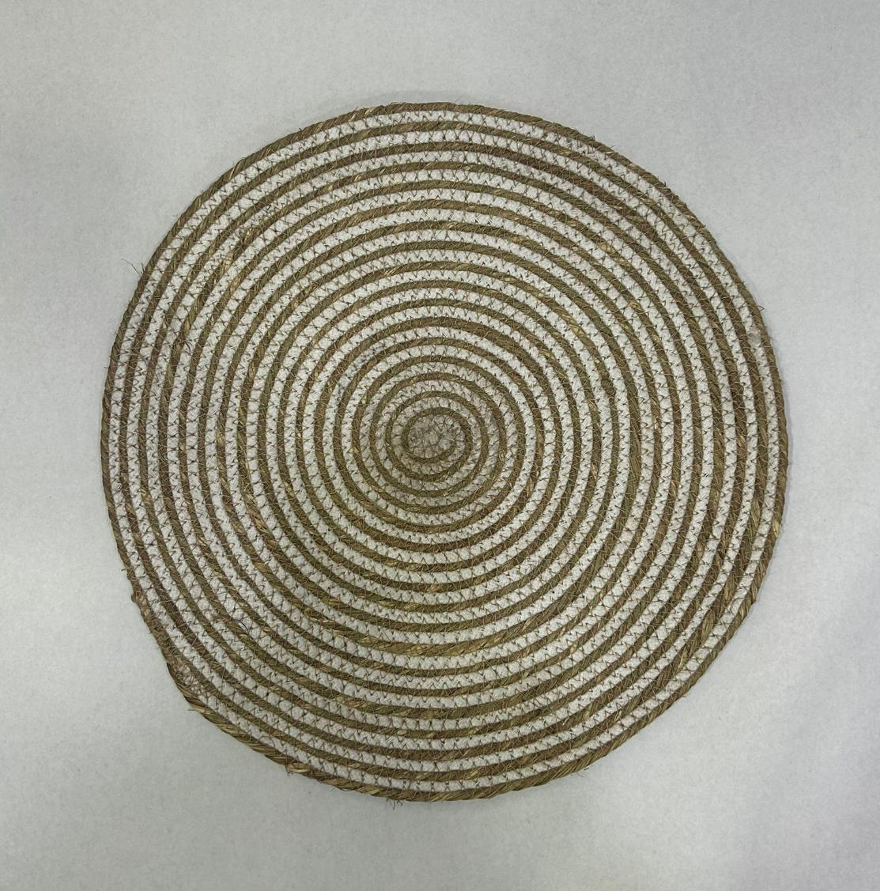
Article No: RT-PM-0550A
Article : Place Mat
Composition : Seagrass + Cotton
Size : 38 cm Round

Slide 12
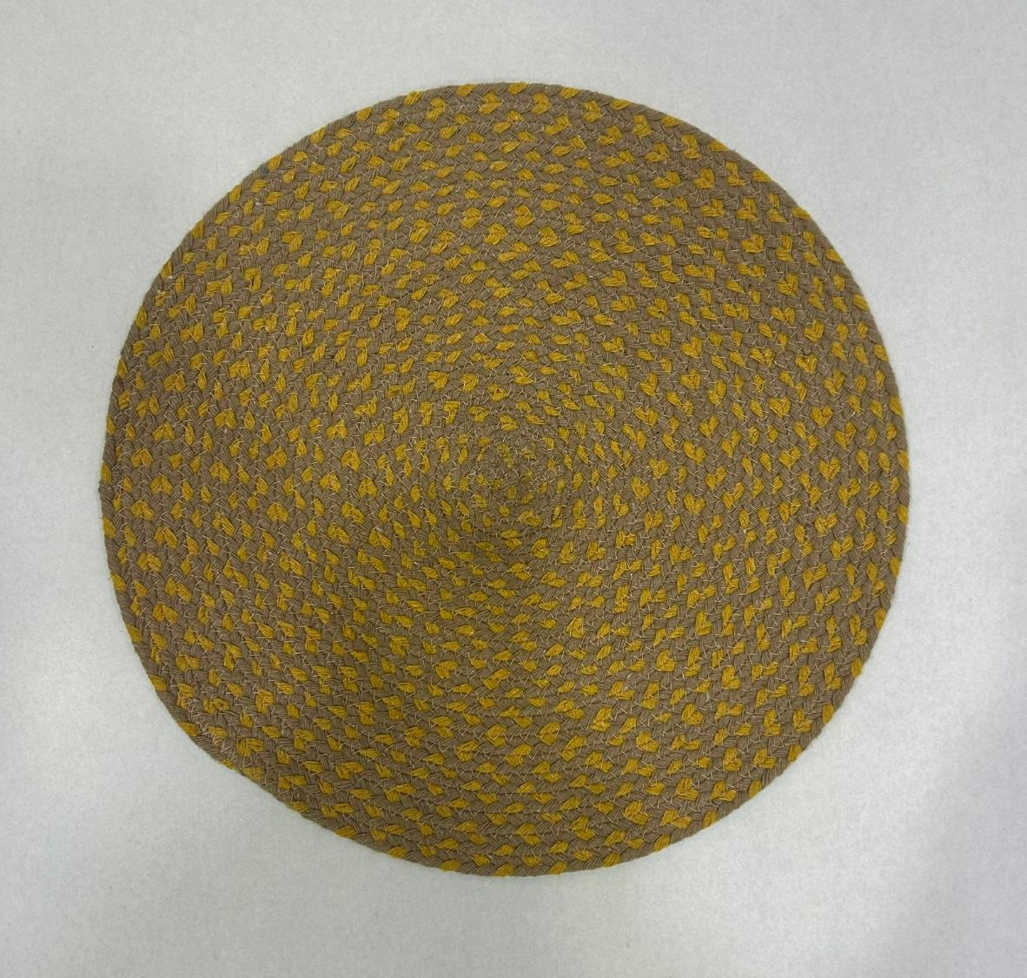
Article No: RT-PM-0380B
Article : Place Mat
Composition : Cotton
Size : 38 cm Round

Slide 13
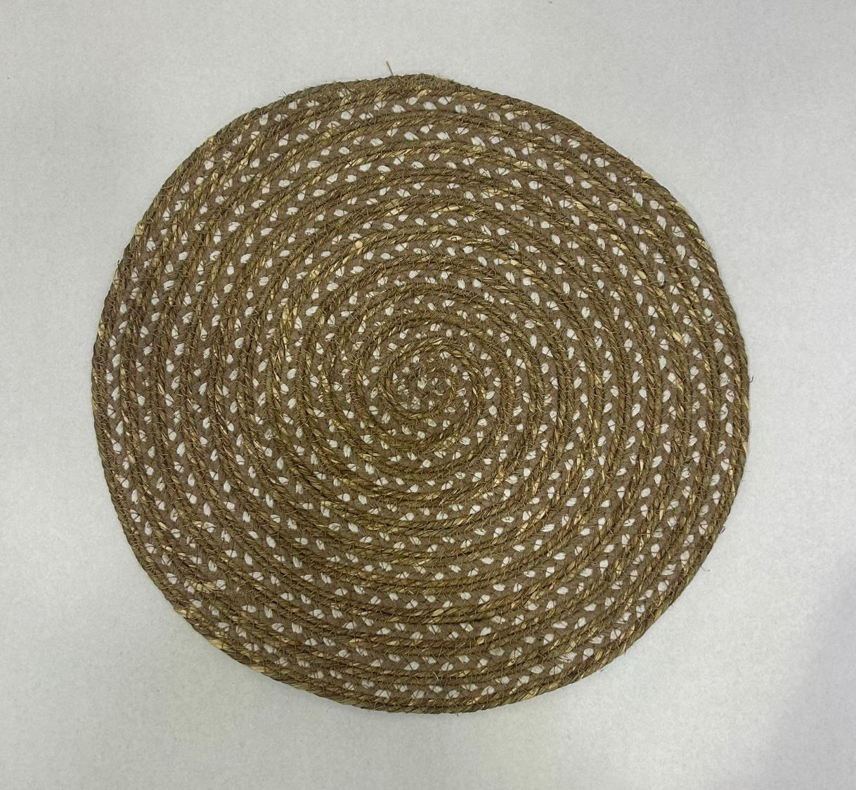
Article No: RT-PM-0540A
Article : Place Mat
Composition : Seagrass + Cotton
Size : 38 cm Round

Slide 14
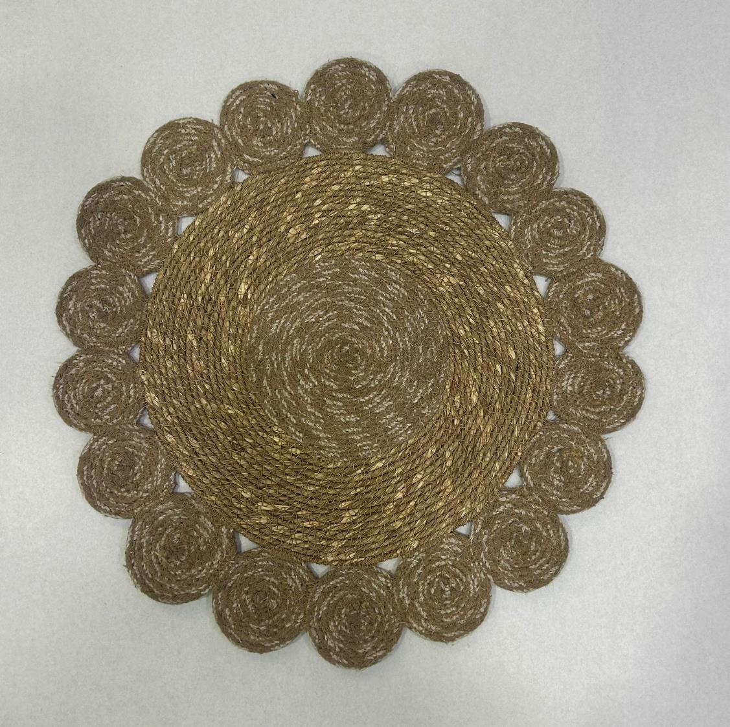
Article No: RT-PM-0620A
Article : Place Mat
Composition : Seagrass + Cotton
Size : 38 cm Round

Slide 15
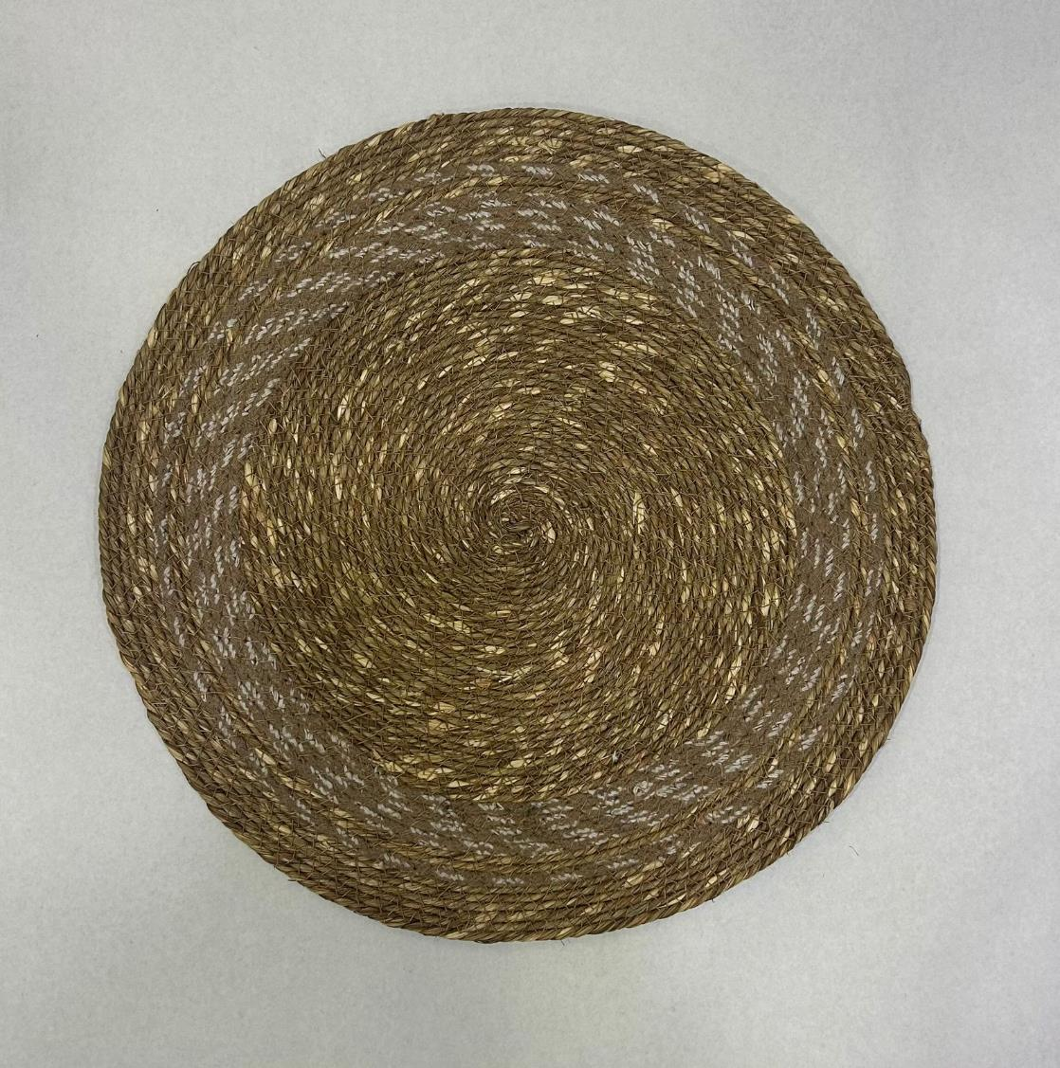
Article No: RT-PM-0520C
Article : Place Mat
Composition : Seagrass + Cotton
Size : 38 cm Round

Slide 16
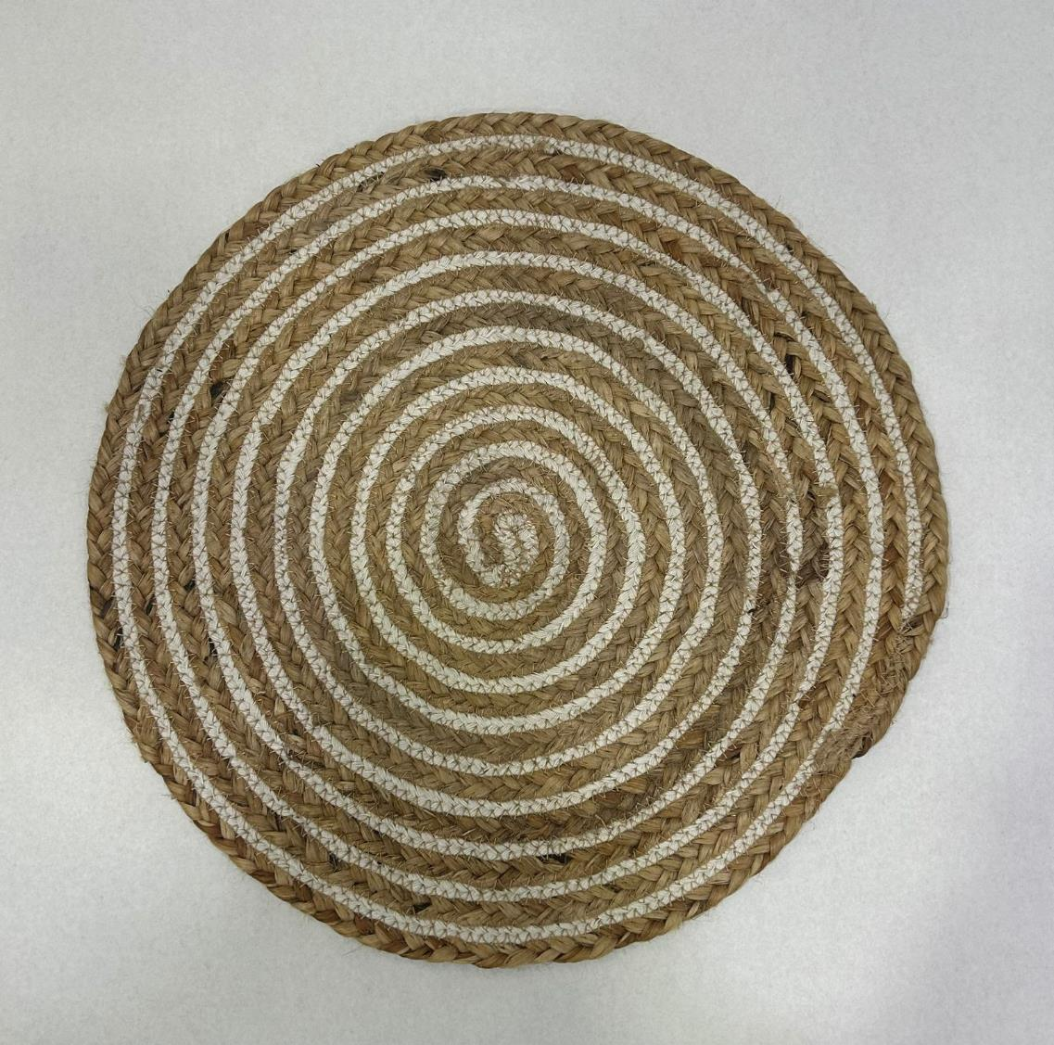
Article No: RT-PM-0460C
Article : Place Mat
Composition : Jute + Cotton
Size : 38 cm Round

Slide 17
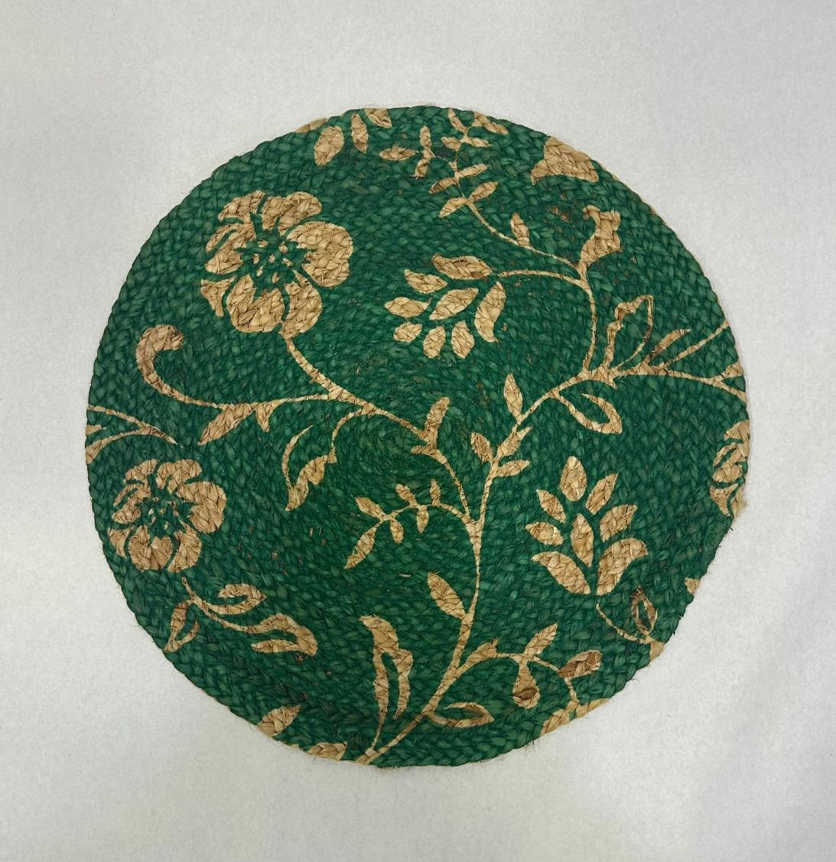
Article No: RT-PM-0500A
Article : Place Mat with Print
Composition : Jute
Size : 38 cm Round

Slide 18
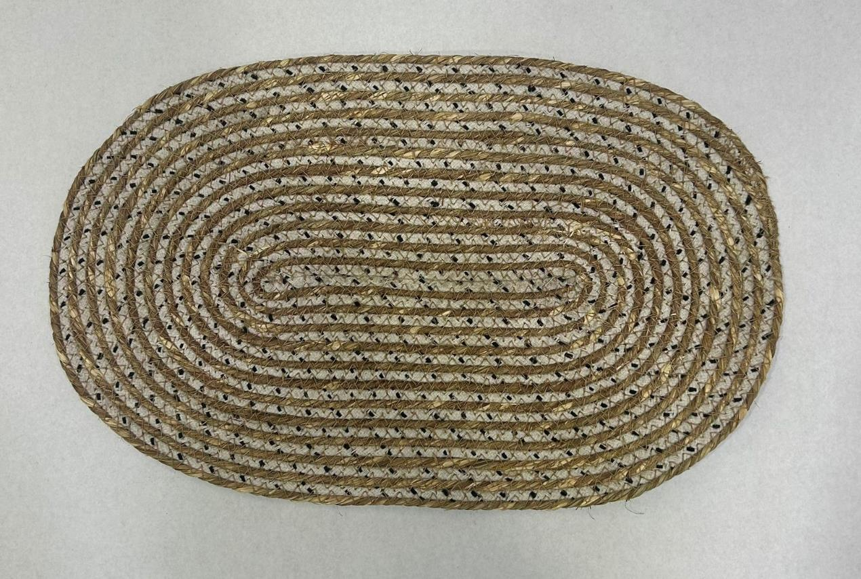
Article No: RT-PM-0450B
Article : Place Mat
Composition : Seagrass + Cotton
Size : 40x25 cm

Slide 19
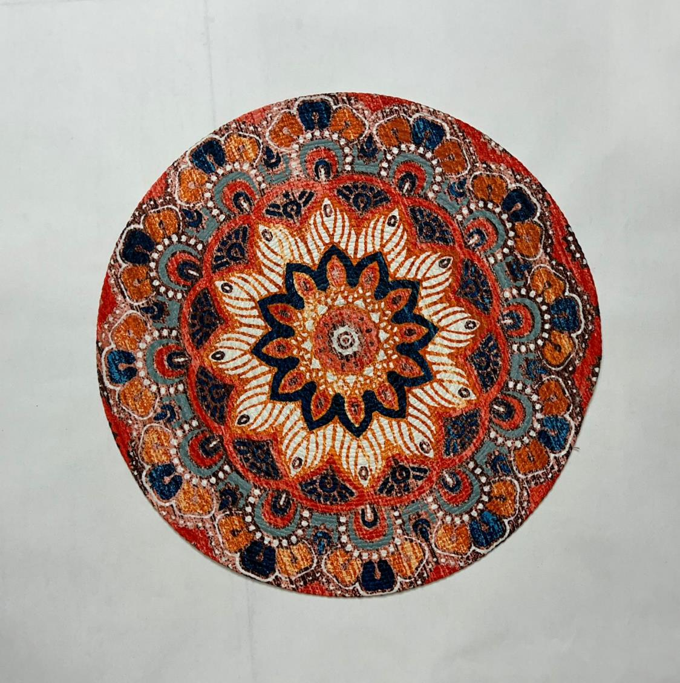
Article No: RT-PM-0500B
Article : Place Mat with digital print
Composition : Pet Yarn
Size : 38 cm Round

Slide 20
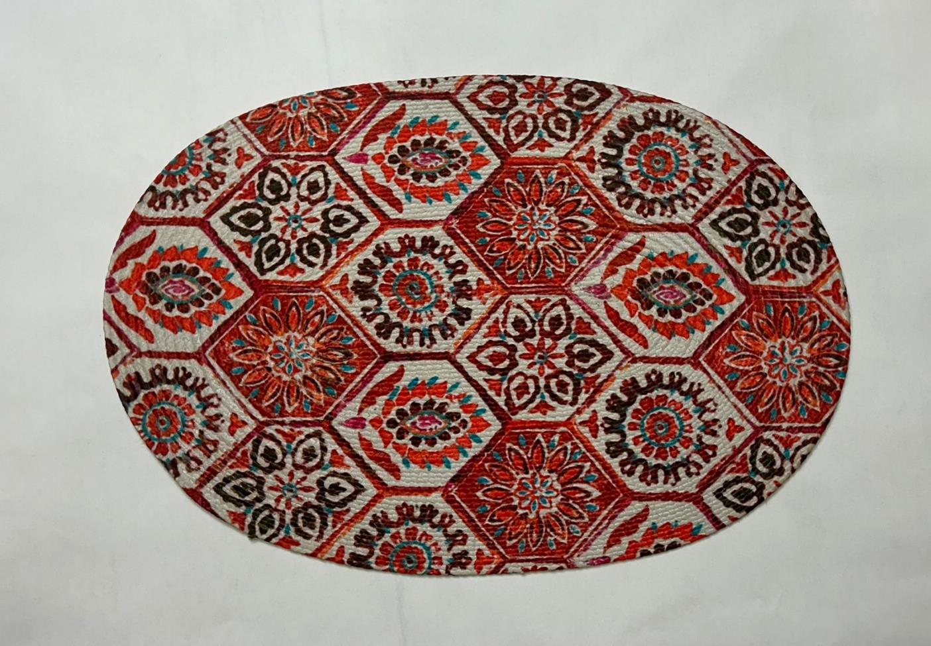
Article No: RT-PM-0670A
Article : Place Mat with Digital Print
Composition : Pet Yarn
Size : 35x50 cm

