Slide 1

New collection

Slide 2
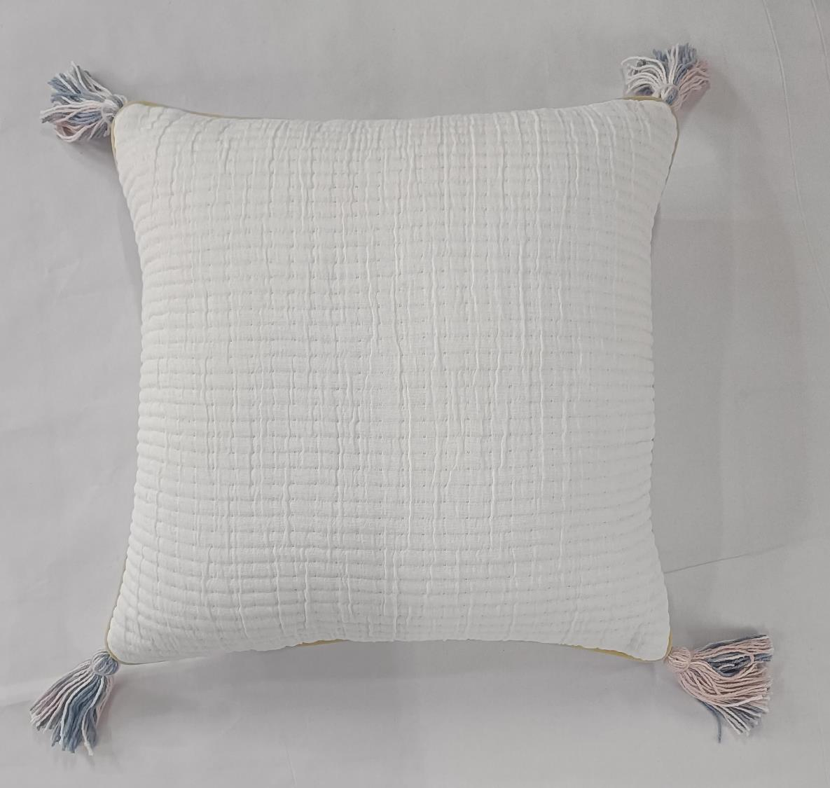
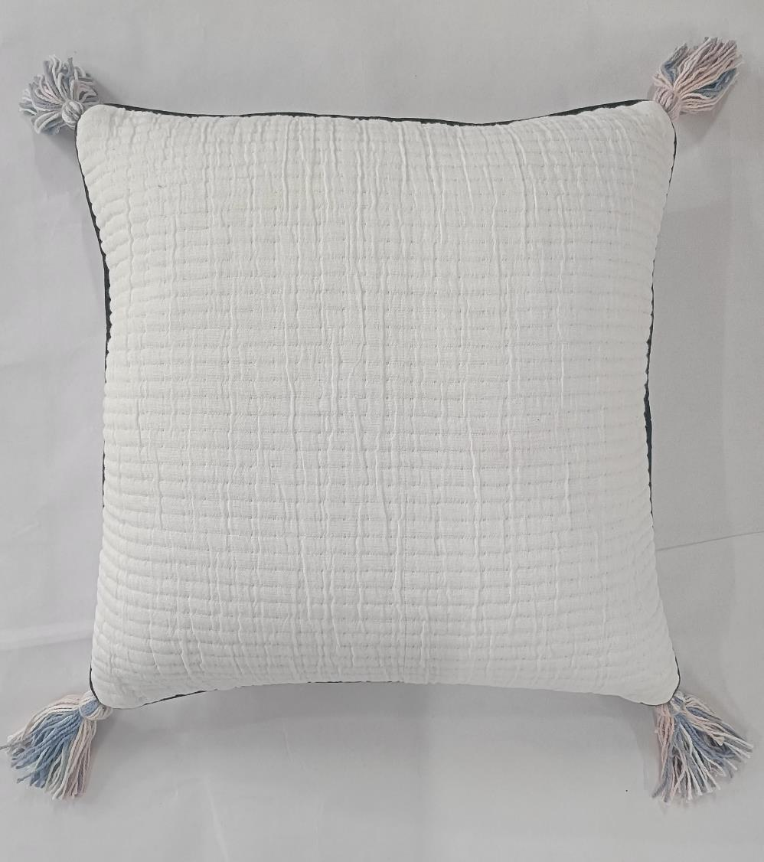
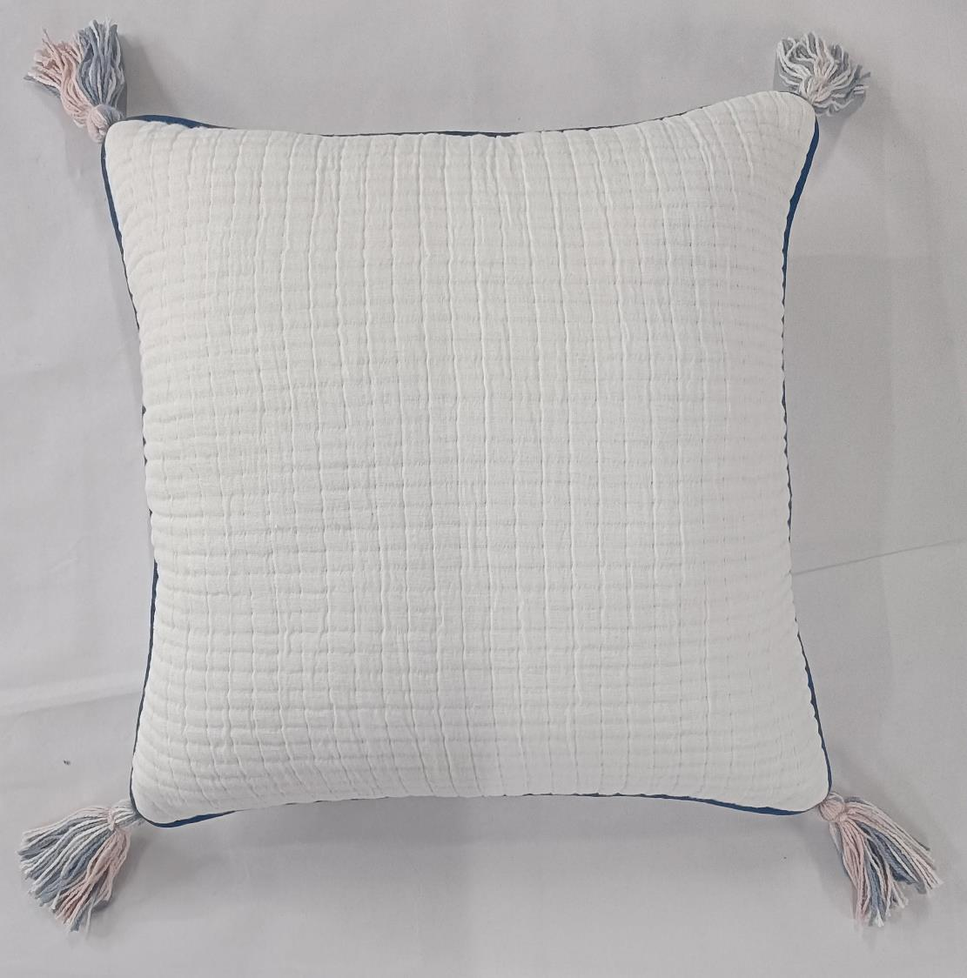
Article : Pick Stitch Gauge Cushion Cover with Tassels
Size: 45x45 cm
MOQ : 1000 pcs
Composition : Cotton

Slide 3
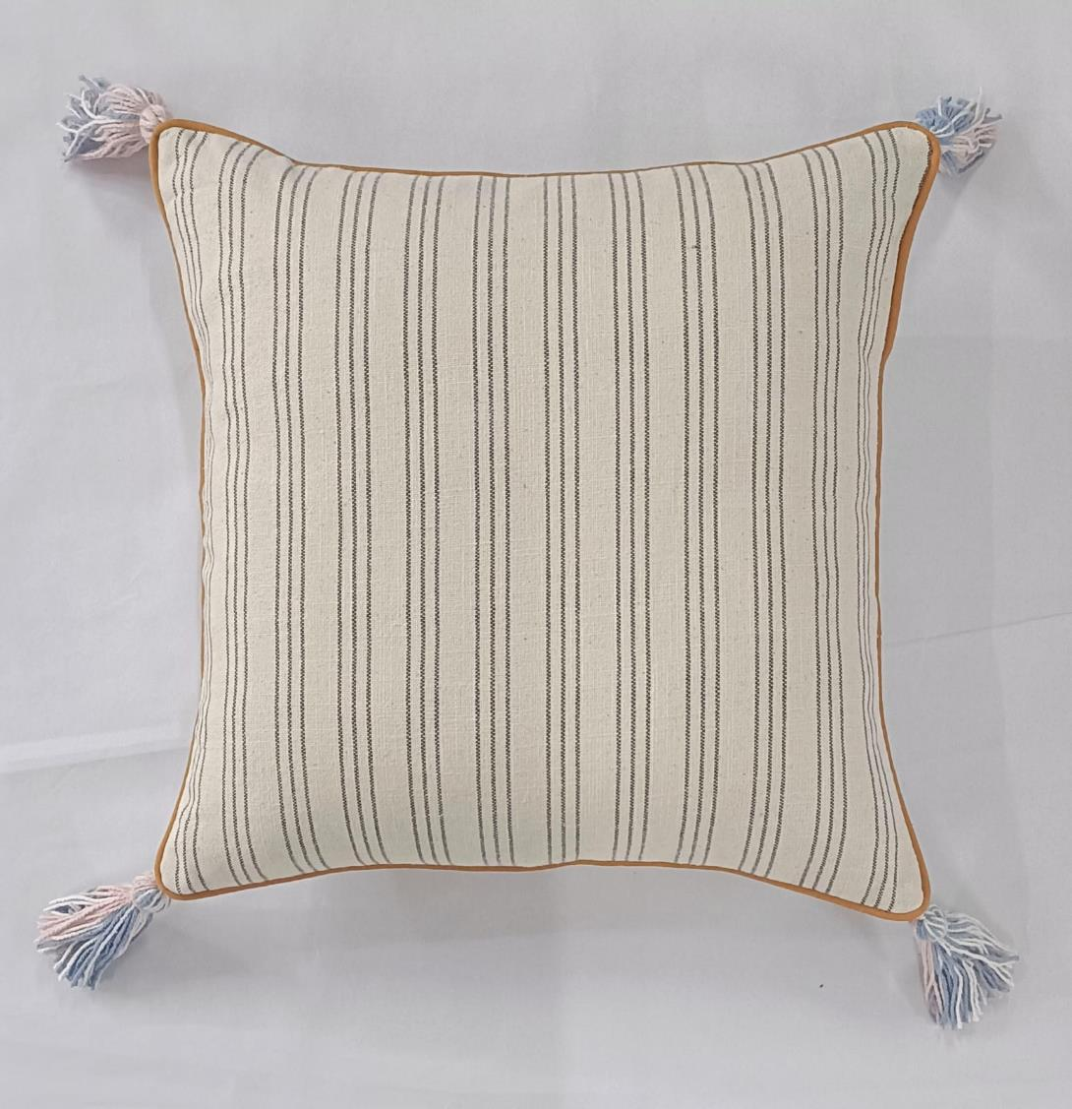
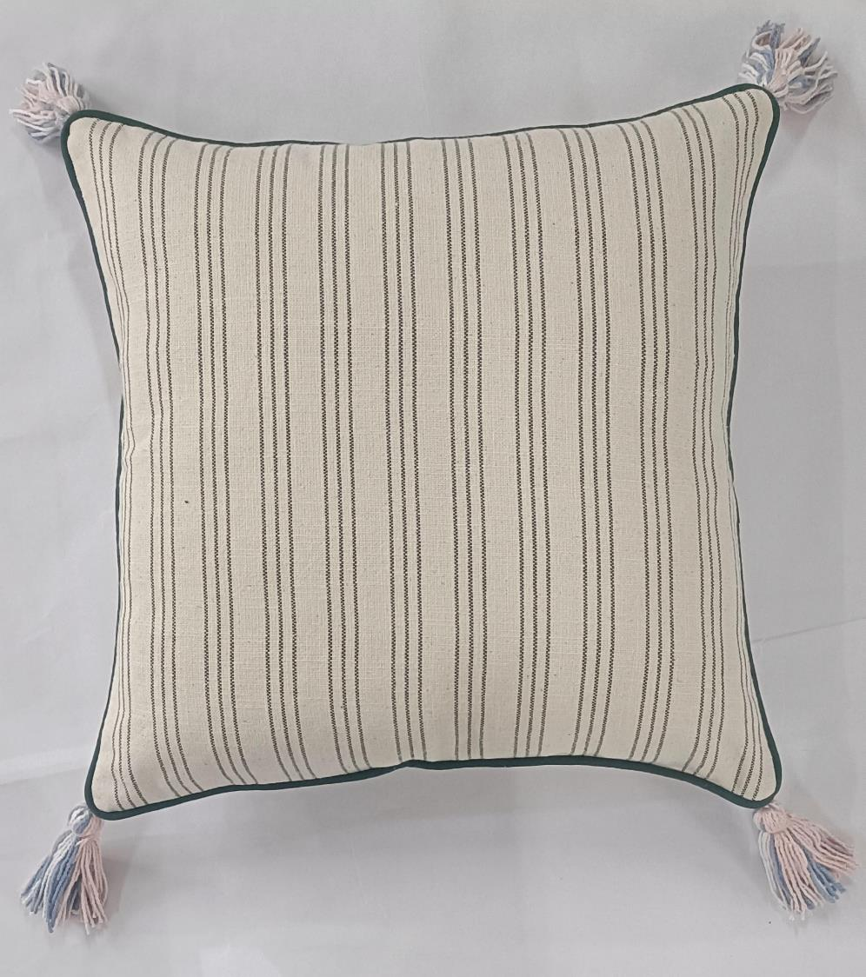
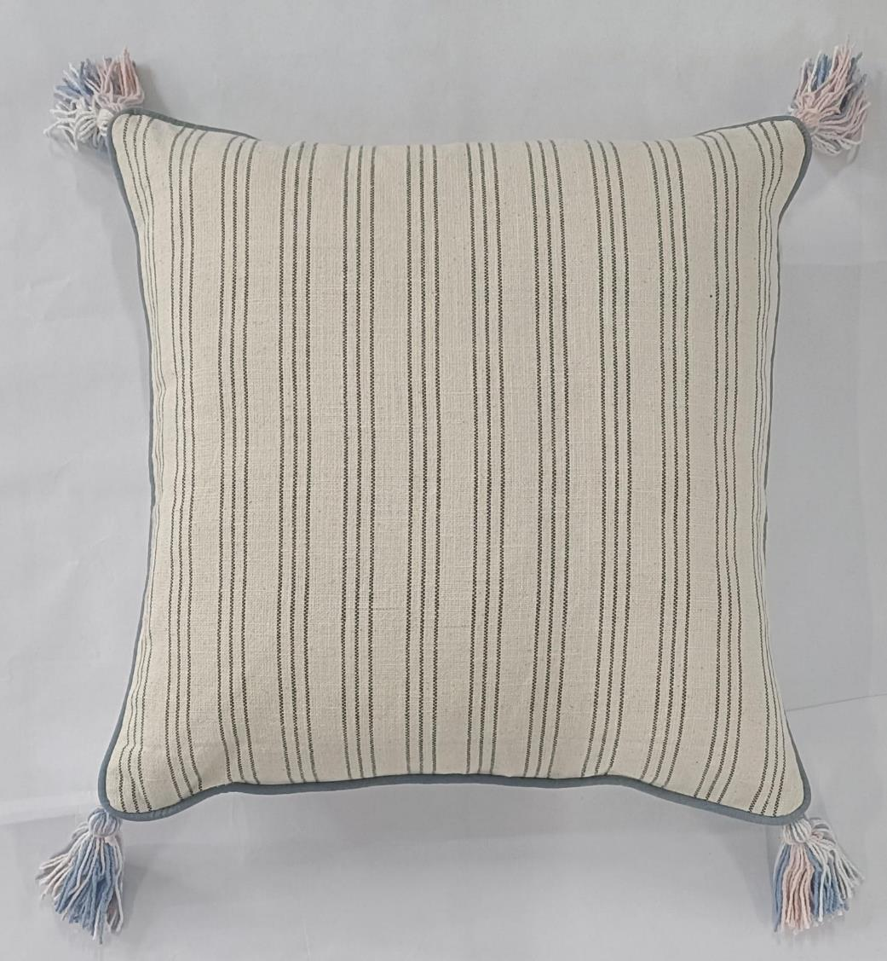
Article : Woven Cushion Cover with Tassels
Size: 45x45 cm
MOQ : 1000 pcs
Composition : Cotton

Slide 4
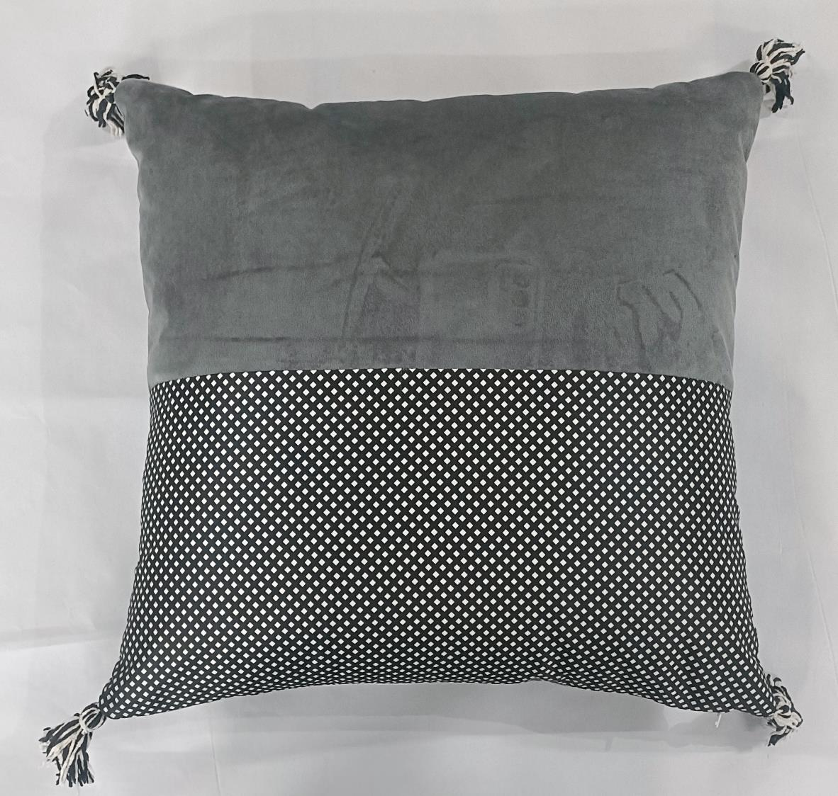
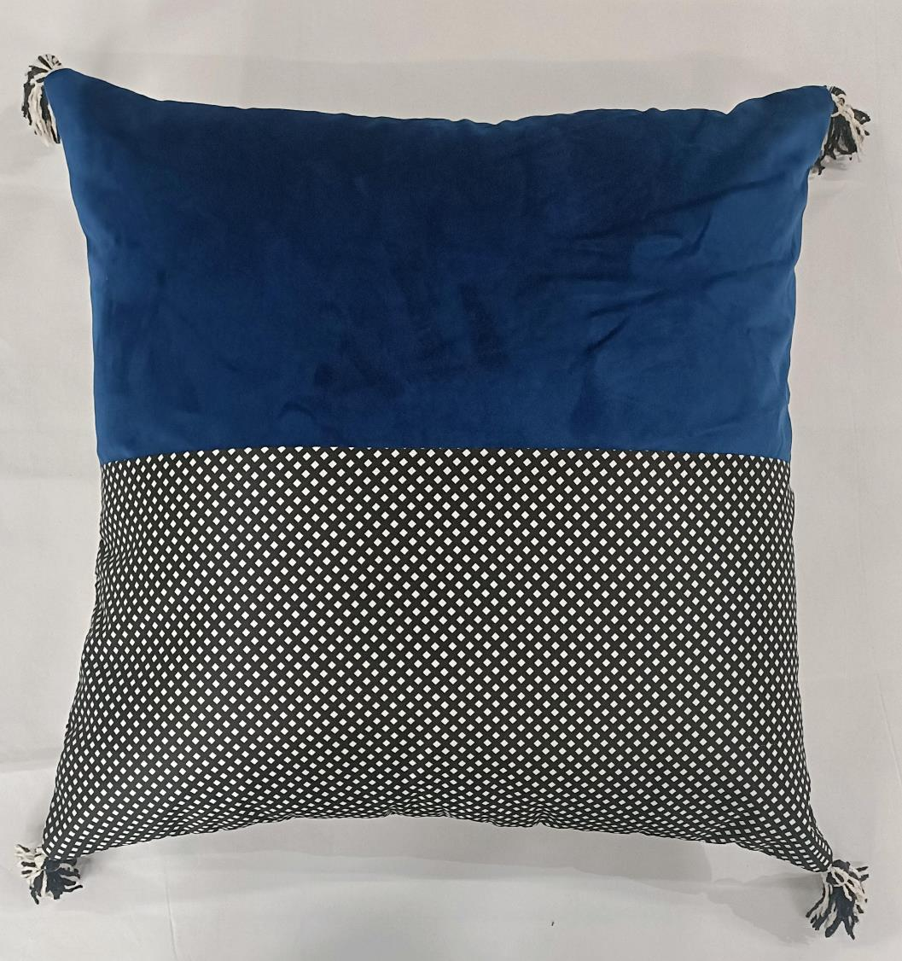
Article : Cushion Cover with Tassels
Size: 45x45 cm
MOQ : 1000 pcs
Composition : Polyester

Slide 5
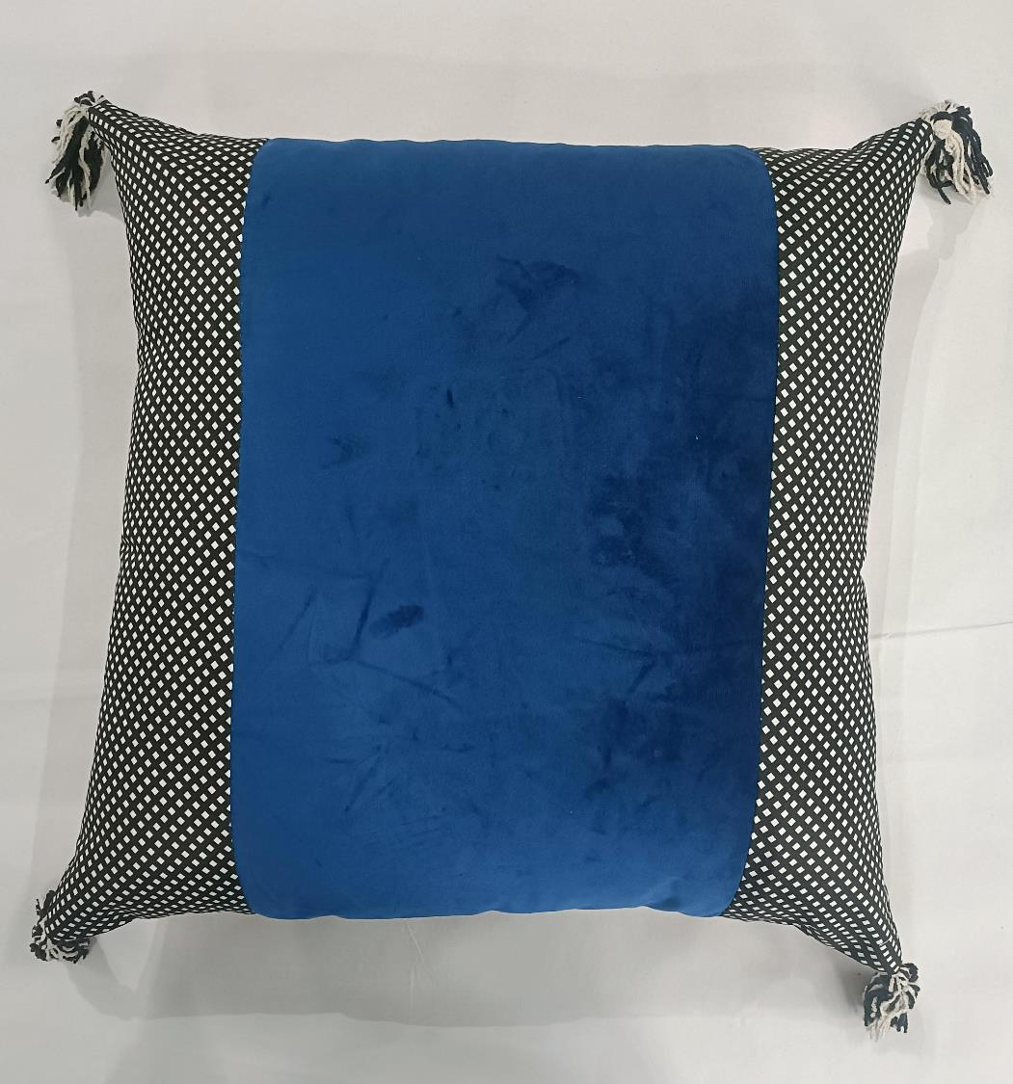
Article : Cushion Cover with Tassels
Size: 45x45 cm
MOQ : 1000 pcs
Composition : Polyester

Slide 6
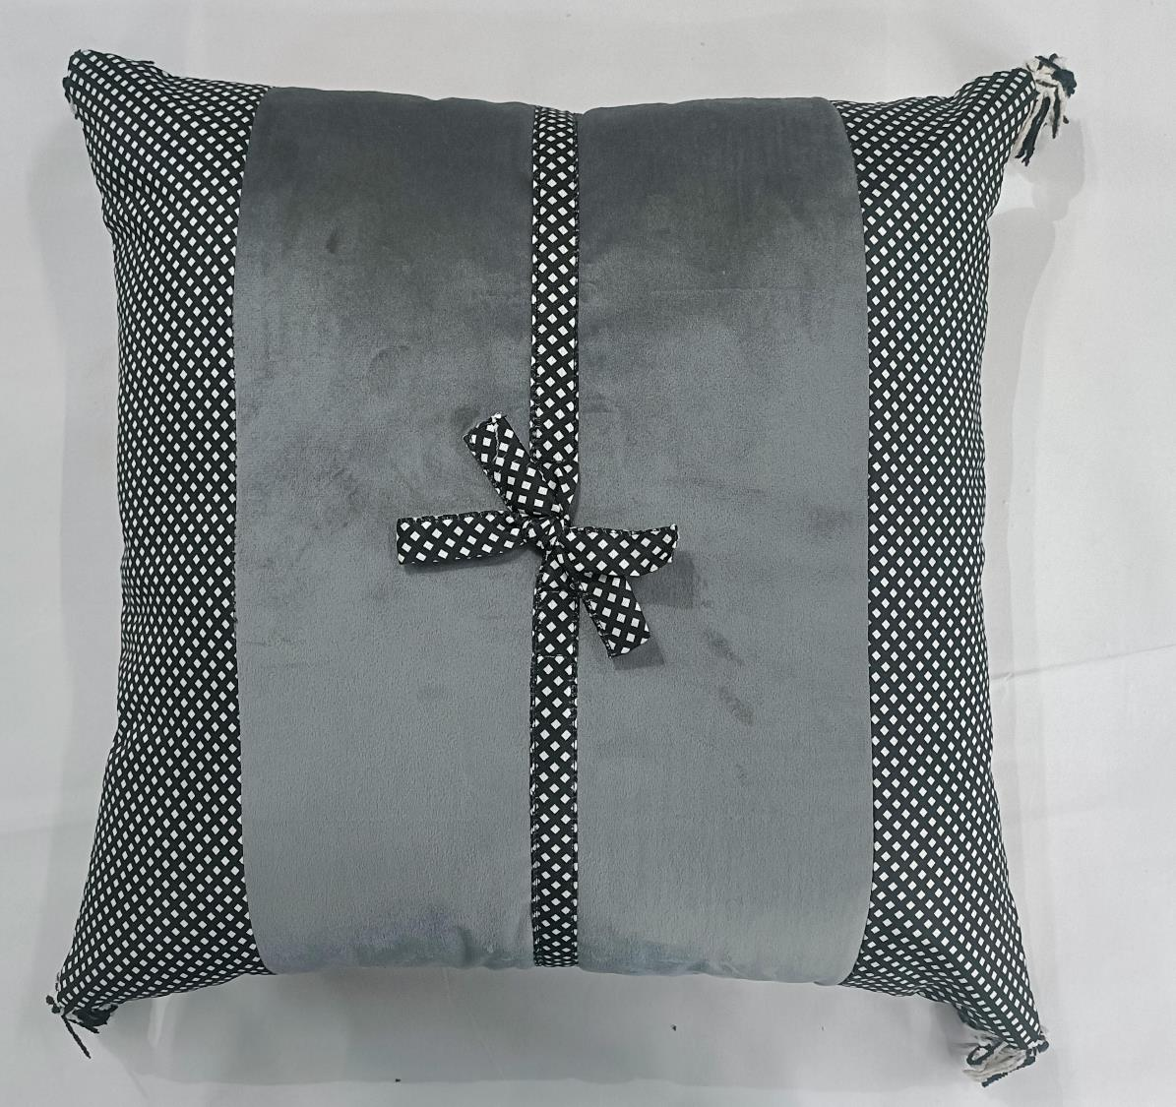
Article : Cushion Cover with Tassels
Size: 45x45 cm
MOQ : 1000 pcs
Composition : Polyester

Slide 7
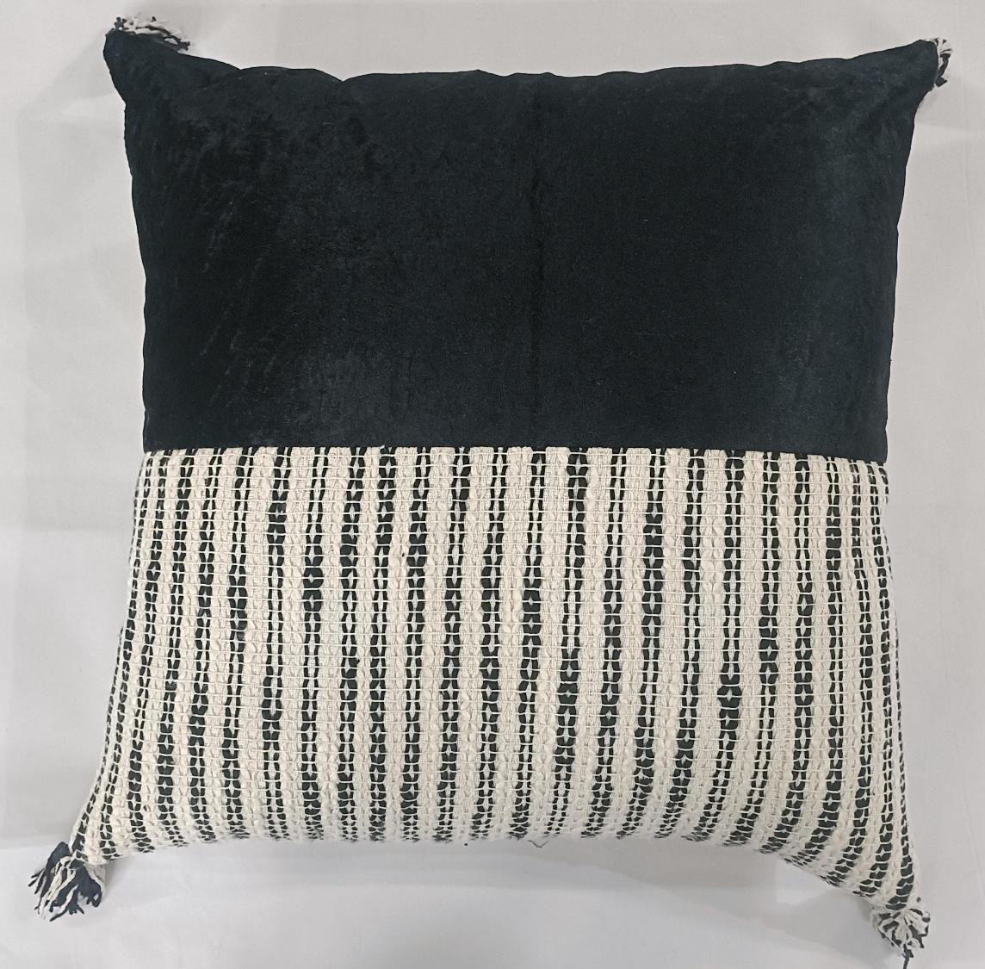
Article : Cushion Cover with Tassels
Size: 45x45 cm
MOQ : 1000 pcs
Composition : Poly Cotton

Slide 8
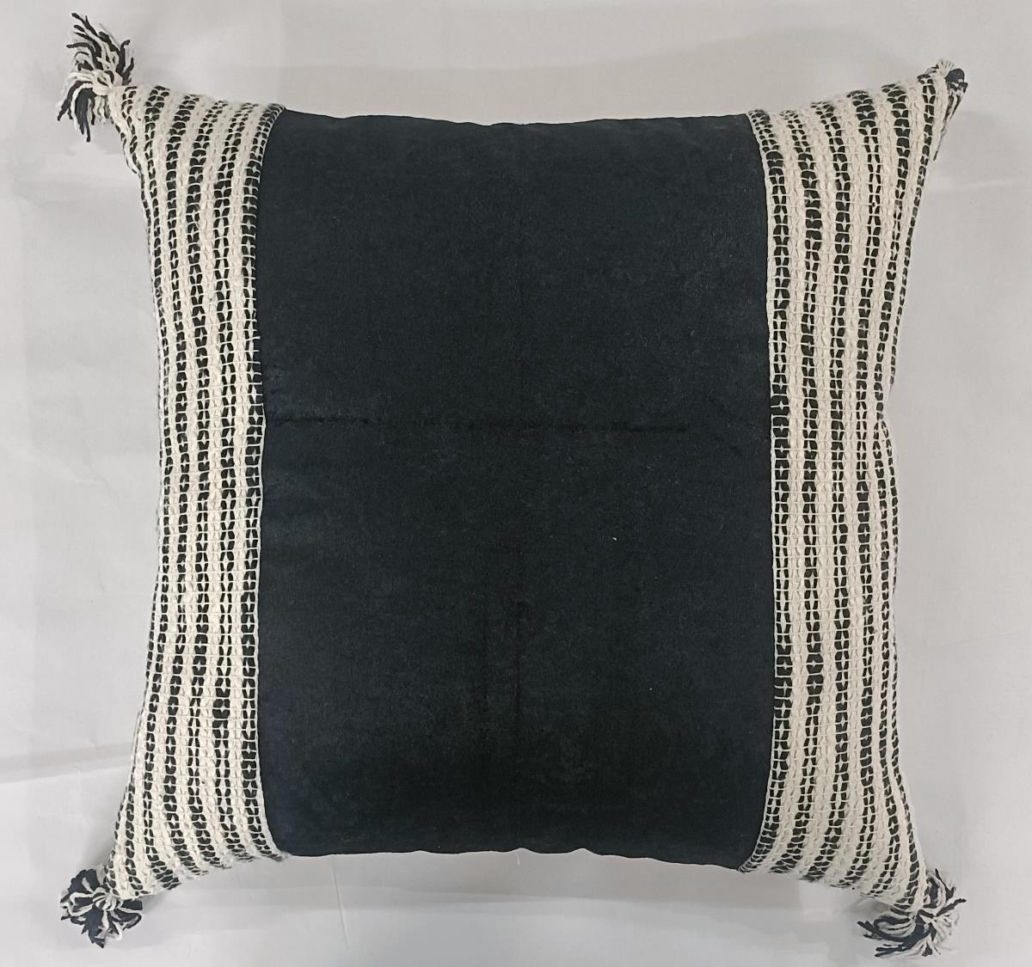
Article : Cushion Cover with Tassels
Size: 45x45 cm
MOQ : 1000 pcs
Composition : Poly Cotton

Slide 9
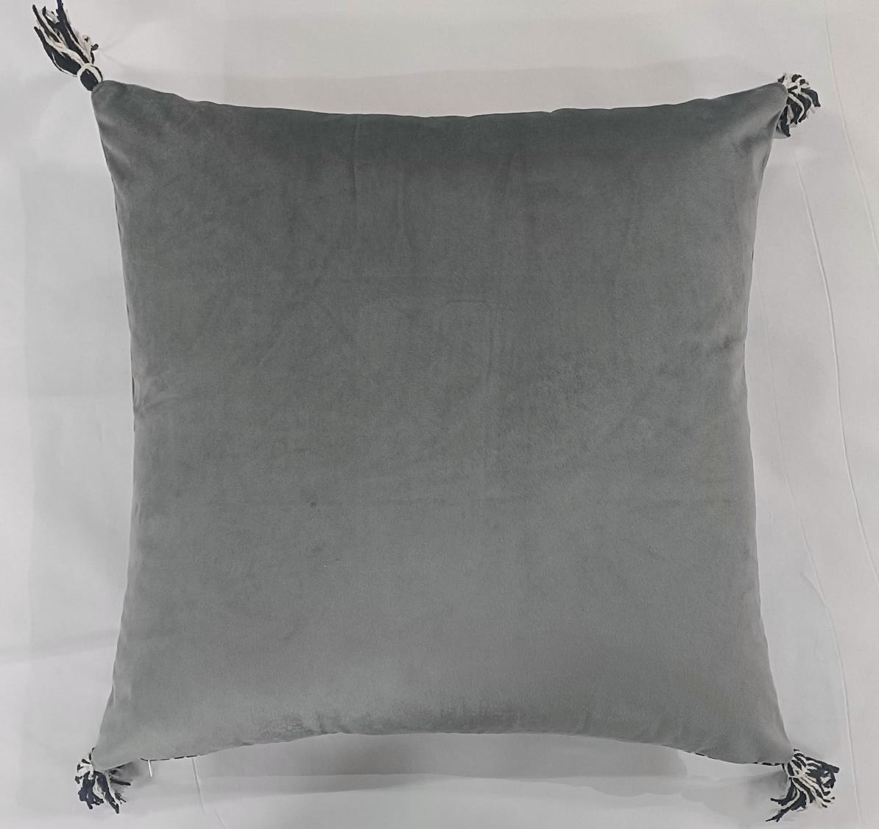
Article : Plain Cushion Cover with Tassesl
Size: 45x45 cm
MOQ : 1000 pcs
Composition : Polyester

Slide 10
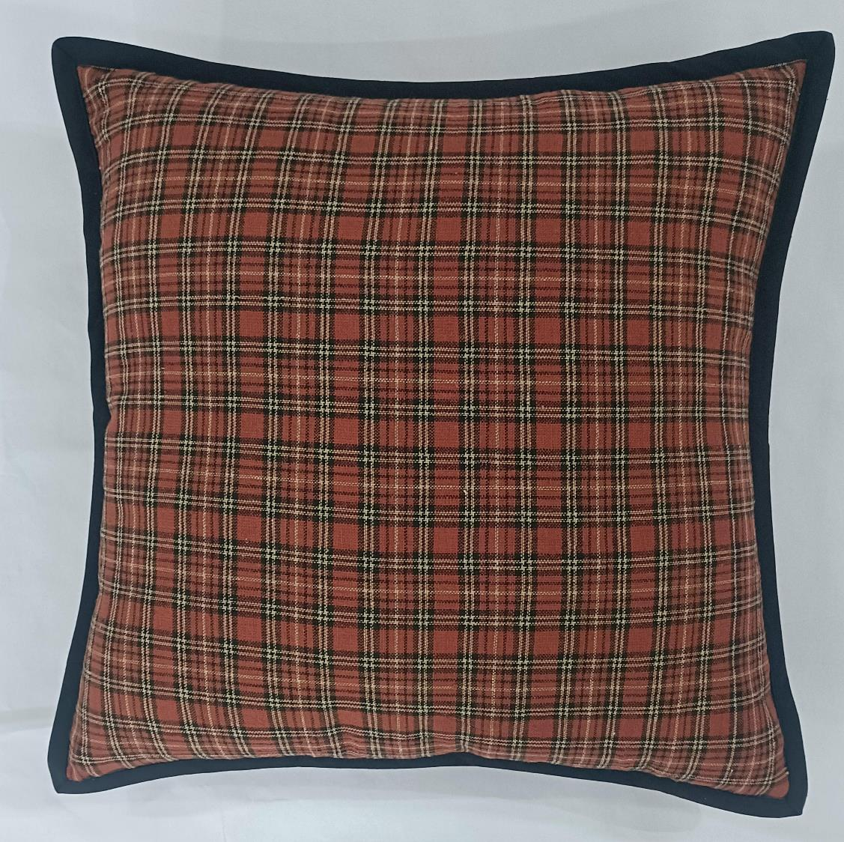
Article : Woven Cushion Cover with Flange
Size: 45x45 cm
MOQ : 1000 pcs
Composition : Cotton

Slide 11
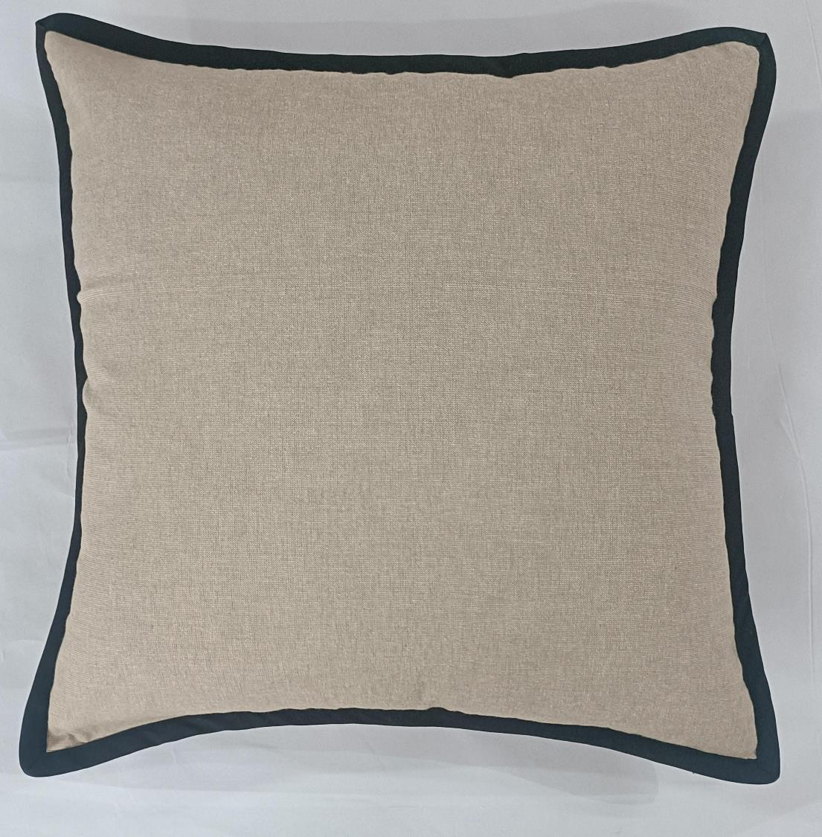
Article : Chambray Cushion Cover with Flange
Size: 45x45 cm
MOQ : 1000 pcs
Composition : Cotton

Slide 12
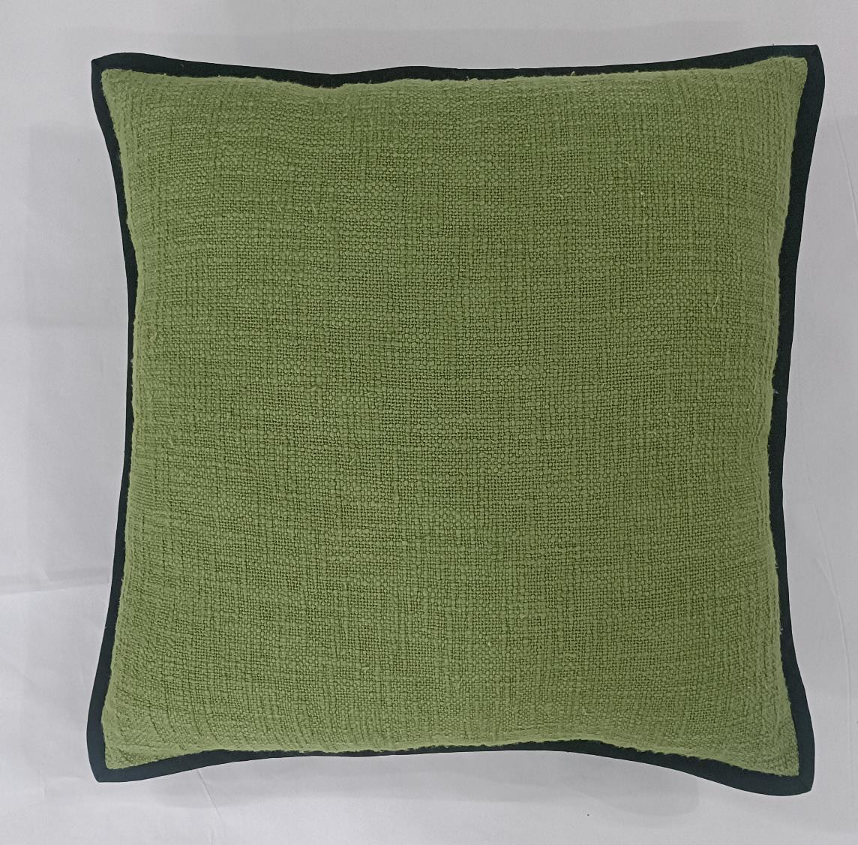
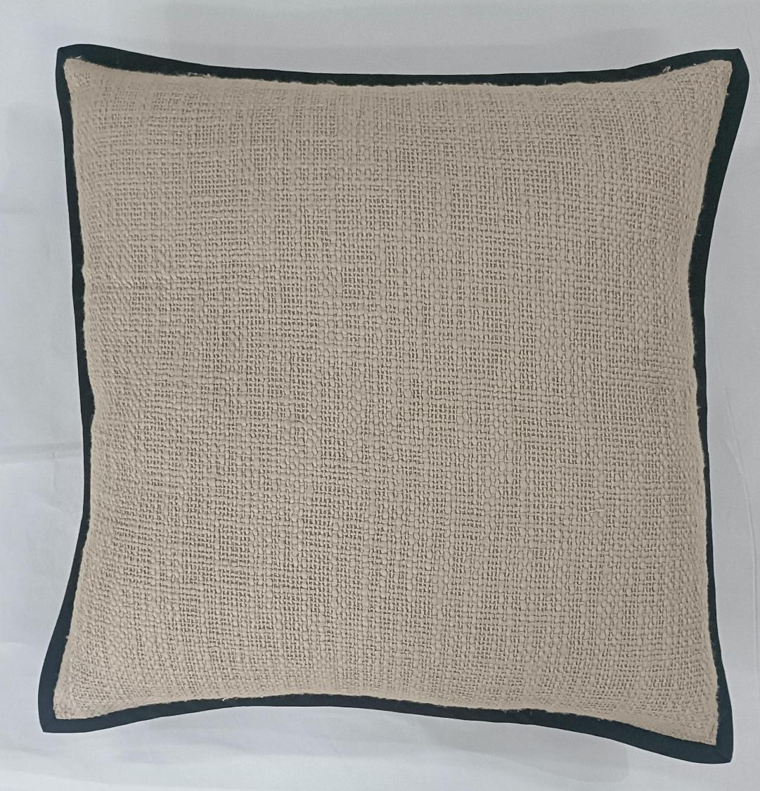
Article : Slub Cushion Cover with Flange
Size: 45x45 cm
MOQ : 1000 pcs
Composition : Cotton

Slide 13
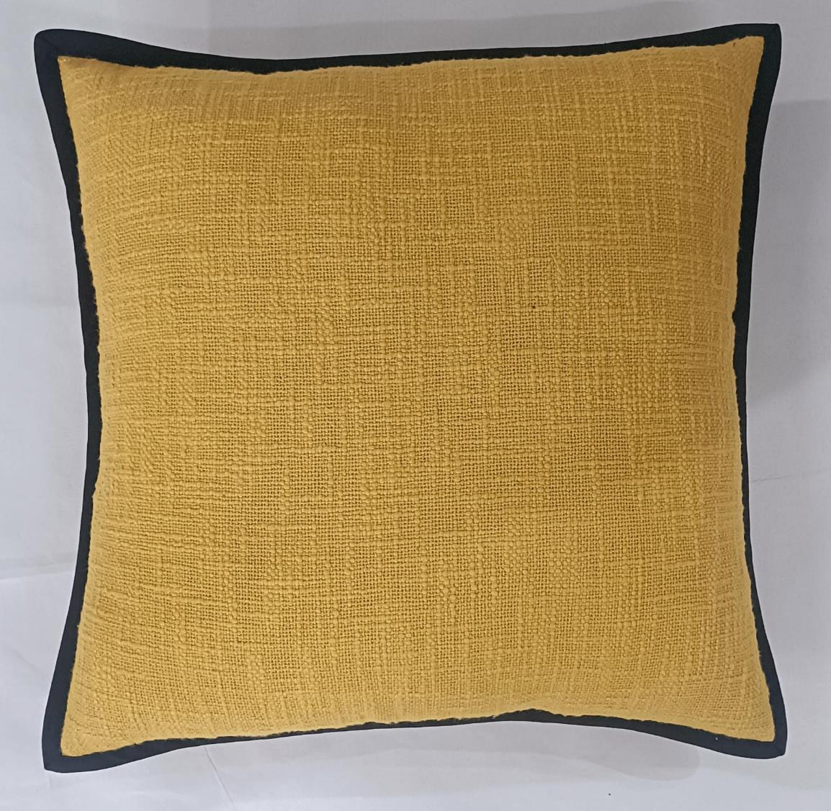
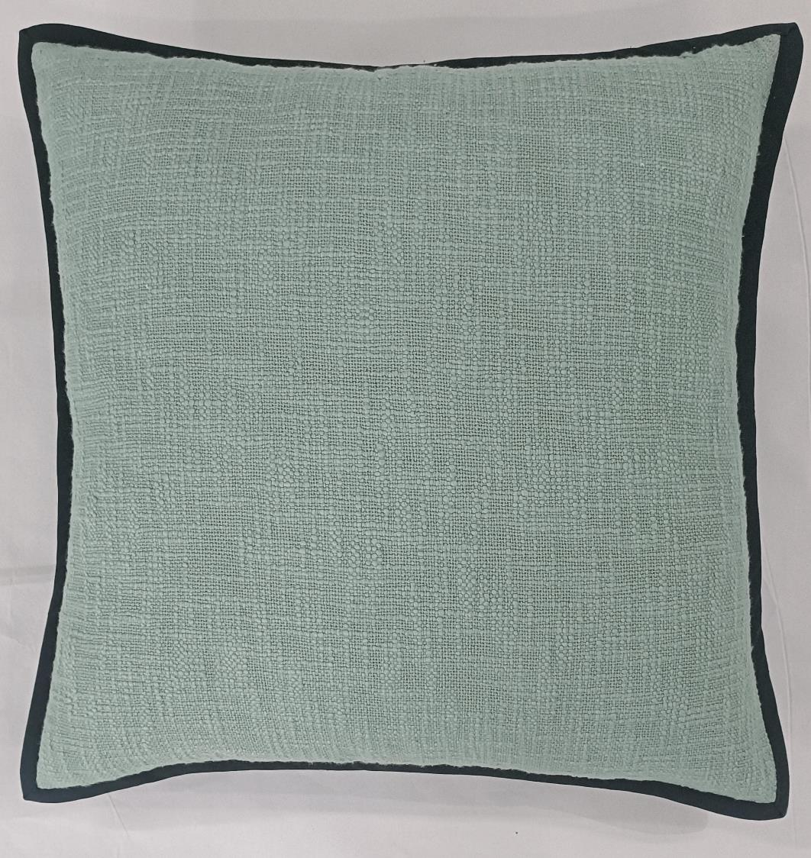
Article : Slub Cushion Cover with Flange
Size: 45x45 cm
MOQ : 1000 pcs
Composition : Cotton

Slide 14
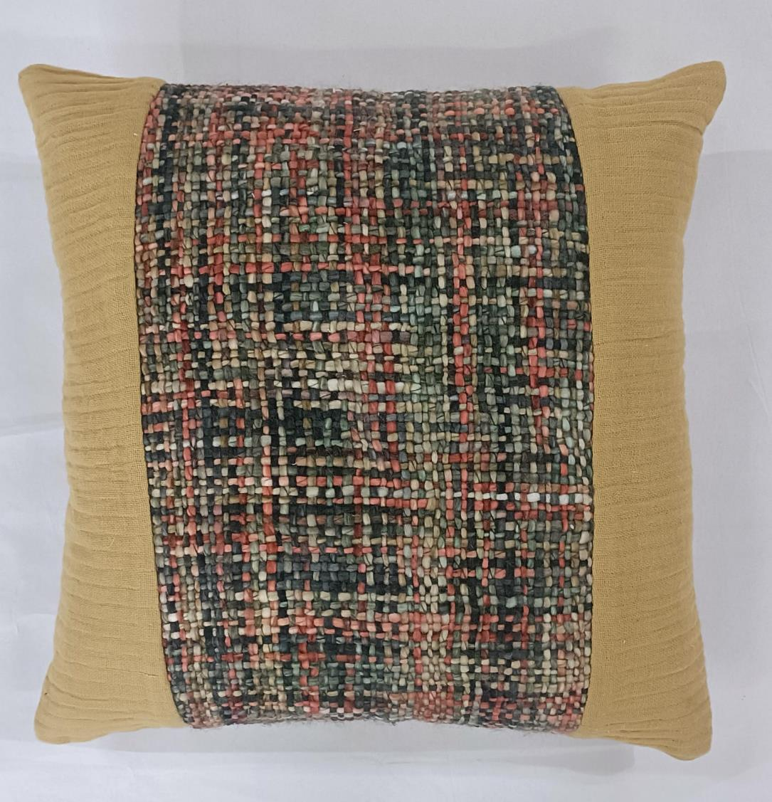
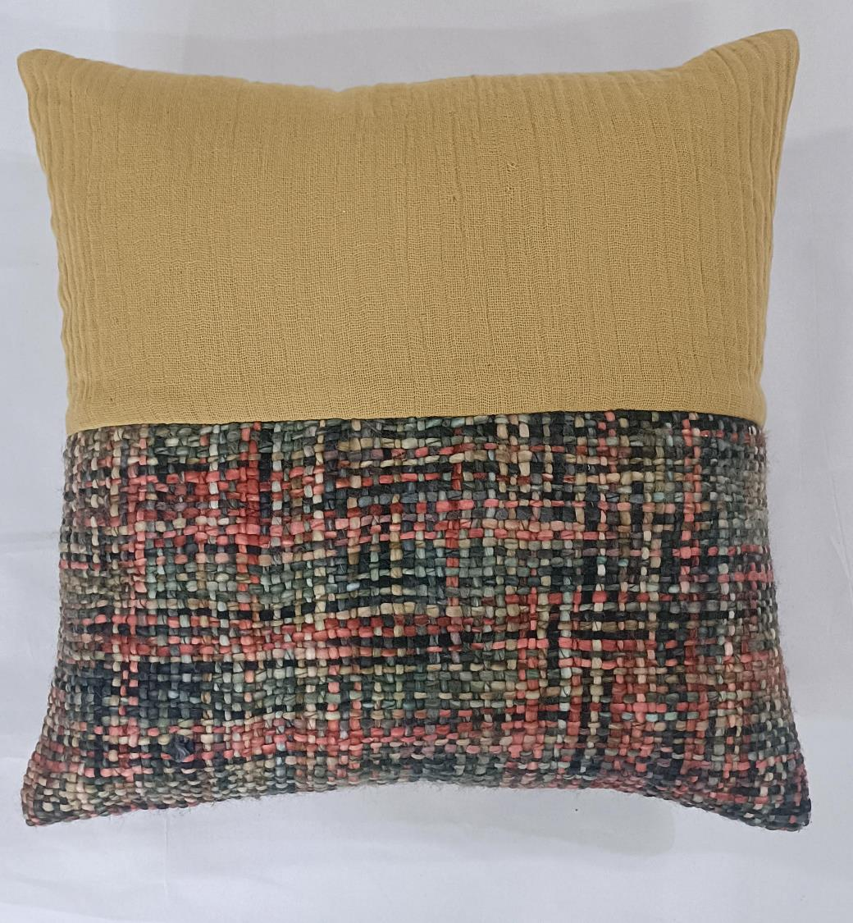
Article : Fancy Cushion Cover
Size: 45x45 cm
MOQ : 1000 pcs
Composition : Cotton Acrylic

Slide 15
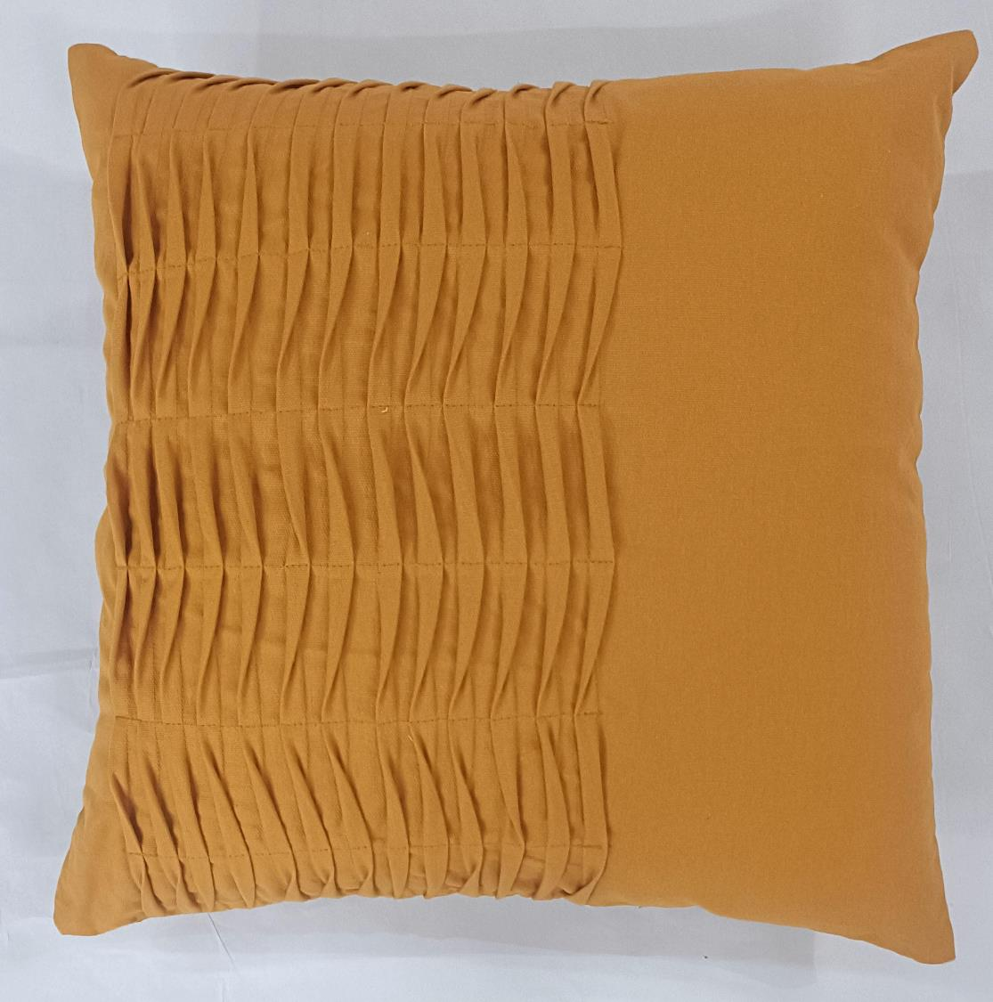
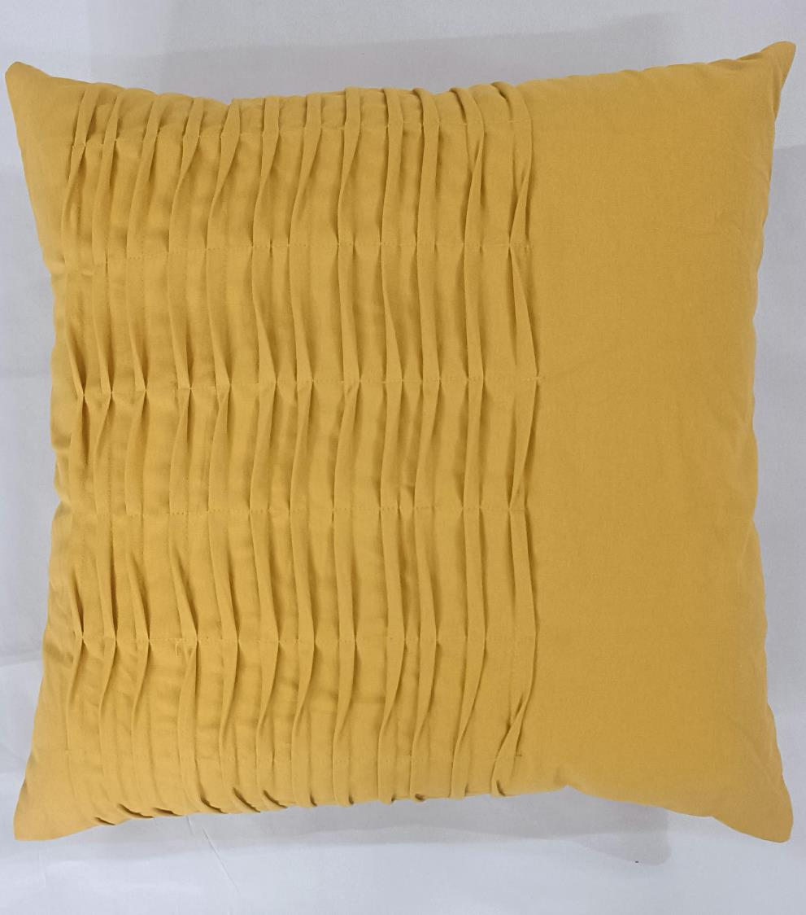
Article : Pleated Cushion Cover
Size: 45x45 cm
MOQ : 1000 pcs
Composition : Cotton

Slide 16
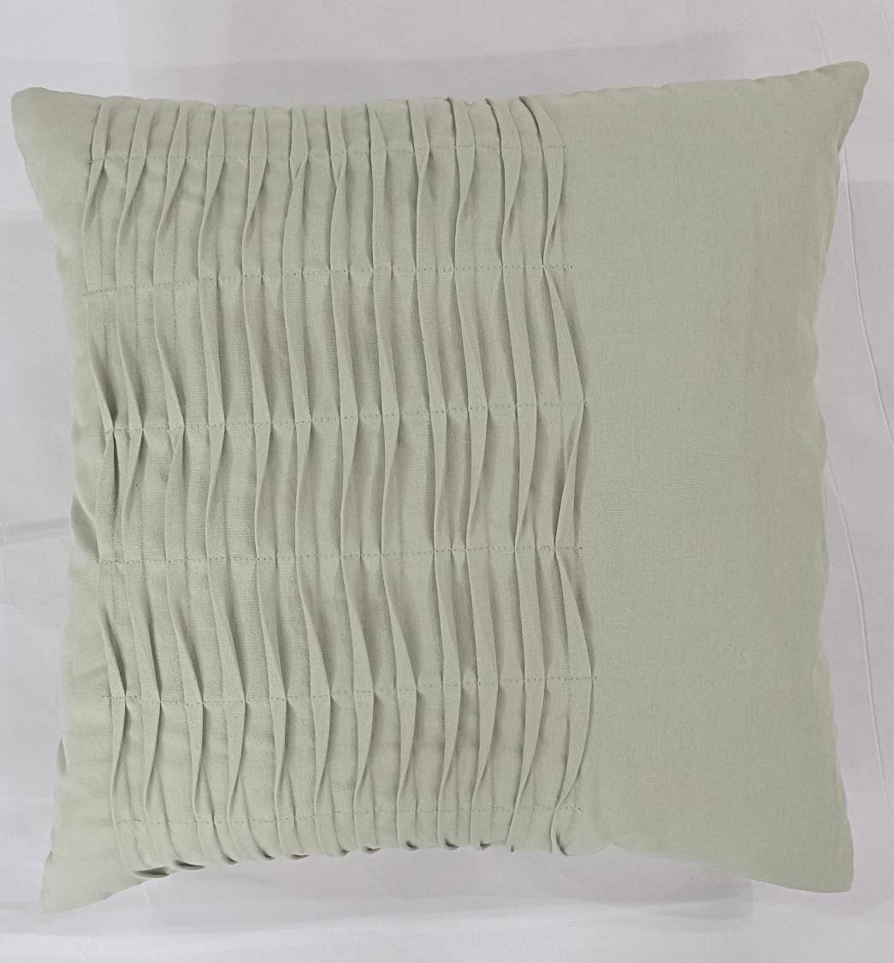
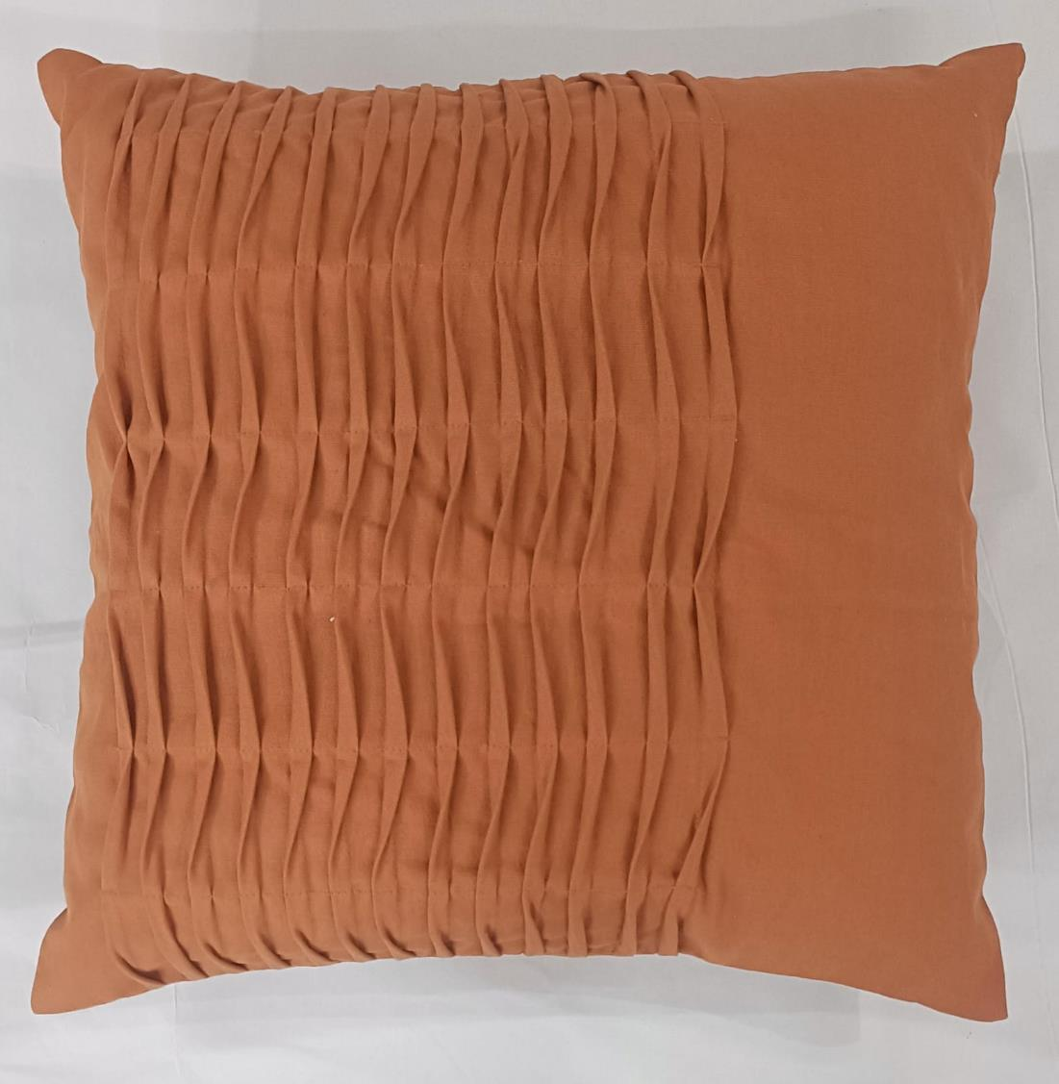
Article : Pleated Cushion Cover
Size: 45x45 cm
MOQ : 1000 pcs
Composition : Cotton

Slide 17
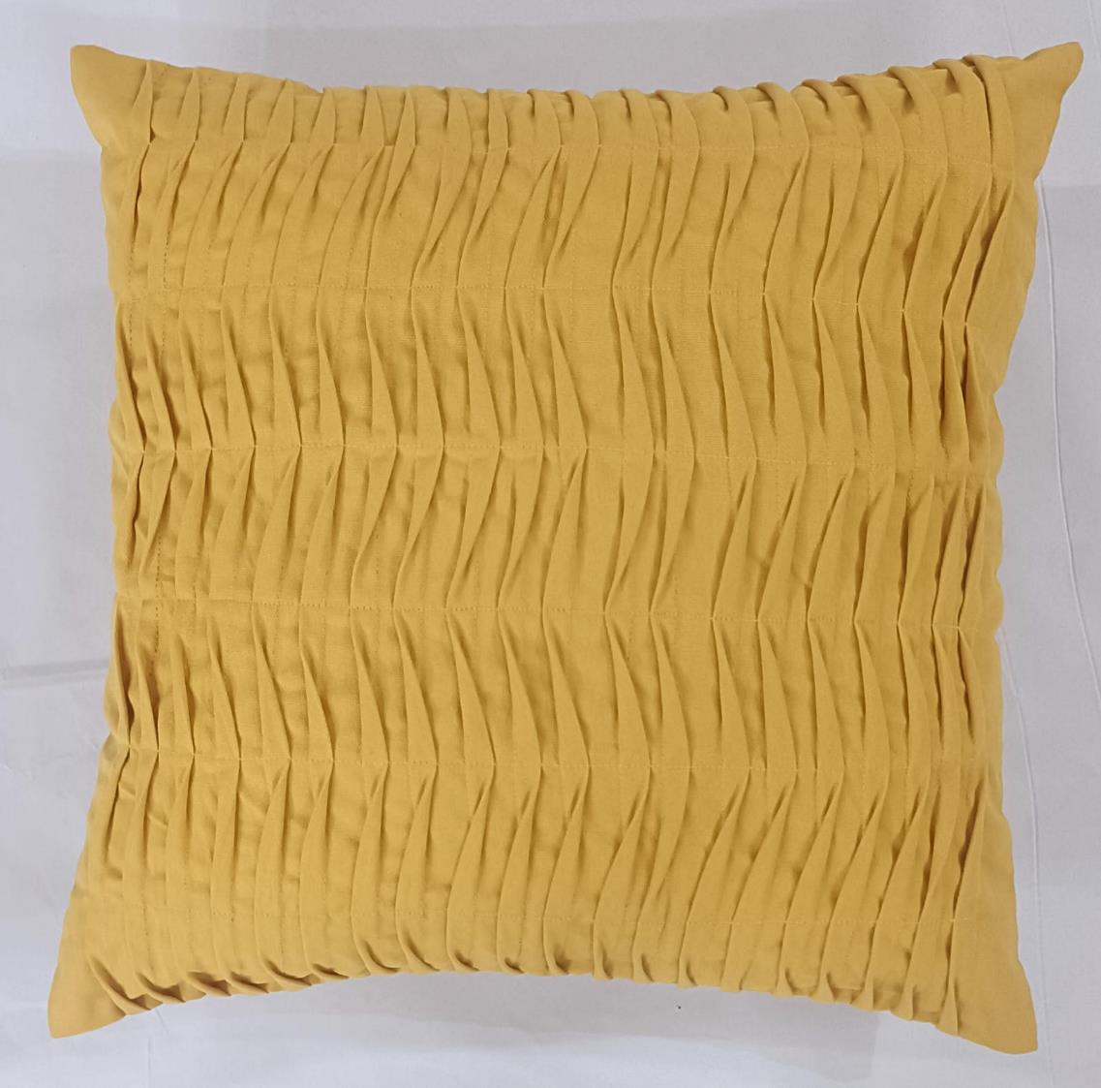
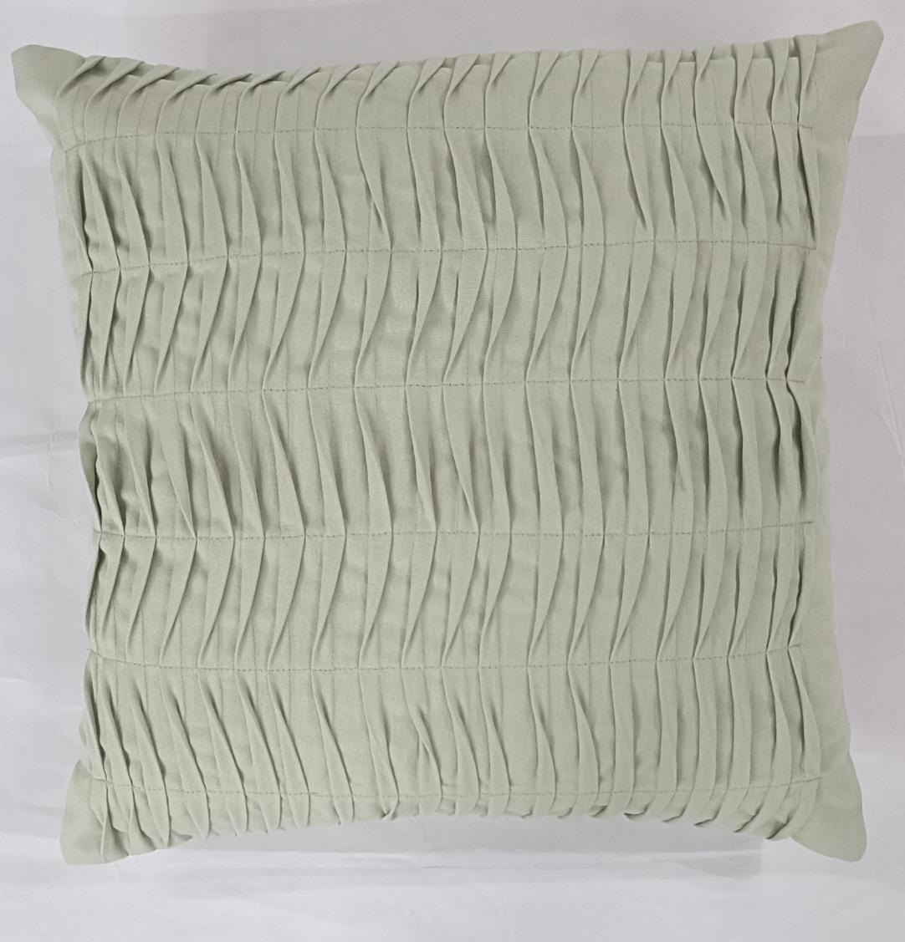
Article : Pleated Cushion Cover
Size: 45x45 cm
MOQ : 1000 pcs
Composition : Cotton

Slide 18
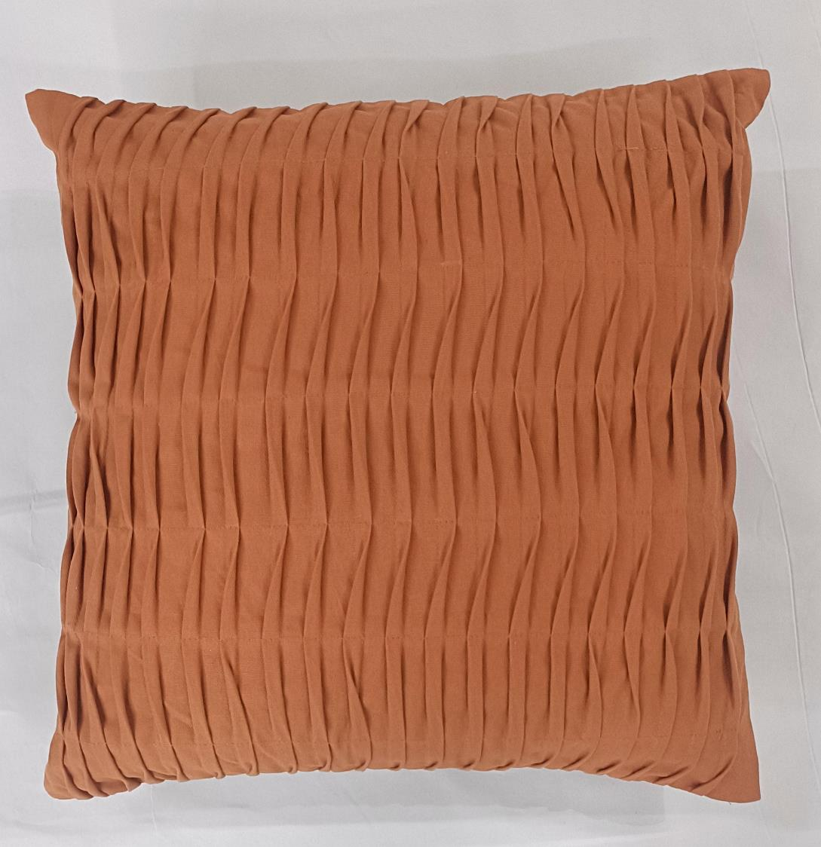
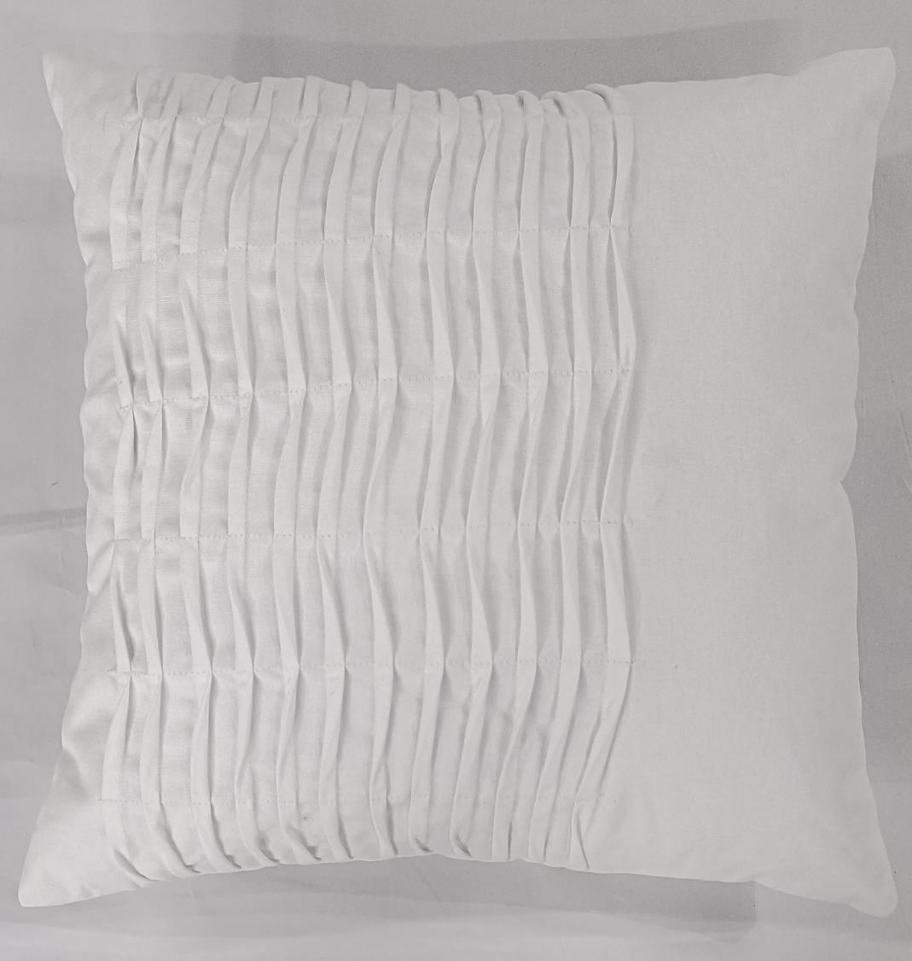
Article : Pleated Cushion Cover
Size: 45x45 cm
MOQ : 1000 pcs
Composition : Cotton

Slide 19
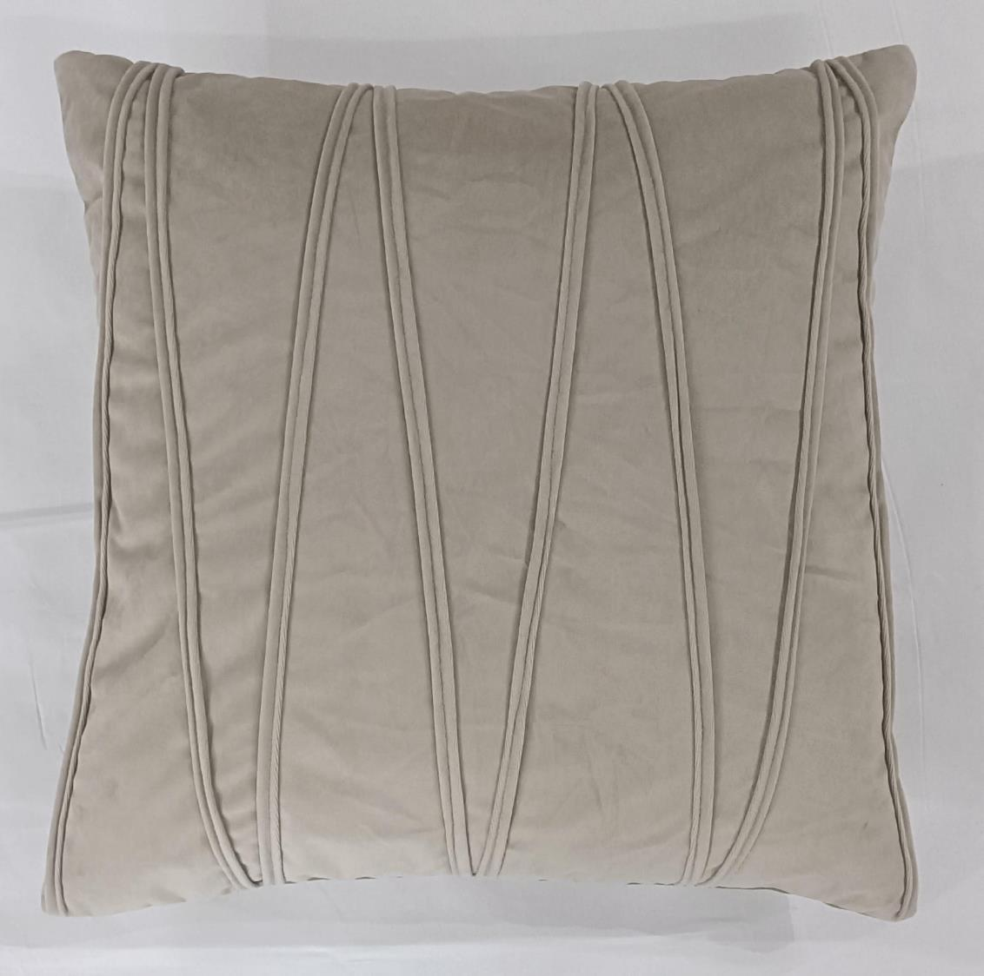
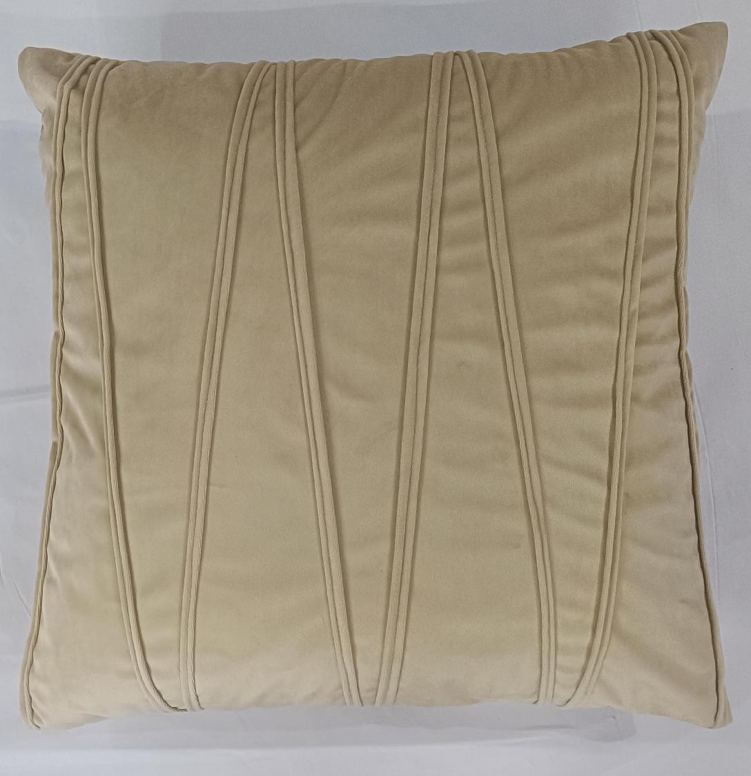
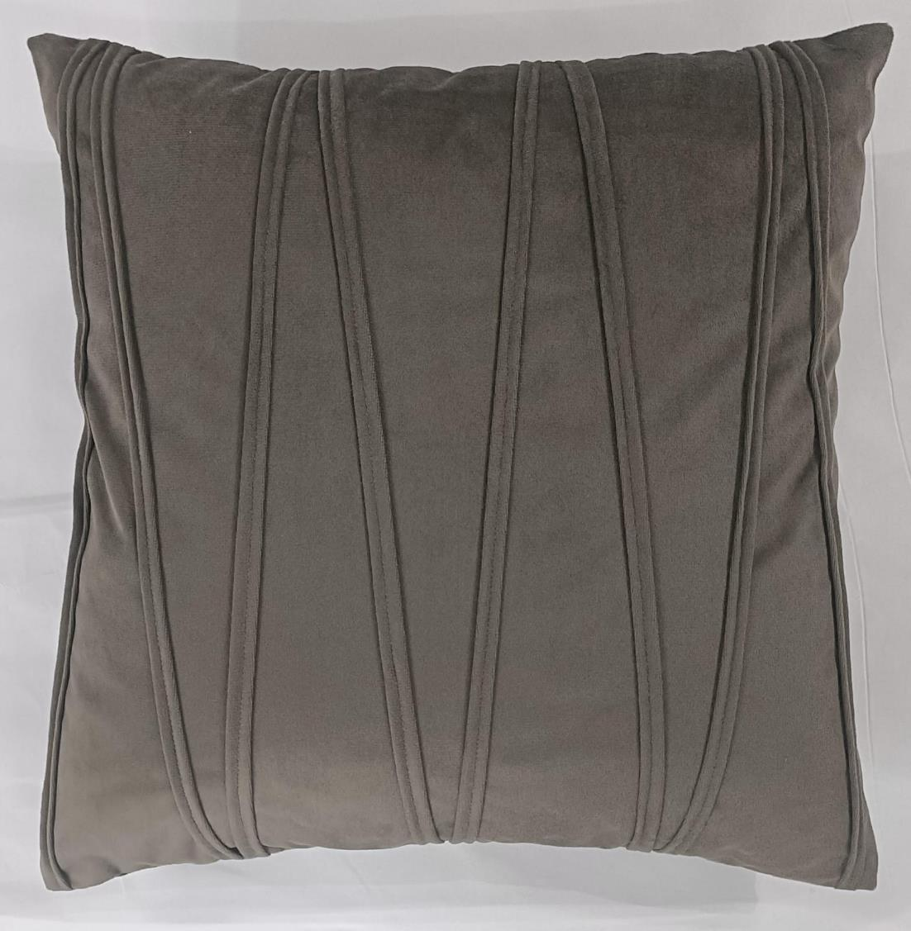
Article : Rib Cushion Cover
Size: 45x45 cm
MOQ : 1000 pcs
Composition : Polyester

Slide 20
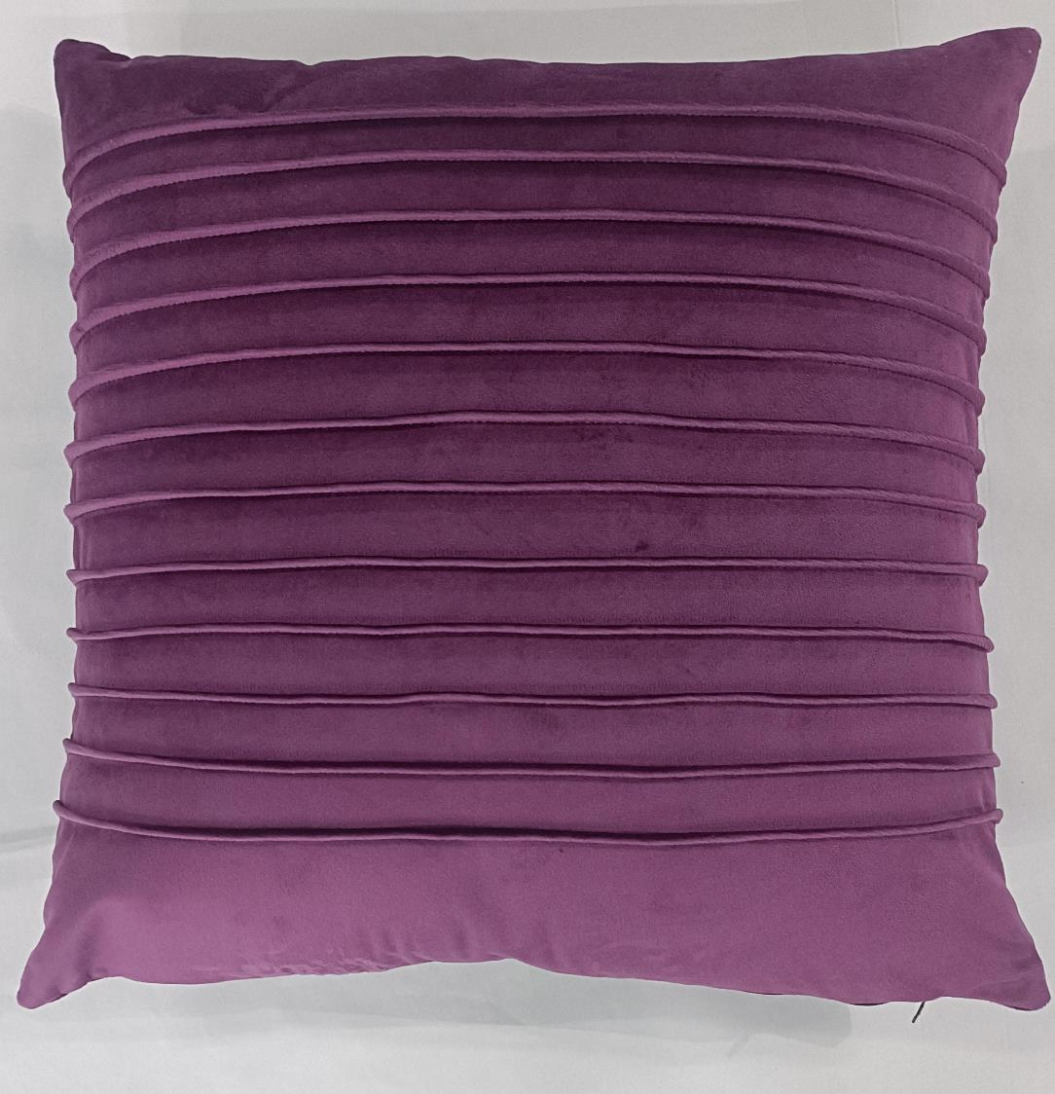
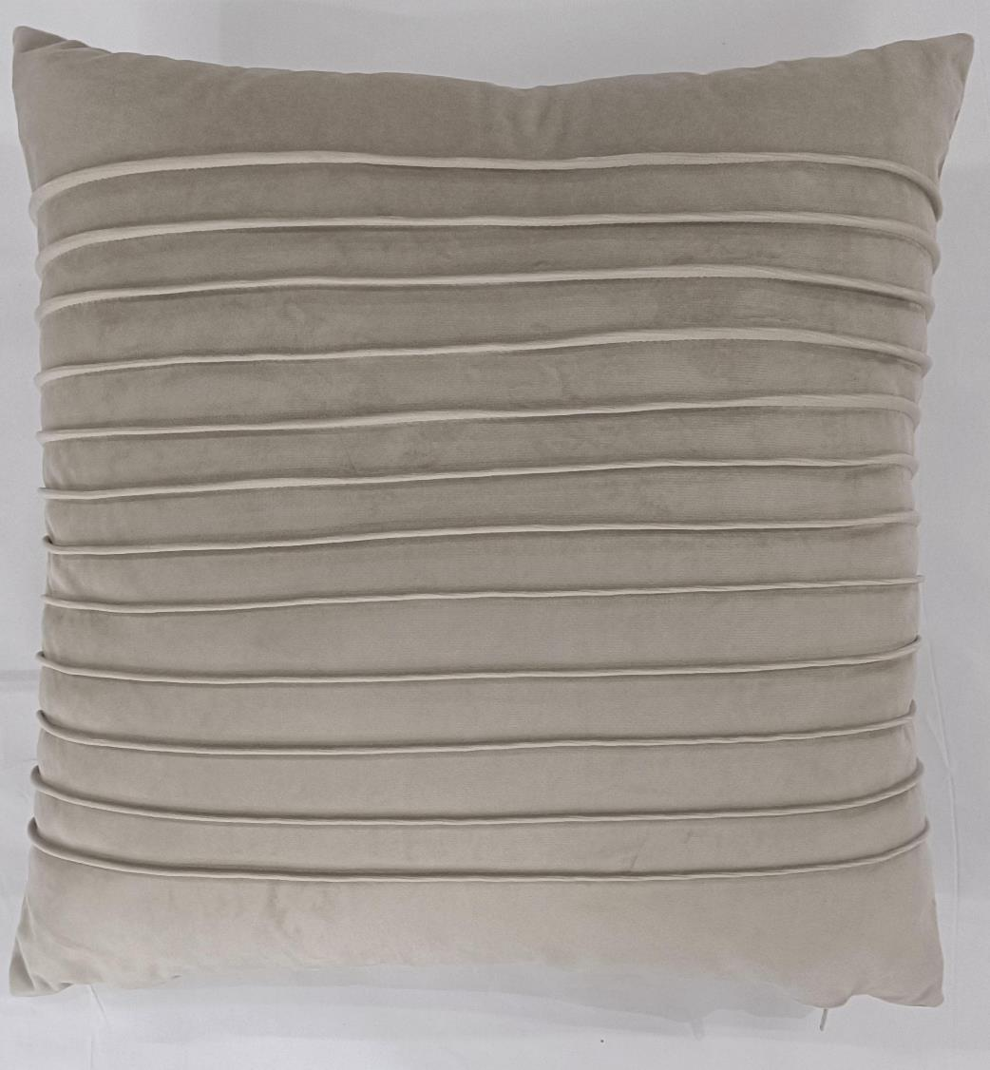
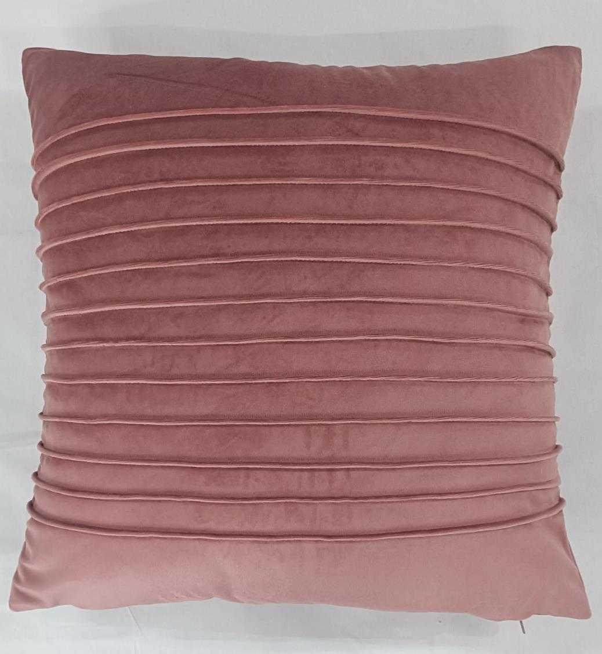
Article : Pin Tuck Cushion Cover
Size: 45x45 cm
MOQ : 1000 pcs
Composition : Polyester

Slide 21
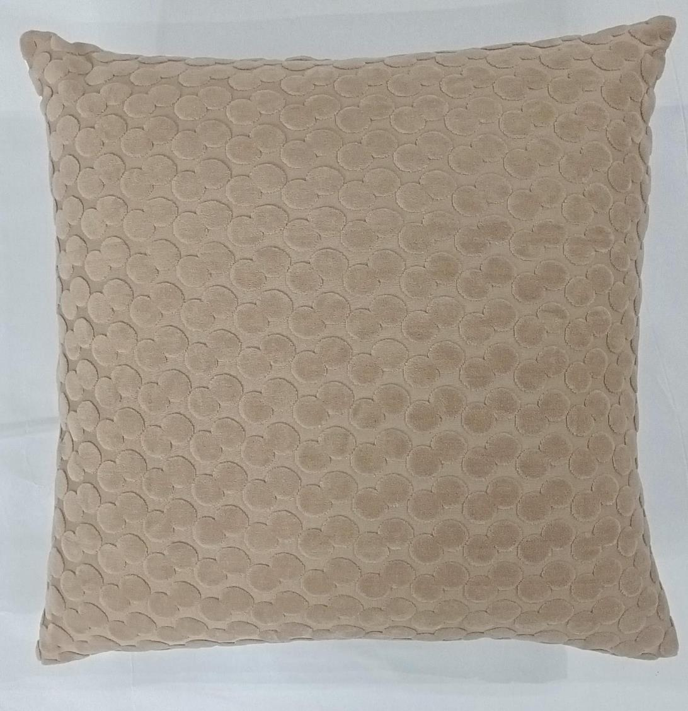
Article : Jacquard Velvet Cushion Cover
Size: 45x45 cm
MOQ : 1000 pcs
Composition : Polyester

Slide 22
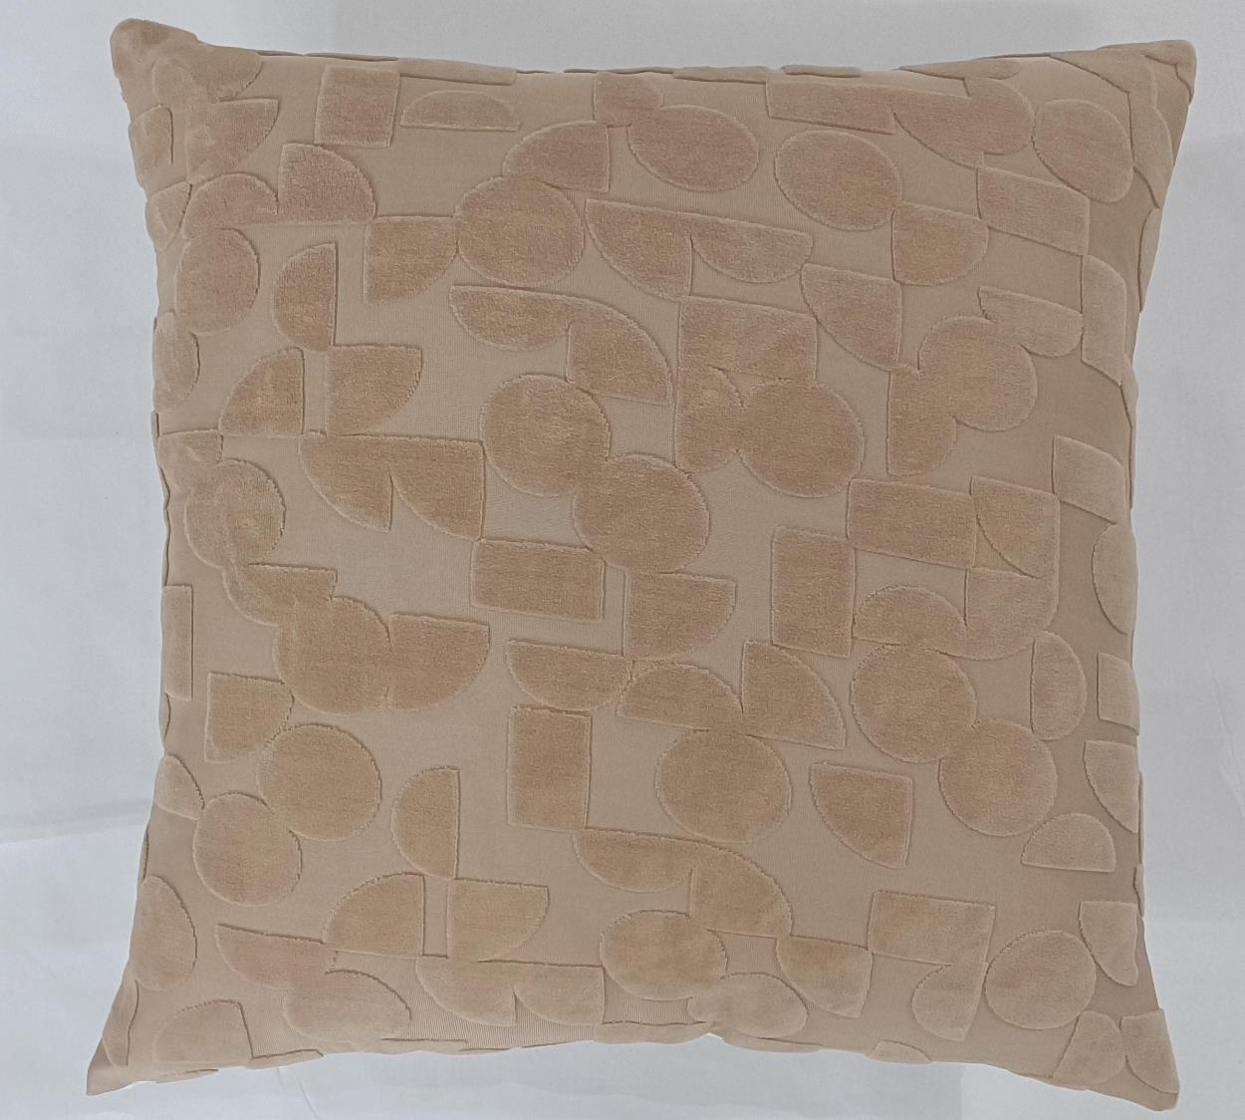
Article : Jacquard Velvet Cushion Cover
Size: 45x45 cm
MOQ : 1000 pcs
Composition : Polyester

Slide 23
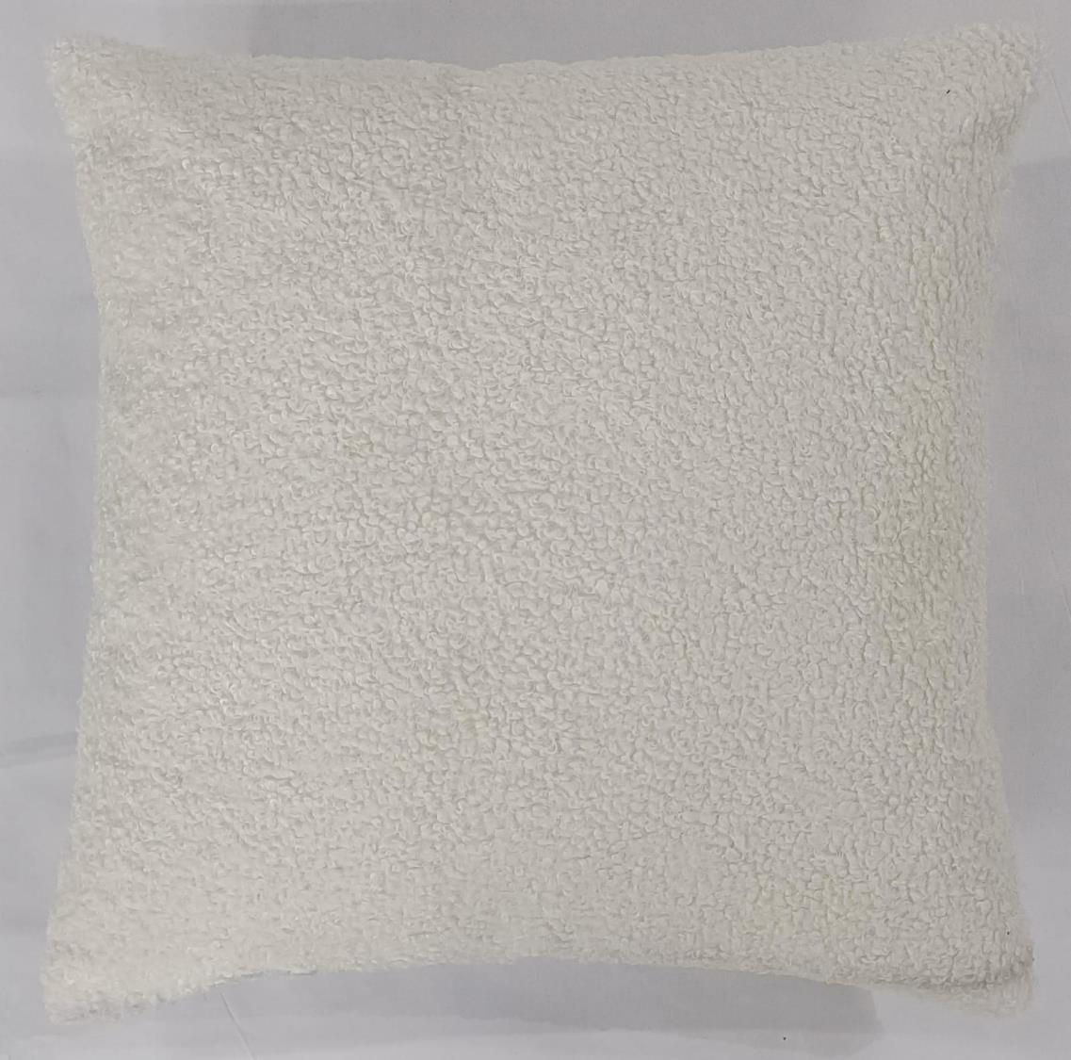
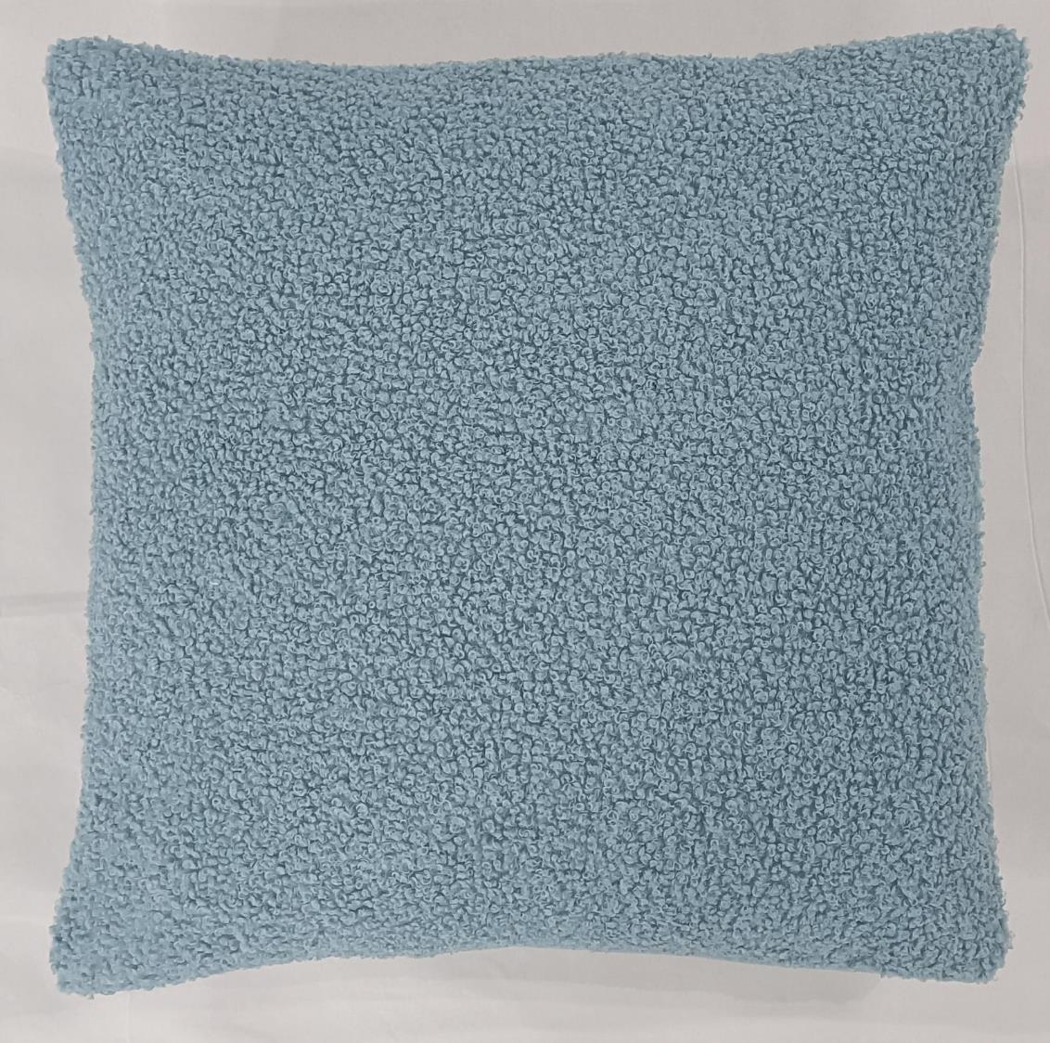
Article : Boucle Cushion Cover
Size: 45x45 cm
MOQ : 1000 pcs
Composition : Polyester

Slide 24
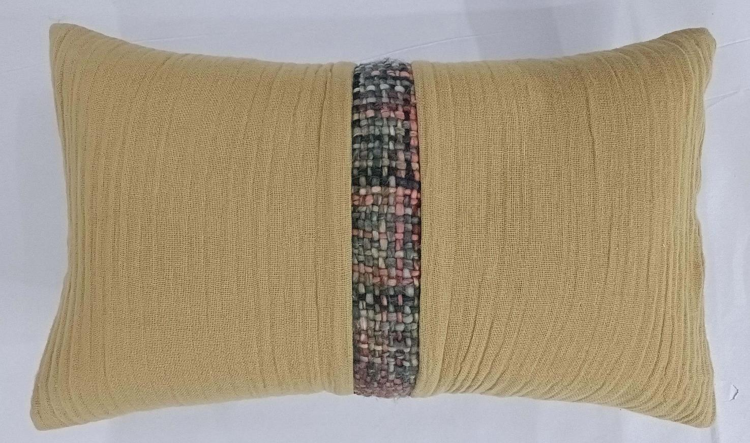
Article : Fancy Cushion Cover
Size: 30x50 cm
MOQ : 1000 pcs
Composition : Cotton Acrylic

Slide 25
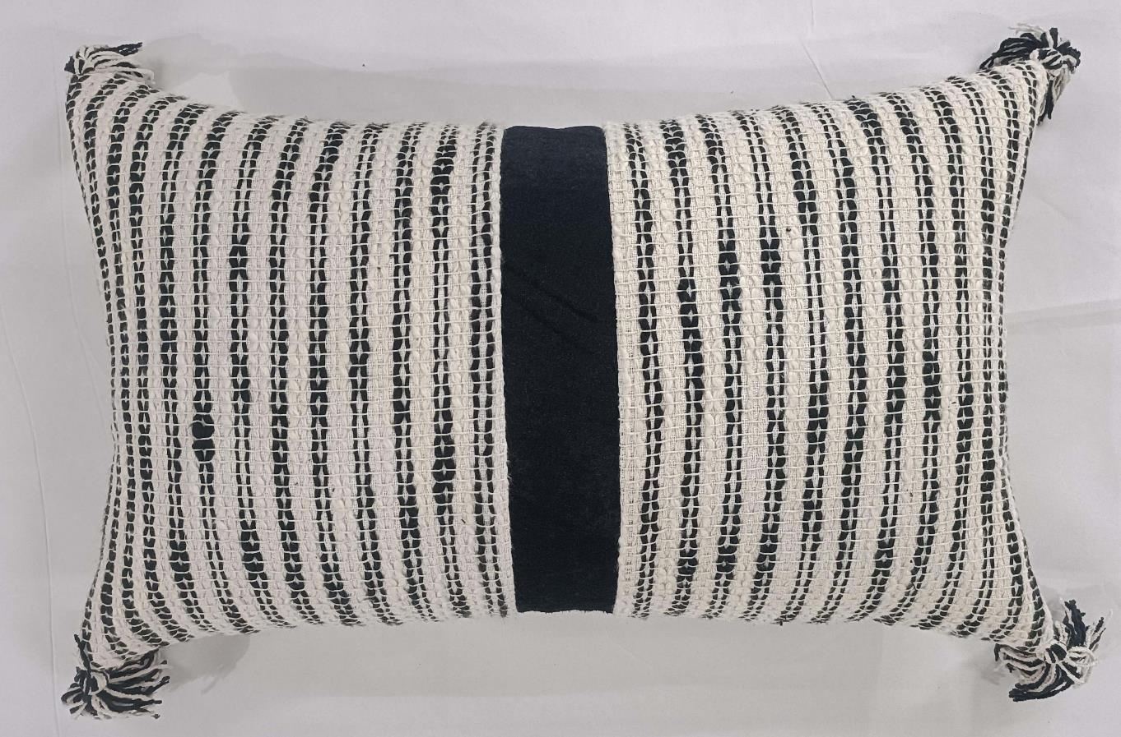
Article : Woven Cushion Cover with Tassles
Size: 30x50 cm
MOQ : 1000 pcs
Composition : Poly Cotton

Slide 26
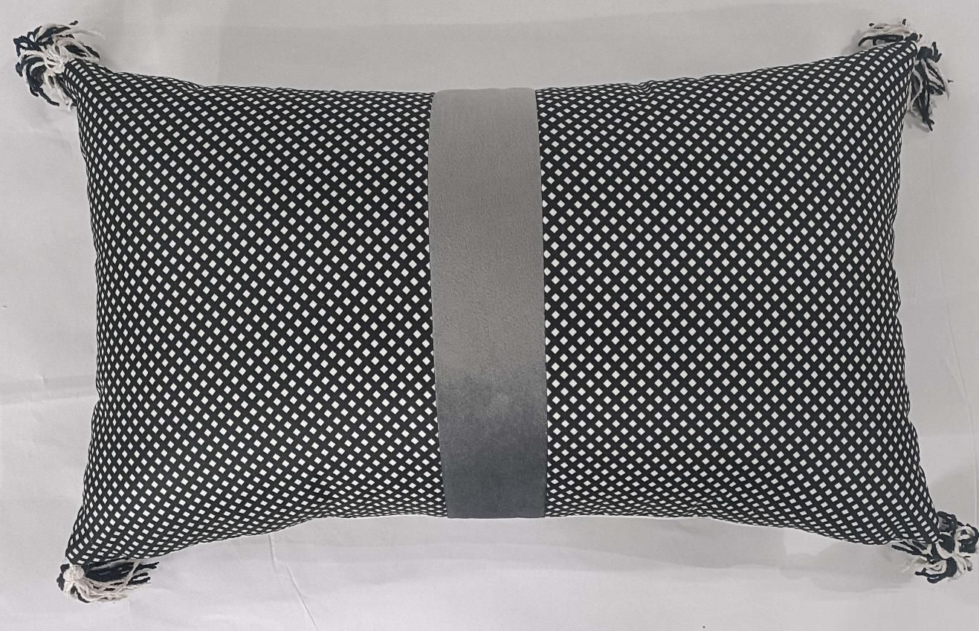
Article : Printed Cushion Cover with Tassels
Size: 30x50 cm
MOQ : 1000 pcs
Composition : Polyester

Slide 27
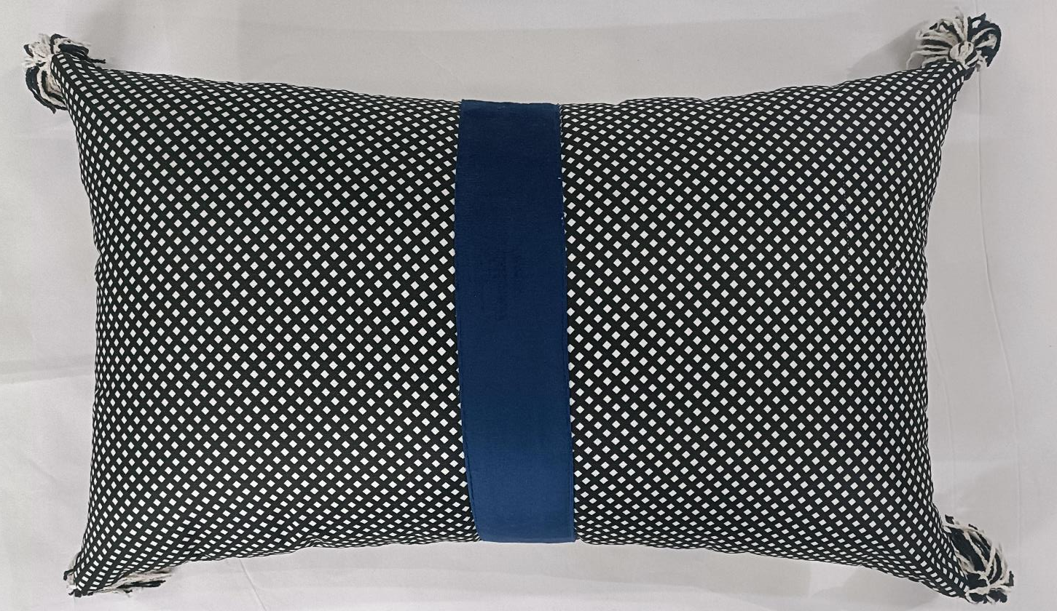
Article : Printed Cushion Cover with Tassels
Size: 30x50 cm
MOQ : 1000 pcs
Composition : Polyester

