Slide 1

RUGS

Slide 2
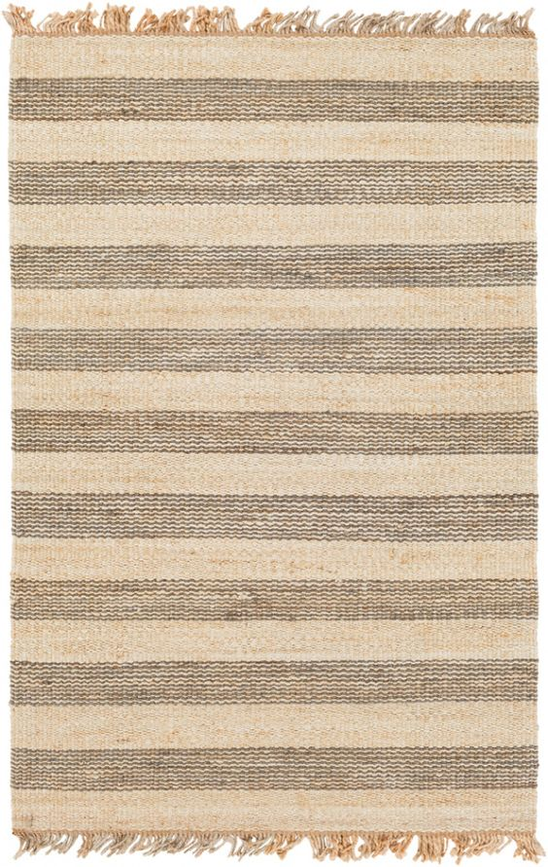
Article no. – RT- RG1001
Size - 27x45 inches
Content –
Price - $

Slide 3
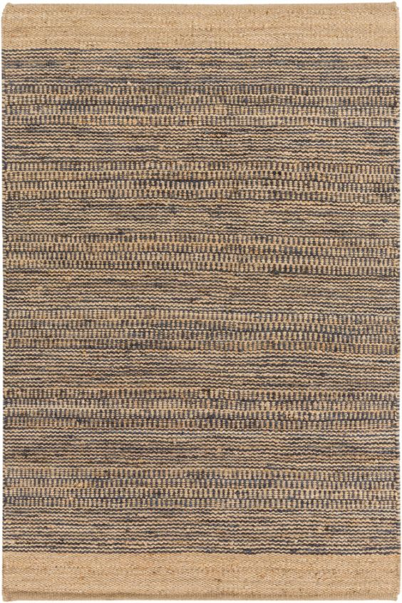
Article no. – RT- RG1002
Size - 27x45 inches
Content –
Price - $

Slide 4

Article no. – RT- RG1003
Size - 27x45 inches
Content –
Price - $

Slide 5
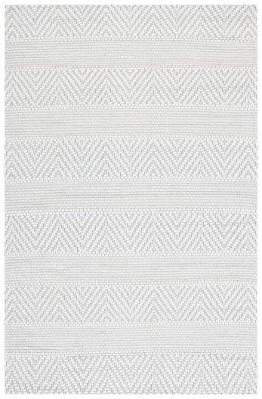
Article no. – RT- RG1004
Size - 27x45 inches
Content –
Price - $

Slide 6

Article no. – RT- RG1005
Size - 27x45 inches
Content –
Price - $

Slide 7
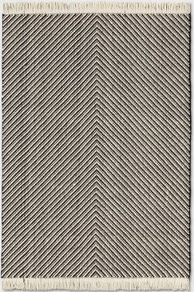
Article no. – RT- RG1006
Size - 27x45 inches
Content –
Price - $

Slide 8

Article no. – RT- RG1007
Size - 27x45 inches
Content –
Price - $

Slide 9
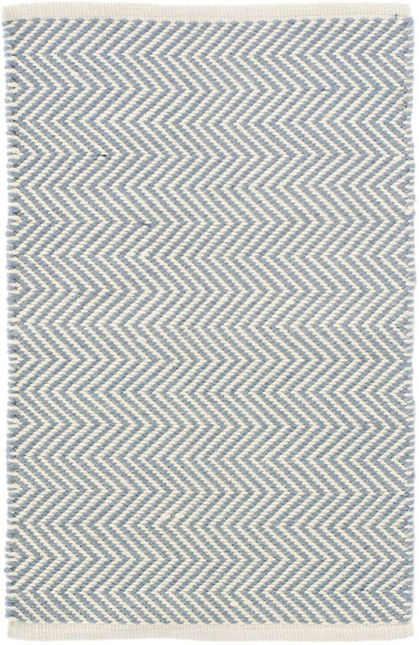
Article no. – RT- RG1008
Size - 27x45 inches
Content –
Price - $

Slide 10
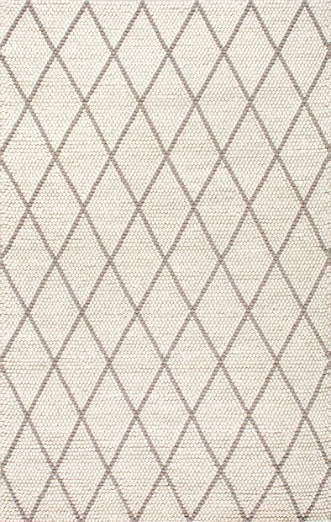
Article no. – RT- RG1009
Size - 27x45 inches
Content –
Price - $

Slide 11
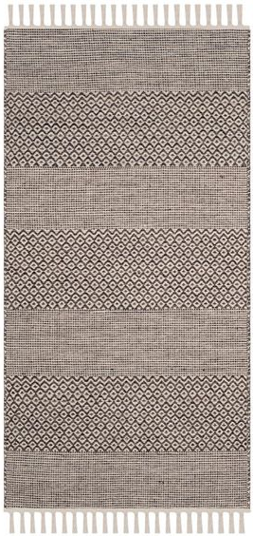
Article no. – RT- RG1010
Size - 27x45 inches
Content –
Price - $

Slide 12
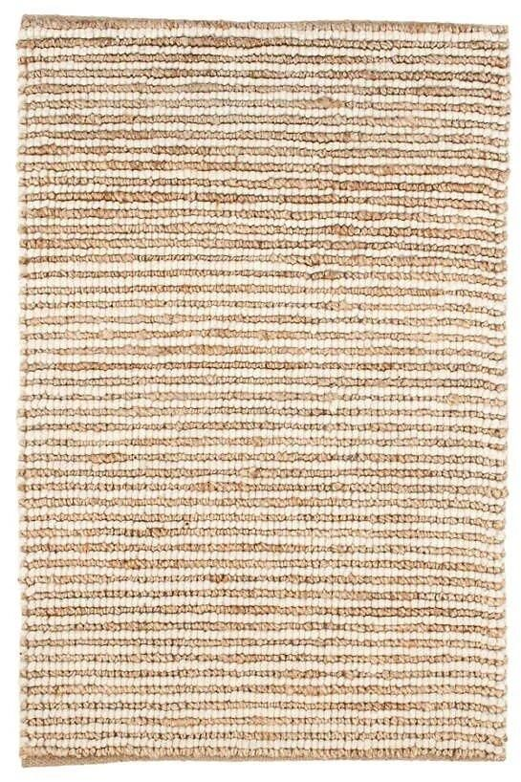
Article no. – RT- RG1011
Size - 27x45 inches
Content –
Price - $

Slide 13
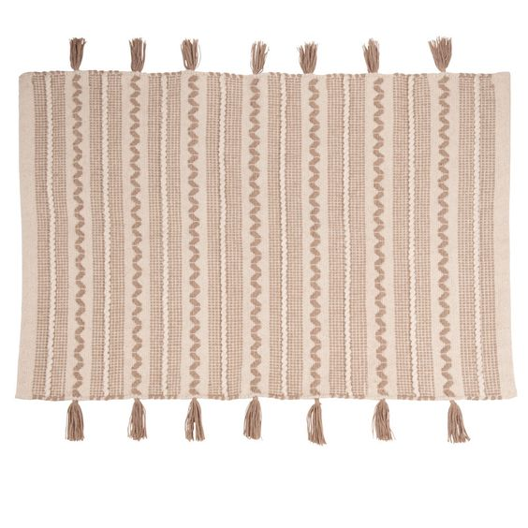
Article no. – RT- RG1012
Size - 27x45 inches
Content –
Price - $

Slide 14
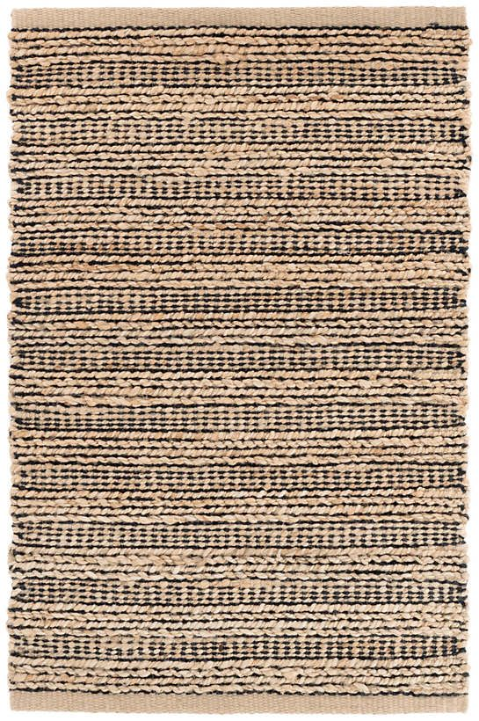
Article no. – RT- RG1013
Size - 27x45 inches
Content –
Price - $

Slide 15
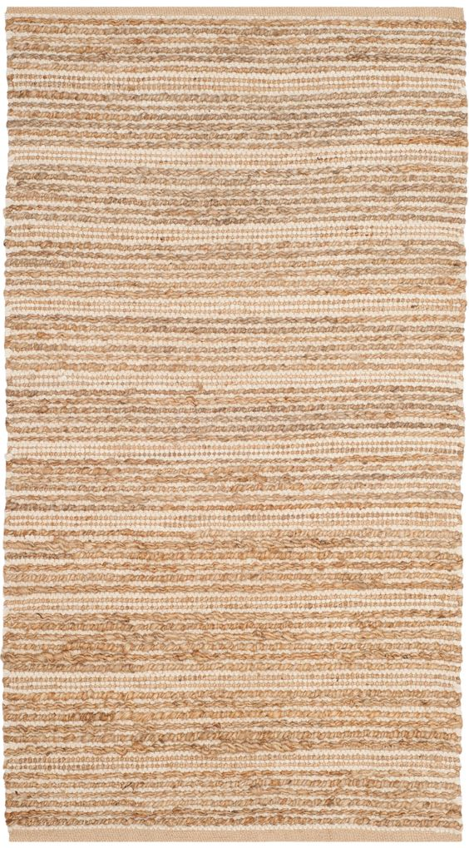
Article no. – RT- RG1014
Size - 27x45 inches
Content –
Price - $

Slide 16
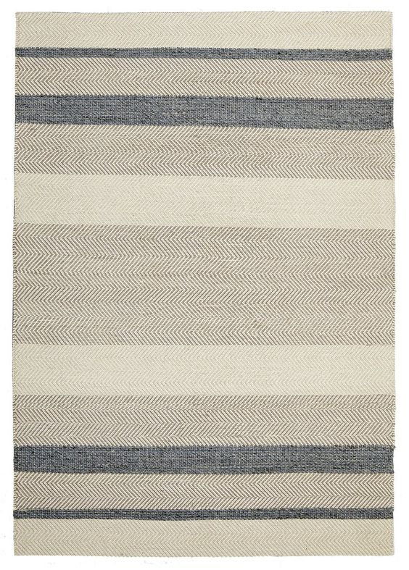
Article no. – RT- RG1015
Size - 27x45 inches
Content –
Price - $

Slide 17
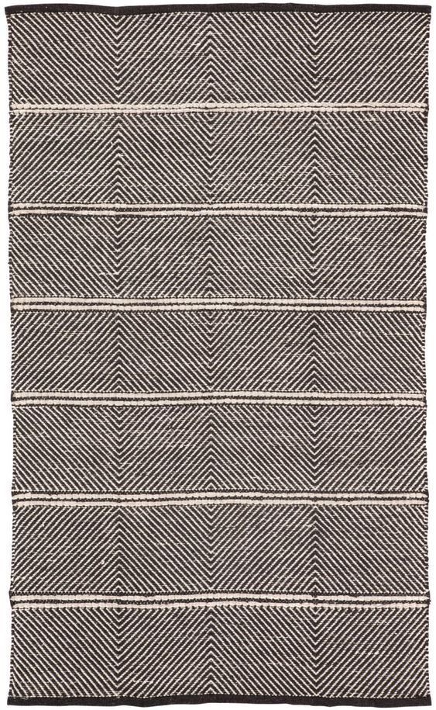
Article no. – RT- RG1016
Size - 27x45 inches
Content –
Price - $

Slide 18

Article no. – RT- RG1017
Size - 27x45 inches
Content –
Price - $

Slide 19
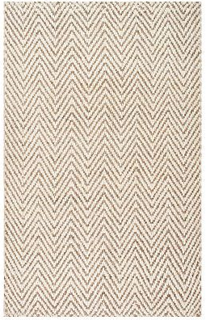
Article no. – RT- RG1018
Size - 27x45 inches
Content –
Price - $

Slide 20
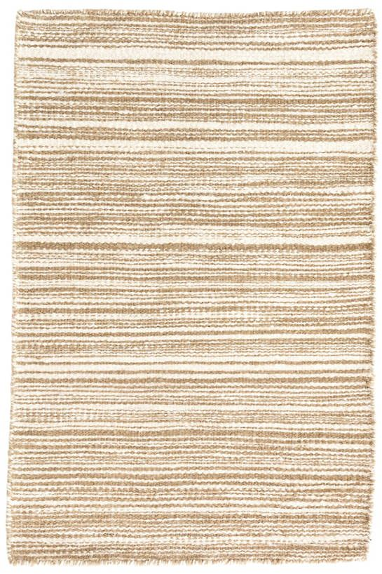
Article no. – RT- RG1019
Size - 27x45 inches
Content –
Price - $

Slide 21
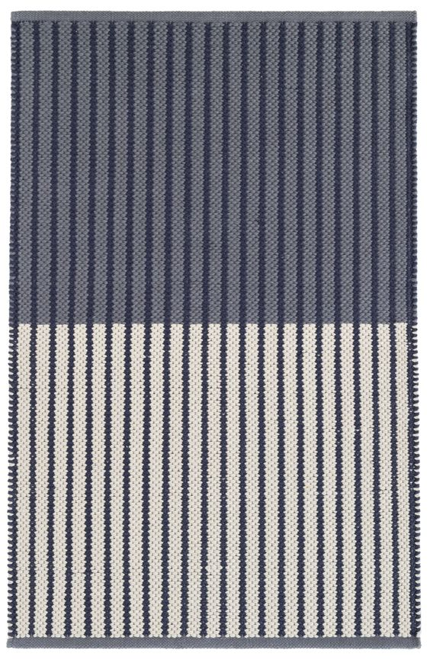
Article no. – RT- RG1020
Size - 27x45 inches
Content –
Price - $

Slide 22

Article no. – RT- RG1021
Size - 27x45 inches
Content –
Price - $

Slide 23
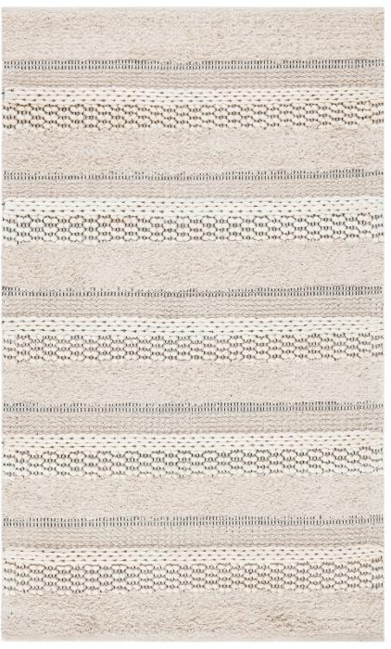
Article no. – RT- RG1022
Size - 27x45 inches
Content –
Price - $

Slide 24

Article no. – RT- RG1023
Size - 27x45 inches
Content –
Price - $

Slide 25
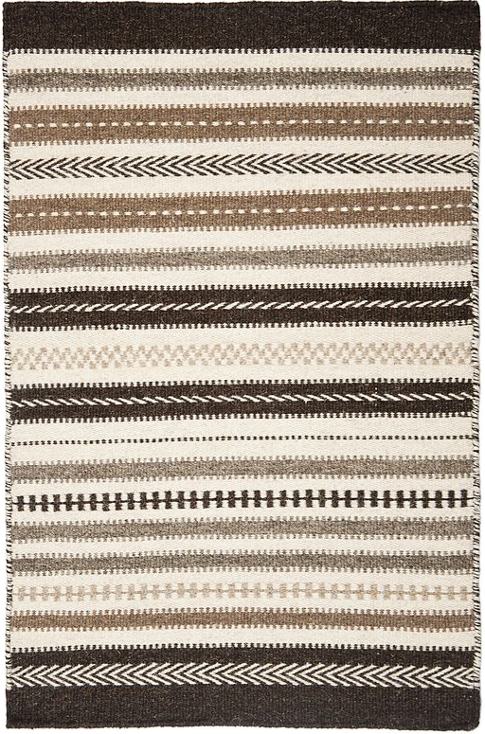
Article no. – RT- RG1024
Size - 27x45 inches
Content –
Price - $

Slide 26
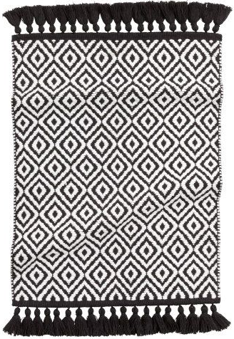
Article no. – RT- RG1025
Size - 27x45 inches
Content –
Price - $

Slide 27
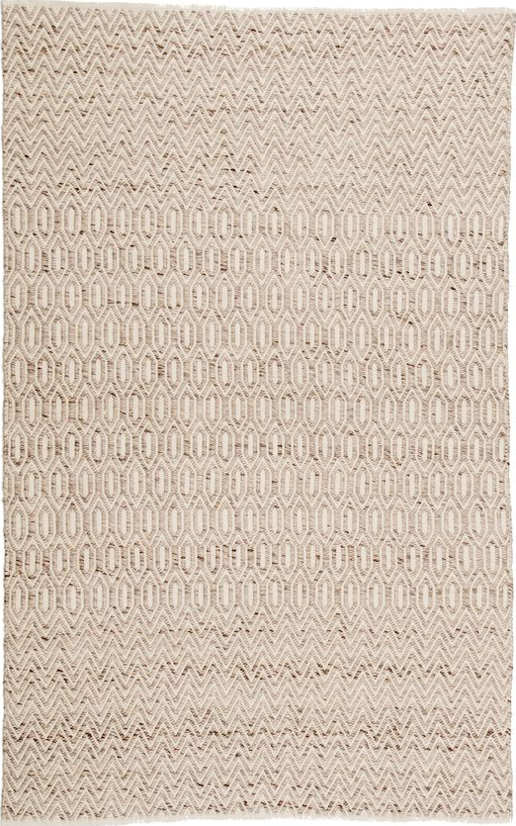
Article no. – RT- RG1026
Size - 27x45 inches
Content –
Price - $

Slide 28
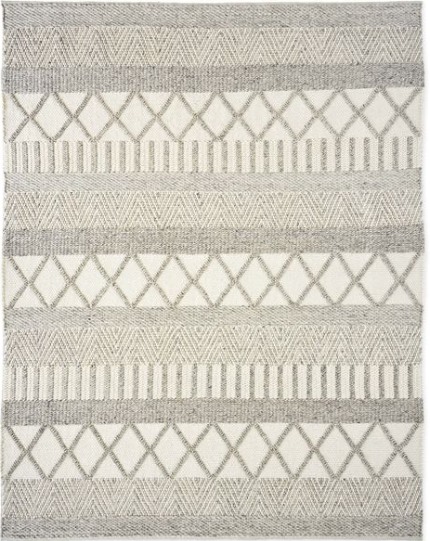
Article no. – RT- RG1027
Size - 27x45 inches
Content –
Price - $

Slide 29
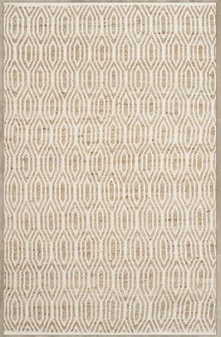
Article no. – RT- RG1028
Size - 27x45 inches
Content –
Price - $

Slide 30
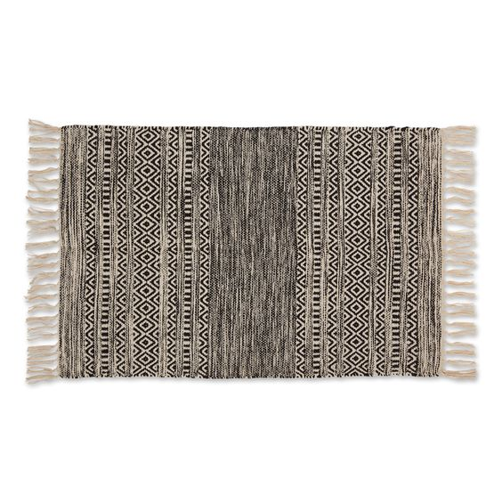
Article no. – RT- RG1029
Size - 27x45 inches
Content –
Price - $

Slide 31
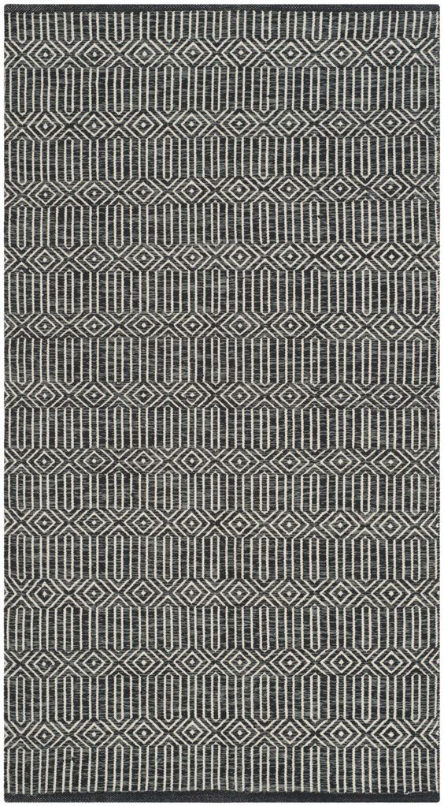
Article no. – RT- RG1030
Size - 27x45 inches
Content –
Price - $

Slide 32
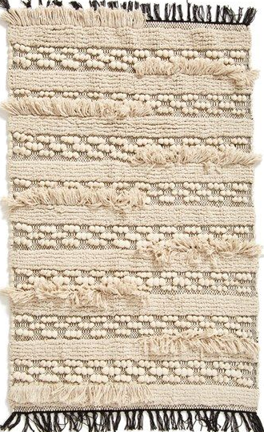
Article no. – RT- RG1031
Size - 27x45 inches
Content –
Price - $

Slide 33
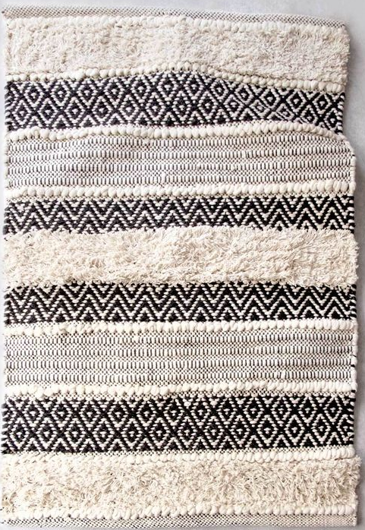
Article no. – RT- RG1032
Size - 27x45 inches
Content –
Price - $

Slide 34
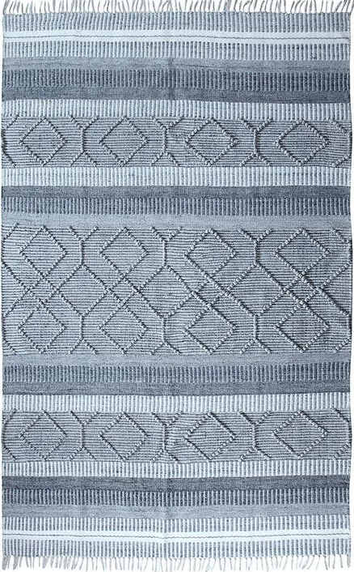
Article no. – RT- RG1033
Size - 27x45 inches
Content –
Price - $

Slide 35
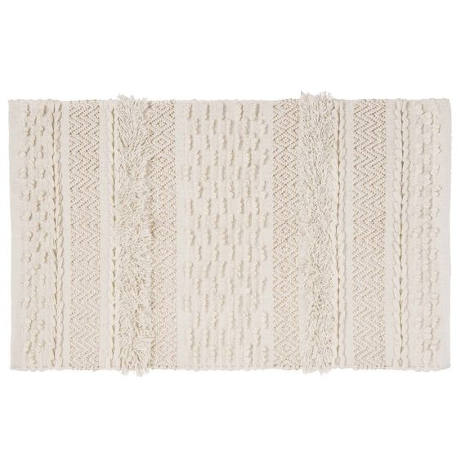
Article no. – RT- RG1034
Size - 27x45 inches
Content –
Price - $

Slide 36
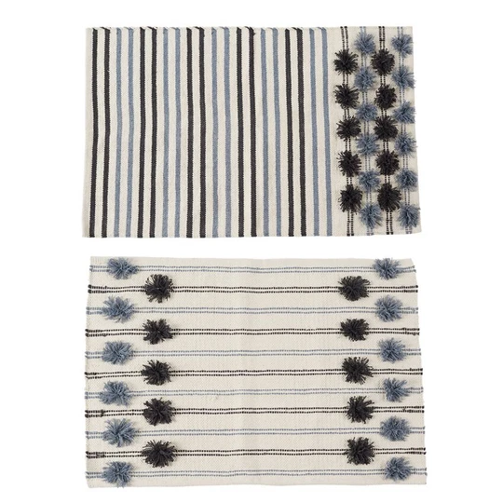
Article no. – RT- RG1035
Size - 27x45 inches
Content –
Price - $

Slide 37
Article no. – RT- RG1036
Size - 27x45 inches
Content –
Price - $

Slide 38
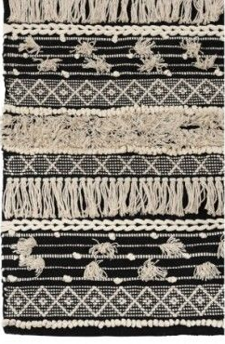
Article no. – RT- RG1037
Size - 27x45 inches
Content –
Price - $

Slide 39
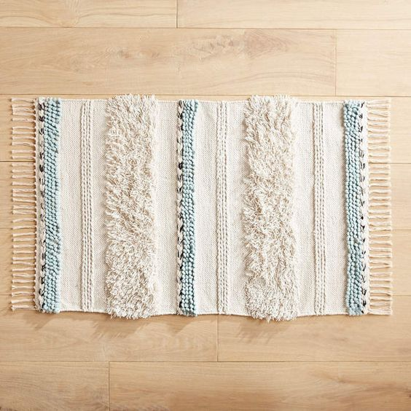
Article no. – RT- RG1038
Size - 27x45 inches
Content –
Price - $

Slide 40
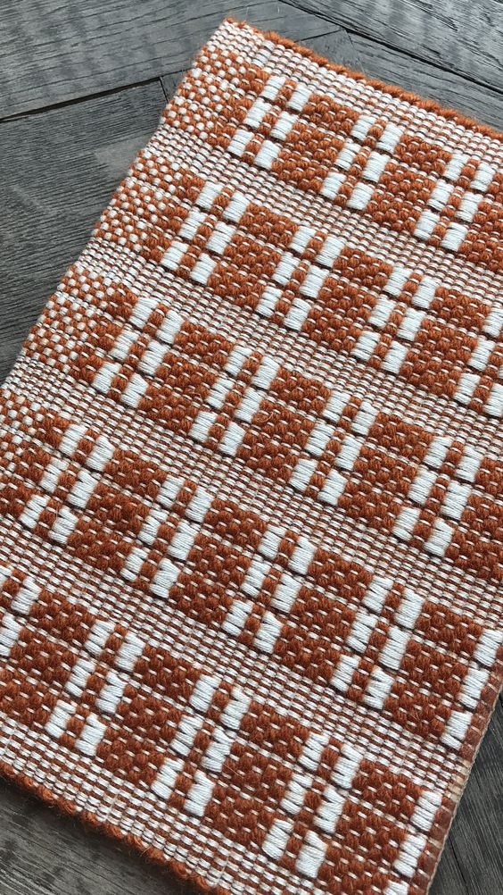
Article no. – RT- RG1039
Size - 27x45 inches
Content –
Price - $

Slide 41

Article no. – RT- RG1040
Size - 27x45 inches
Content –
Price - $

Slide 42

Article no. – RT- RG1041
Size - 27x45 inches
Content –
Price - $

