Slide 1
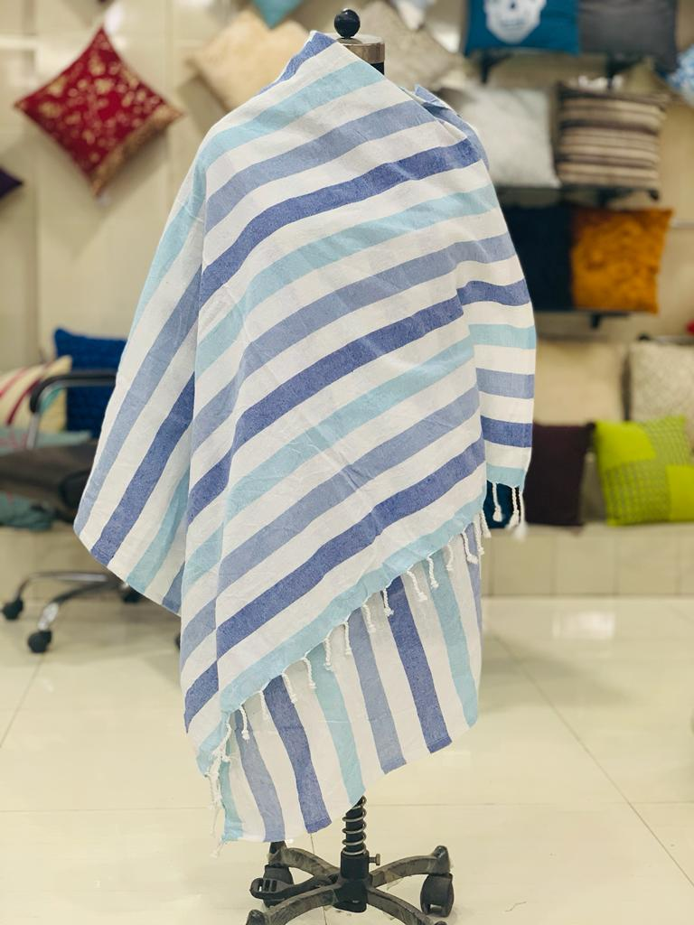
Turkish Towel
Product Description – Cotton Woven Throw
Design Name/Item No – RT-TT-100
Color – as per image

Slide 2
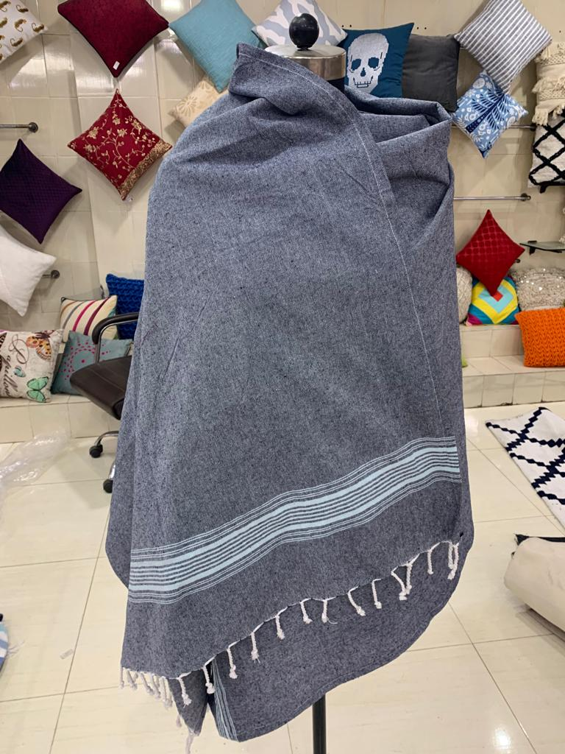
Turkish Towel
Product Description – Cotton Woven Throw
Design Name/Item No – RT-TT-100
Color – as per image

Slide 3
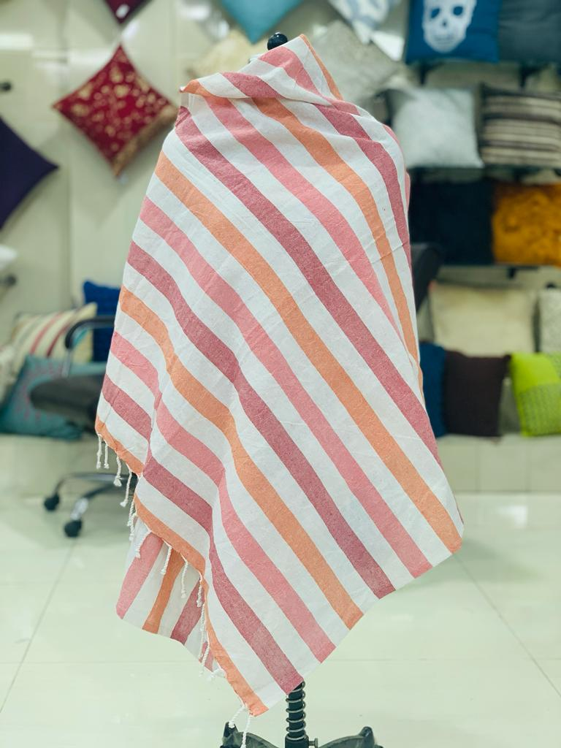
Turkish Towel
Product Description – Cotton Woven Throw
Design Name/Item No – RT-TT-100
Color – as per image

Slide 4
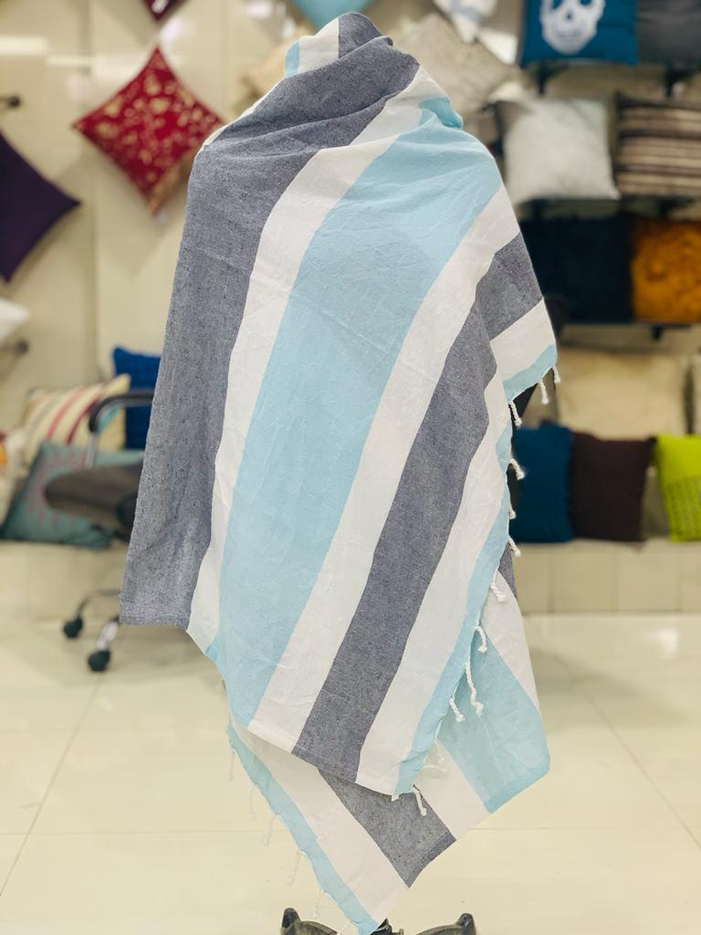
Turkish Towel
Product Description – Cotton Woven Throw
Design Name/Item No – RT-TT-100
Color – as per image

Slide 5
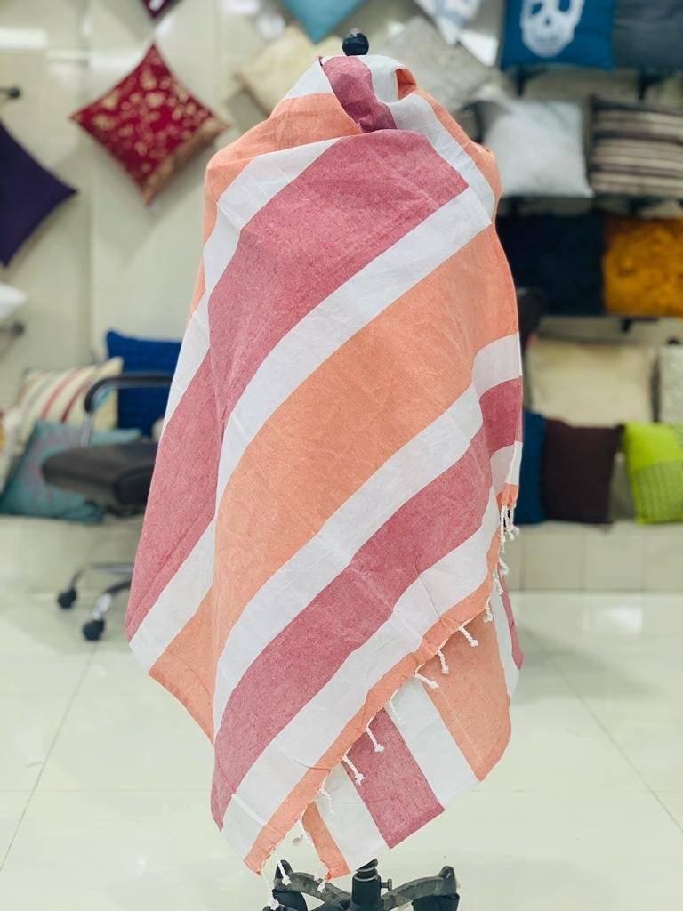
Turkish Towel
Product Description – Cotton Woven Throw
Design Name/Item No – RT-TT-100
Color – as per image

Slide 6
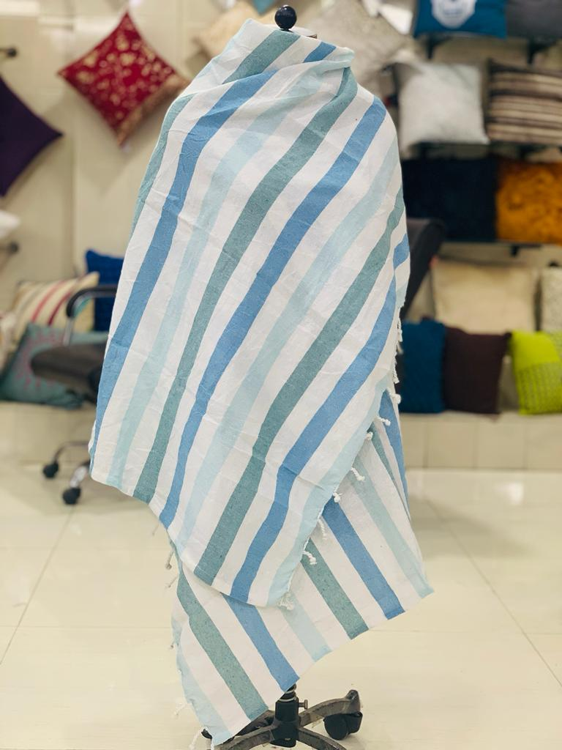
Turkish Towel
Product Description – recylec Cotton Woven Throw ,
90” cm into 180’cm
1000-
180 GSM waits
80 cotton + mis fiber20%
Inhouse ;95Rs.- 20
20ft container,
Design Name/Item No – RT-TT-100
Color – as per image
Rs,81
Tanna polister , banaa- recyle cottan
70% polise
135GSm

Slide 7
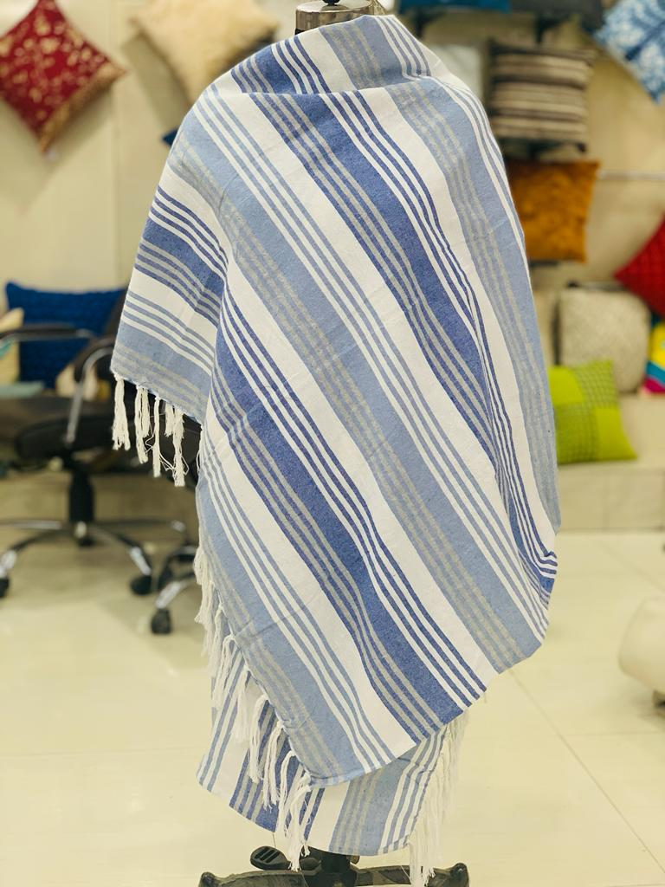
Turkish Towel
Product Description – Cotton Woven Throw
Design Name/Item No – RT-TT-100
Color – as per image

Slide 8
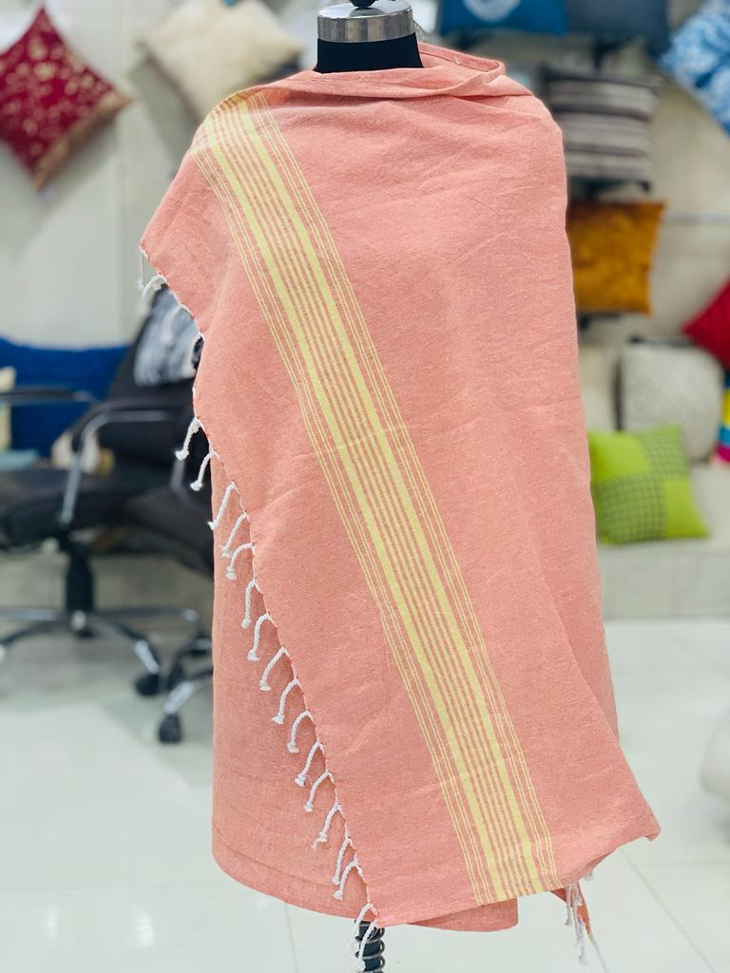
Turkish Towel
Product Description – Cotton Woven Throw
Design Name/Item No – RT-TT-100
Color – as per image

Slide 9
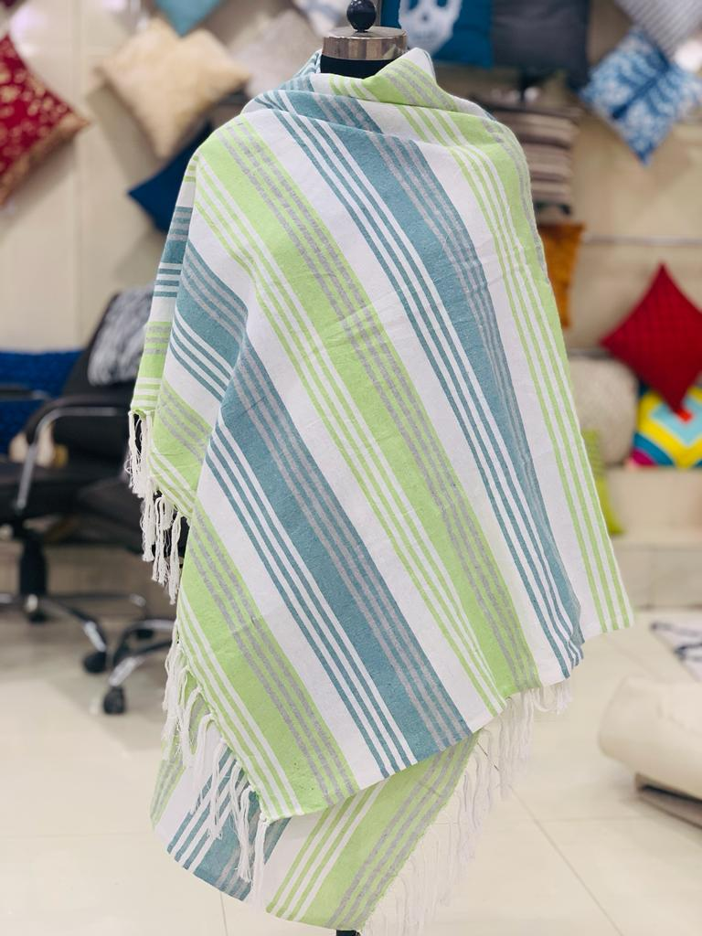
Turkish Towel
Product Description – Cotton Woven Throw
Design Name/Item No – RT-TT-100
Color – as per image

Slide 10
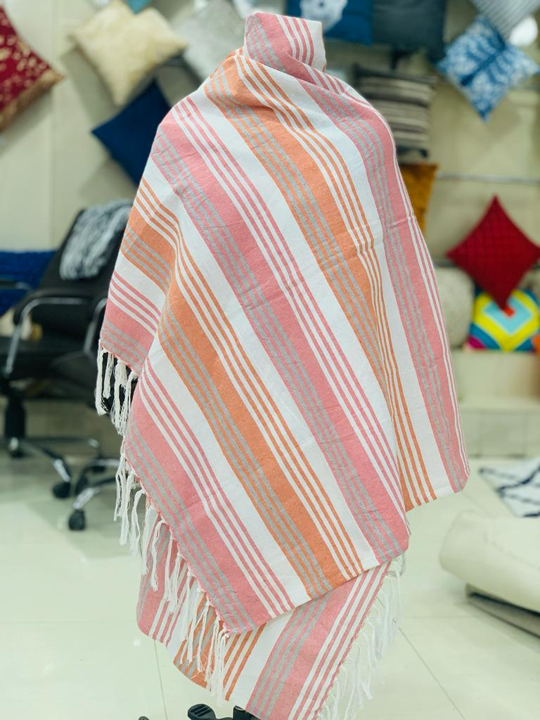
Turkish Towel
Product Description – Cotton Woven Throw
Design Name/Item No – RT-TT-100
Color – as per image

Slide 11
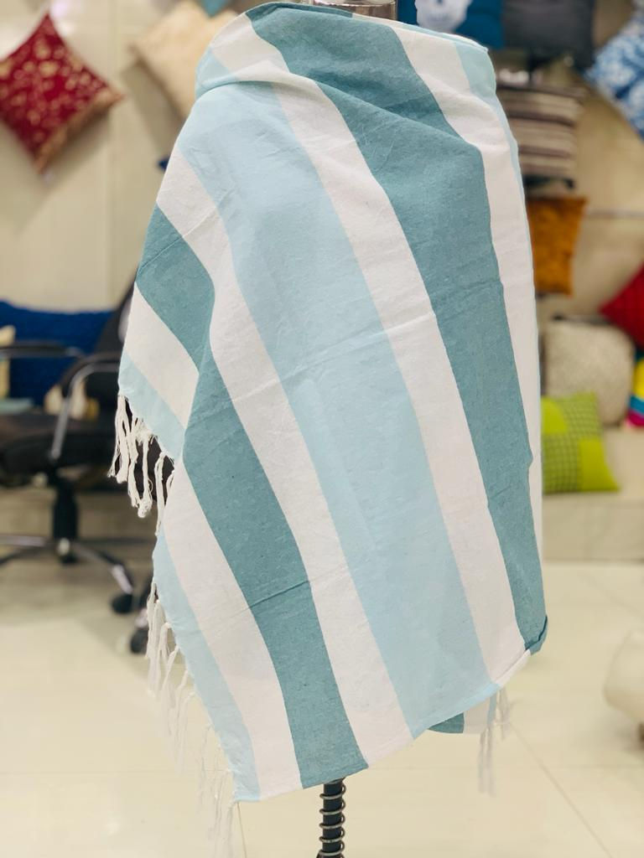
Turkish Towel
Product Description – Cotton Woven Throw
Design Name/Item No – RT-TT-100
Color – as per image

Slide 12
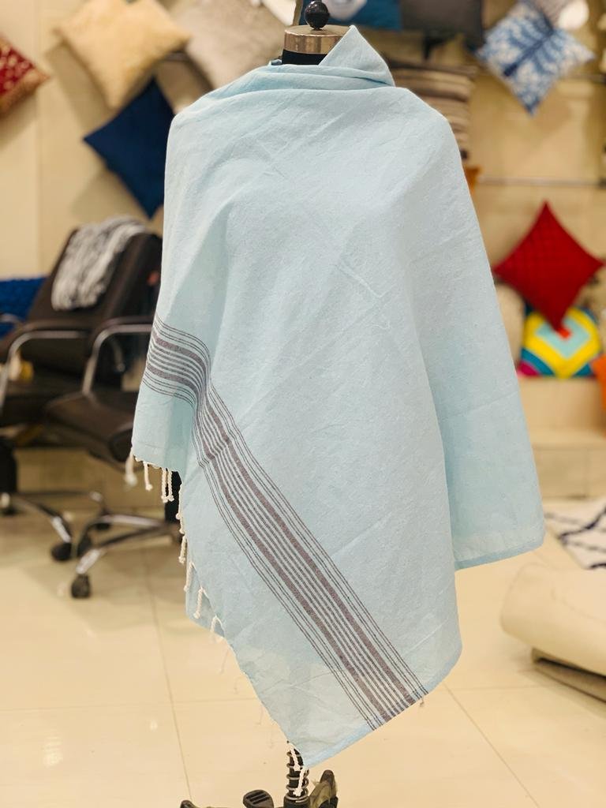
Turkish Towel
Product Description – Cotton Woven Throw
Design Name/Item No – RT-TT-100
Color – as per image

