Slide 1
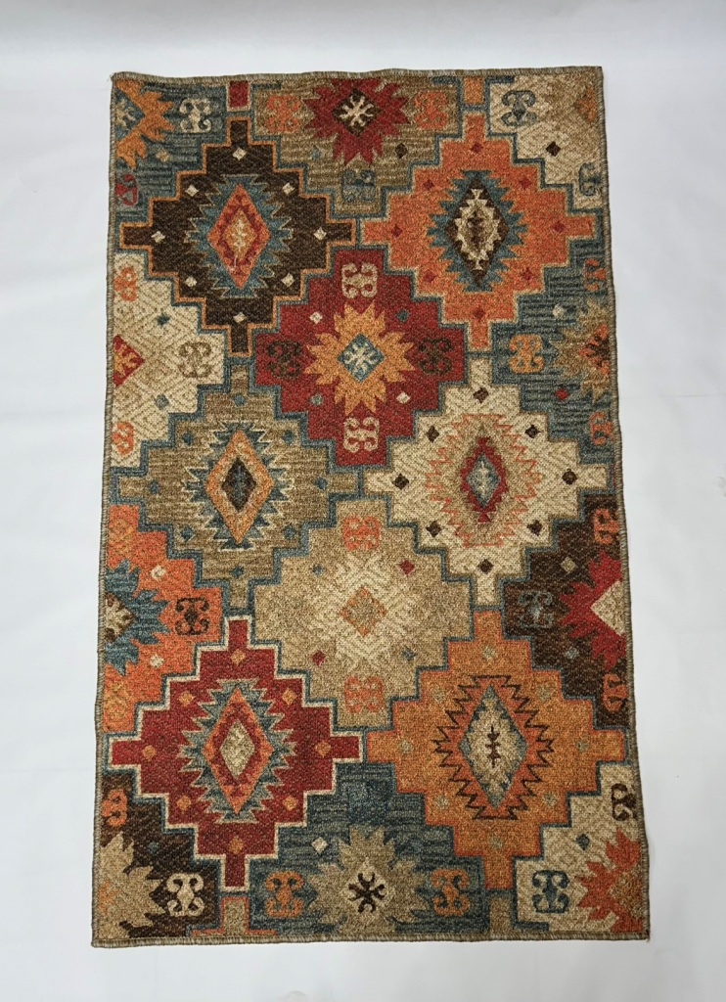
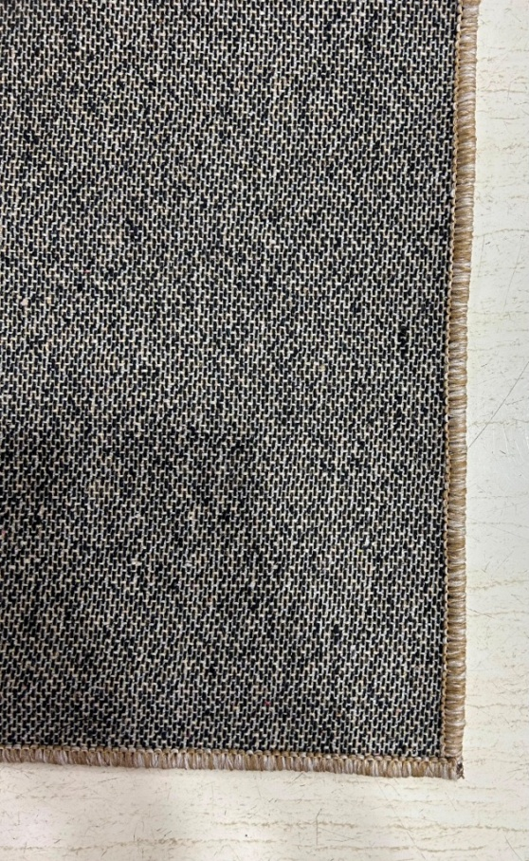
Article : Digital Printed Rug / Carpet
Backing: Cotton
GSM : 1400
Size: 90x150 cm
Composition : Jute + Chenille
MOQ: 300 pcs
BACK VIEW

Slide 2
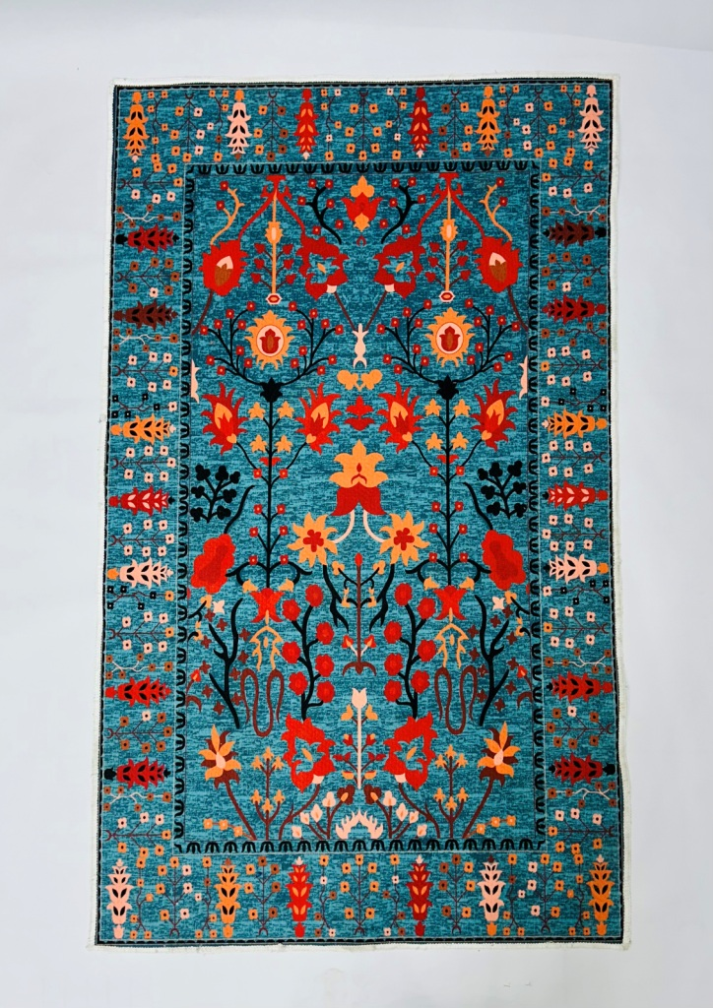
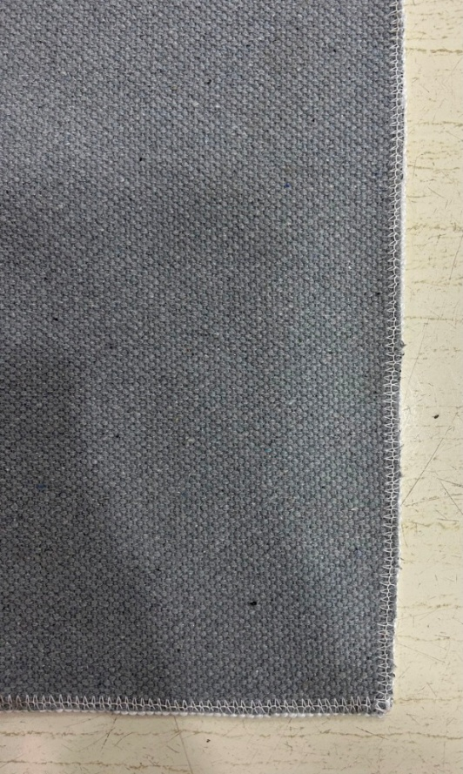
Article : Digital Printed Rug / Carpet
Backing: Cotton
GSM : 1400
Size: 90x150 cm
Composition : Micro Chenille
MOQ: 300 pcs
BACK VIEW

Slide 3
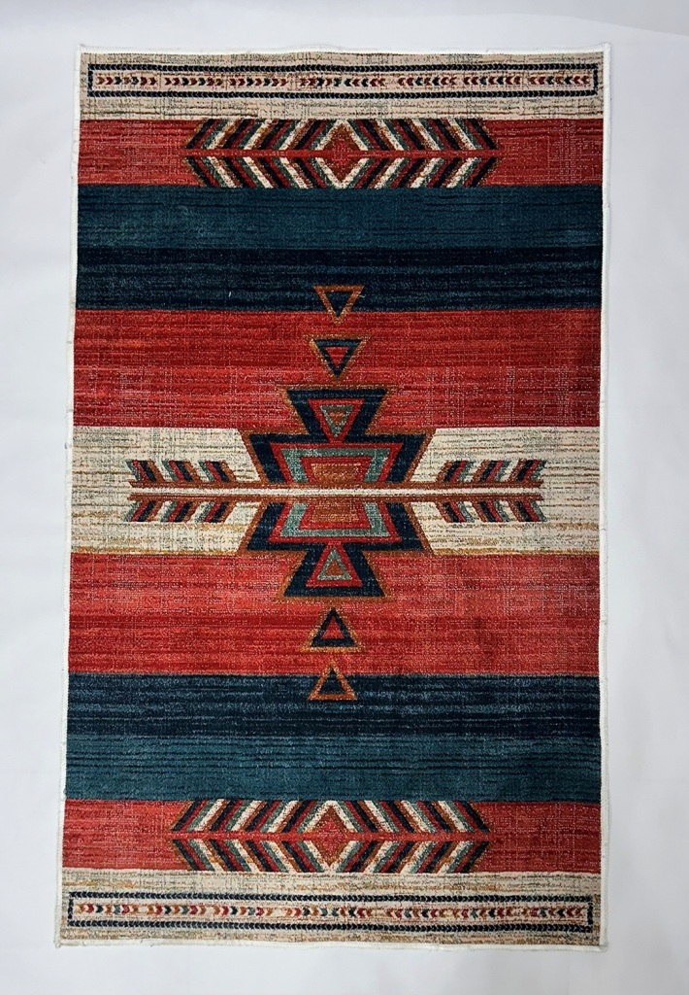
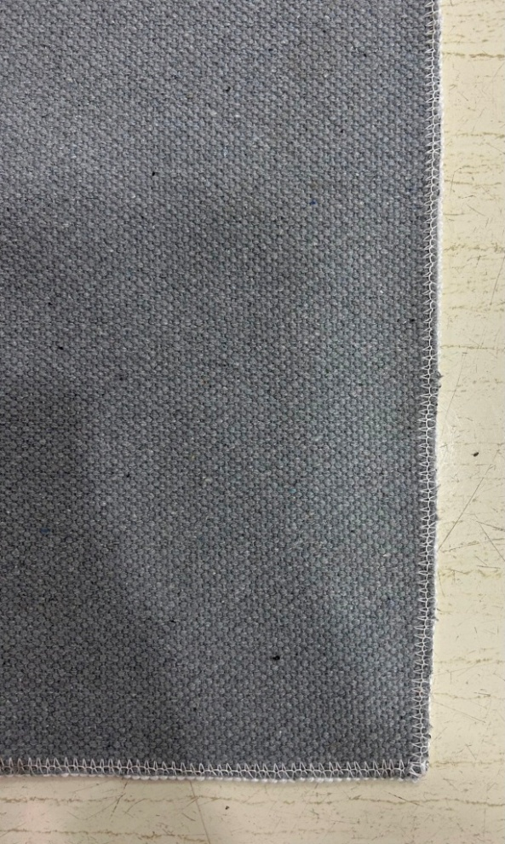
Article : Digital Printed Rug / Carpet
Backing: Cotton
GSM : 1400
Size: 90x150 cm
Composition : Micro Chenille
MOQ: 300 pcs
BACK VIEW

Slide 4
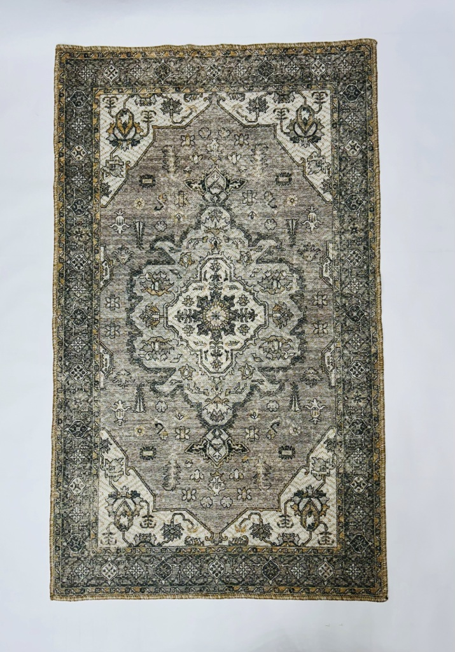

Article : Digital Printed Rug / Carpet
Backing: Cotton
GSM : 1400
Size: 90x150 cm
Composition : Jute + Chenille
MOQ: 300 pcs
BACK VIEW

Slide 5
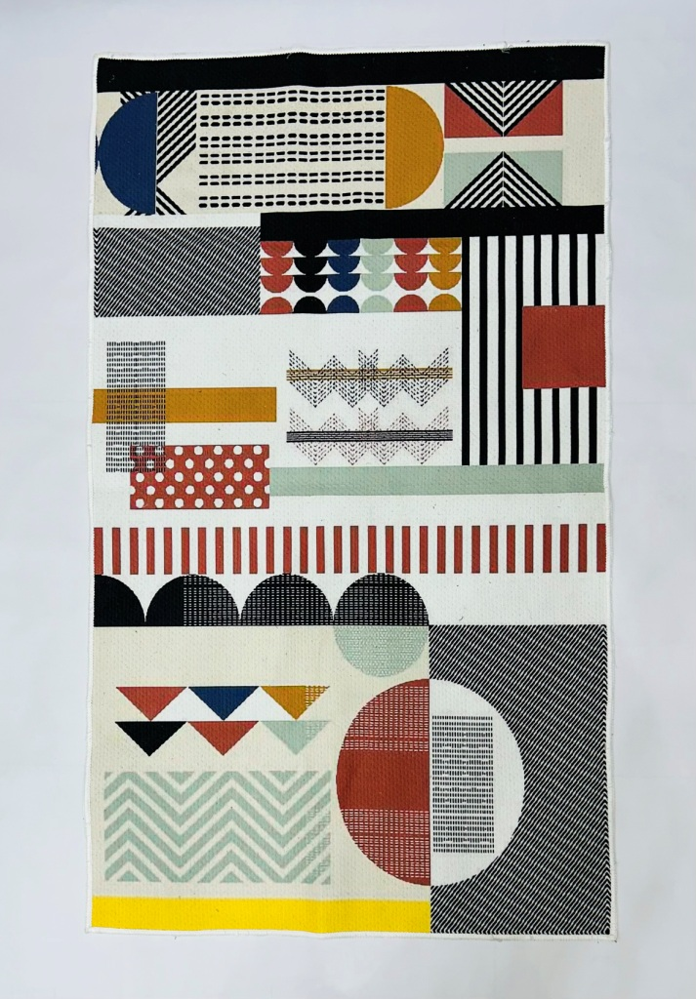
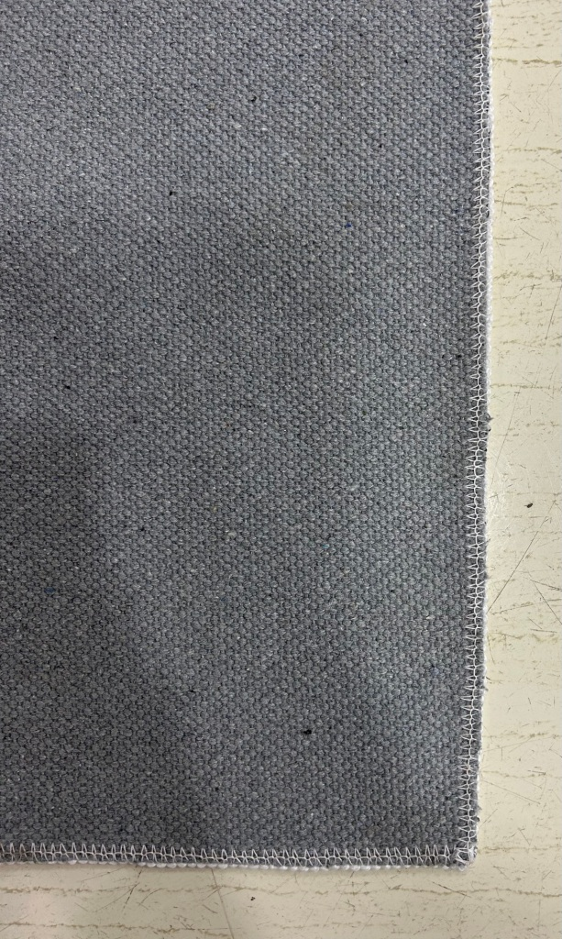
Article : Digital Printed Rug / Carpet
Backing: Cotton
GSM : 1400
Size: 90x150 cm
Composition : Micro Chenille
MOQ: 300 pcs
BACK VIEW

Slide 6
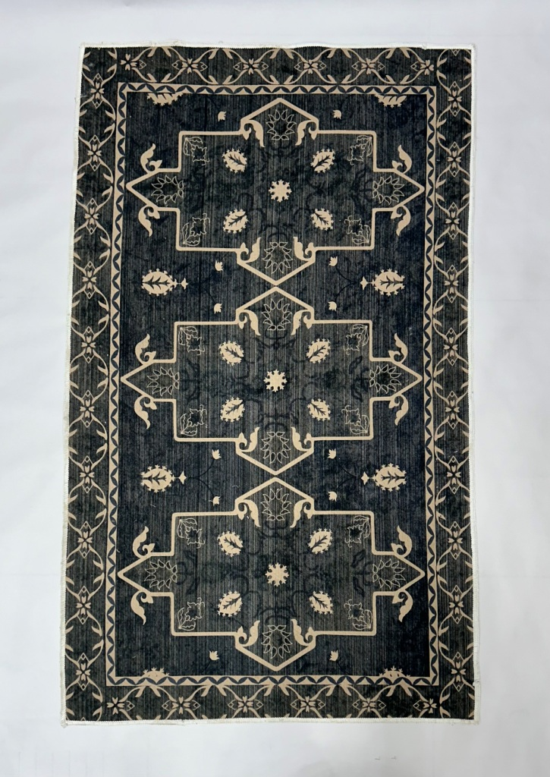

Article : Digital Printed Rug / Carpet
Backing: Cotton
GSM : 1400
Size: 90x150 cm
Composition : Micro Chenille
MOQ: 300 pcs
BACK VIEW

Slide 7
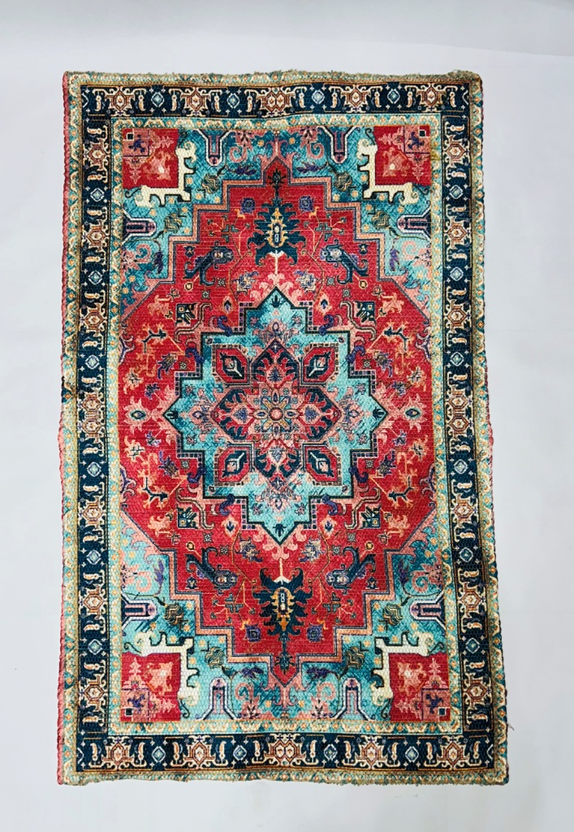
Article : Digital Printed Rug
GSM : 1600
Size: 90x150 cm
Composition : Polyester Chindi
MOQ: 300 pcs

Slide 8
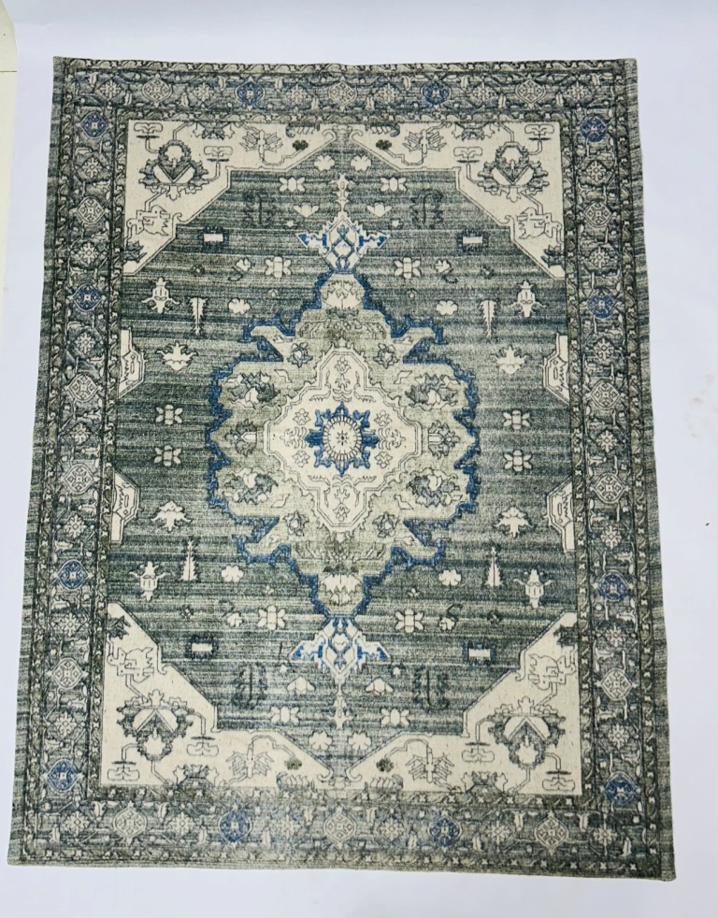
Article : Screen Printed Rug
GSM : 550
Size: 120x170 cm
Composition : Recycle Cotton Canvas
MOQ: 300 pcs

