Slide 1

THROWS

Slide 2
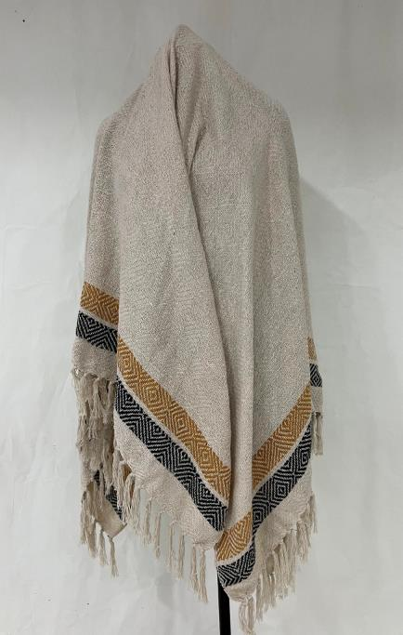
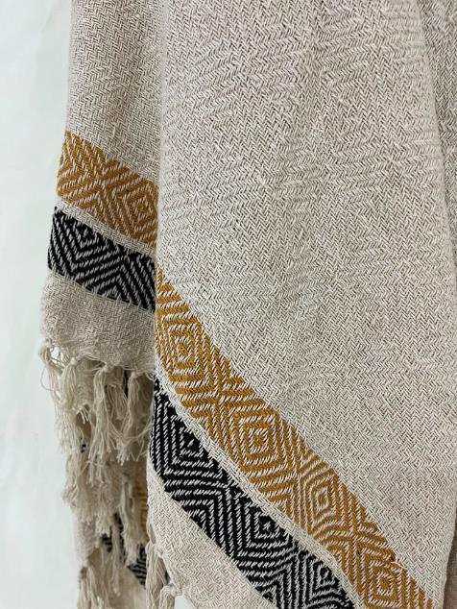
ARTICLE : Recycle Cotton Throw
SIZE: 125 x 150 cm
COMPOSITION : Cotton
MOQ: 500 PCS
GSM: 400 Rs,155 cost, 400GSM, 100% recyle cotton, 125”cm X150cm
30 se 40 shades card provide.
CLOSE VIEW

Slide 3
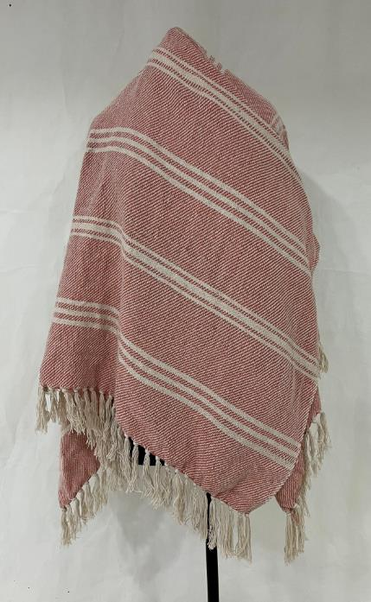
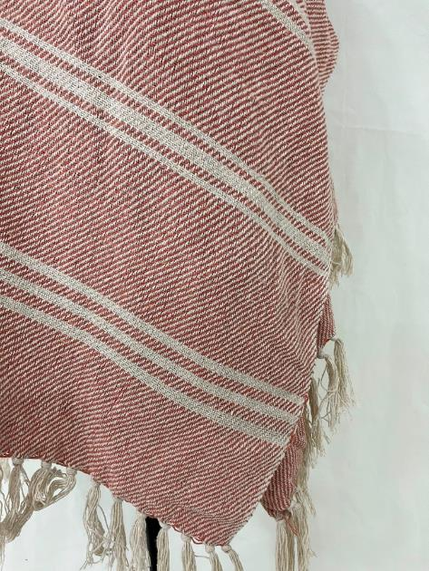
ARTICLE : Recycle Cotton Throw
SIZE: 125 x 150 cm
COMPOSITION : Cotton
MOQ: 300 PCS
GSM: 400
CLOSE VIEW

Slide 4
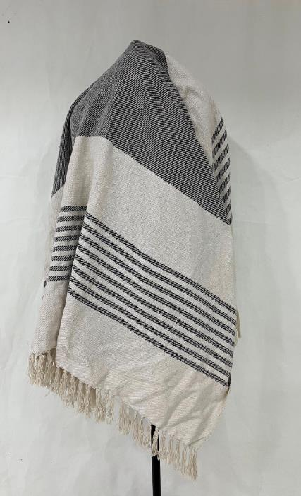
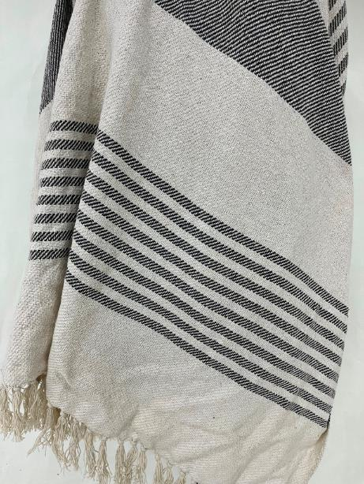
ARTICLE : Recycle Cotton Throw
SIZE: 125 x 150 cm
COMPOSITION : Cotton
MOQ: 300 PCS
GSM: 400
CLOSE VIEW

Slide 5
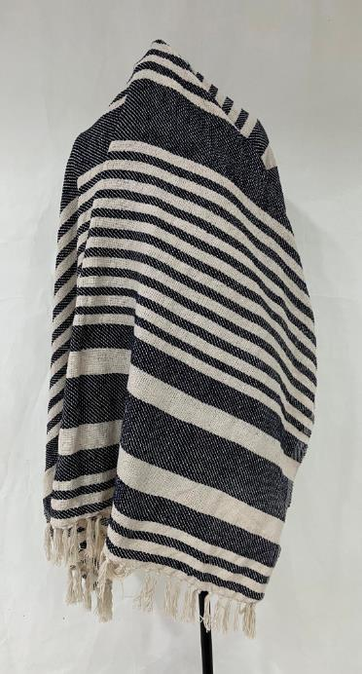
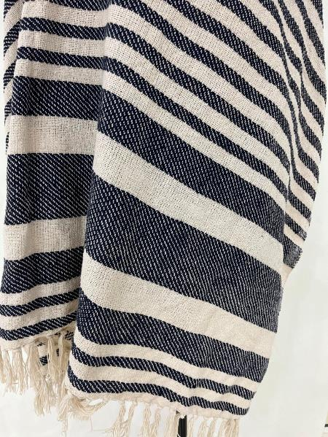
ARTICLE : Recycle Cotton Throw
SIZE: 125 x 150 cm
COMPOSITION : Cotton
MOQ: 300 PCS
GSM: 400
CLOSE VIEW

Slide 6
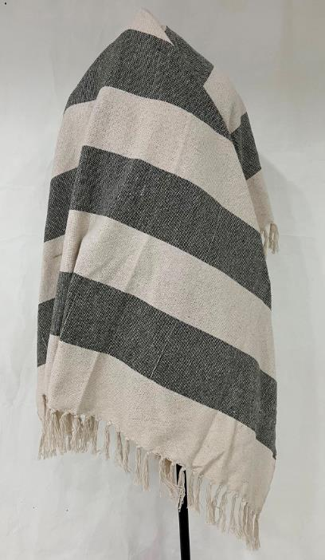
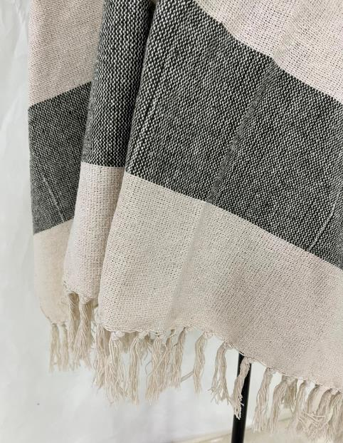
ARTICLE : Recycle Cotton Throw
SIZE: 125 x 150 cm
COMPOSITION : Cotton
MOQ: 300 PCS
GSM: 400
CLOSE VIEW

Slide 7
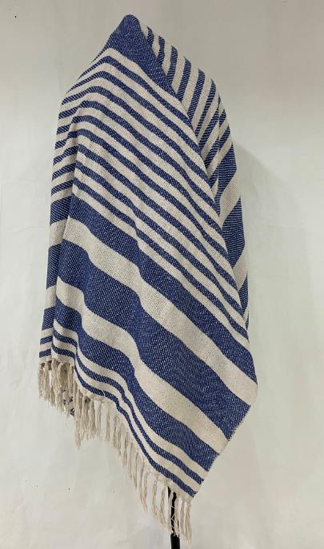
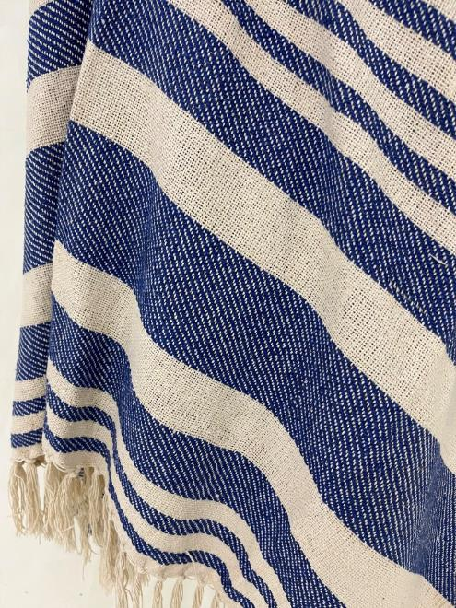
ARTICLE : Recycle Cotton Throw
SIZE: 125 x 150 cm
COMPOSITION : Cotton
MOQ: 300 PCS
GSM: 400
CLOSE VIEW

Slide 8
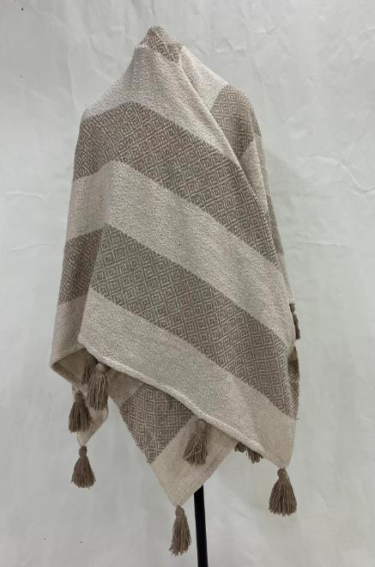
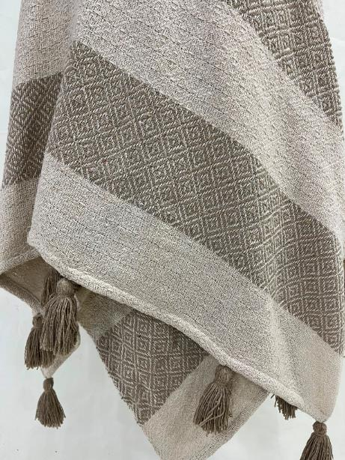
ARTICLE : Recycle Cotton Throw with Tassels
SIZE: 125 x 150 cm
COMPOSITION : Cotton
MOQ: 300 PCS
GSM: 400
CLOSE VIEW

Slide 9
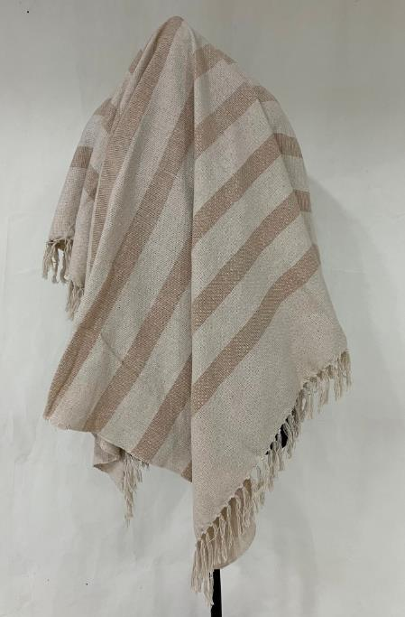
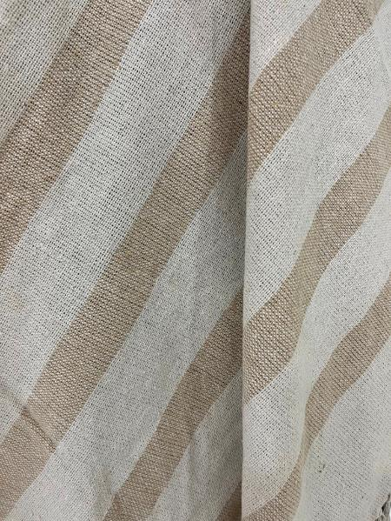
ARTICLE : Recycle Cotton Throw
SIZE: 125 x 150 cm
COMPOSITION : Cotton
MOQ: 300 PCS
GSM: 400
CLOSE VIEW

Slide 10
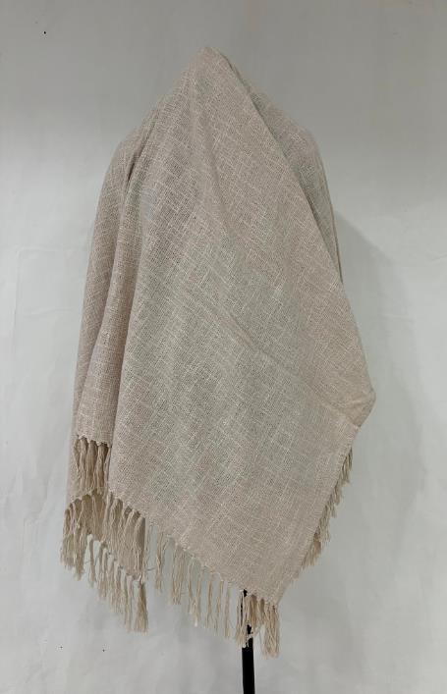
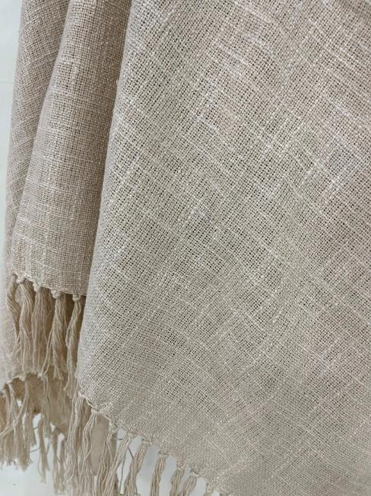
ARTICLE : Cotton Slub Throw
SIZE: 125 x 150 cm
COMPOSITION : Cotton Slub
MOQ: 300 PCS
GSM:
CLOSE VIEW

Slide 11
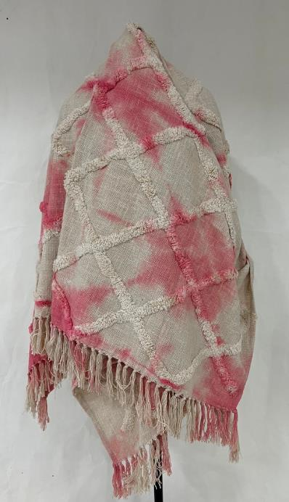
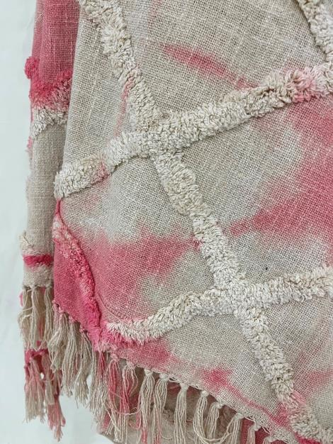
ARTICLE :Tufted Throw with Tye Dye
SIZE: 125 x 150 cm
COMPOSITION : Cotton Slub
MOQ: 300 PCS
GSM:
CLOSE VIEW

Slide 12
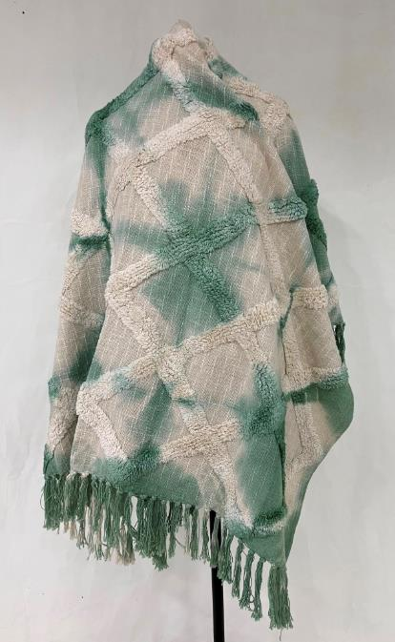
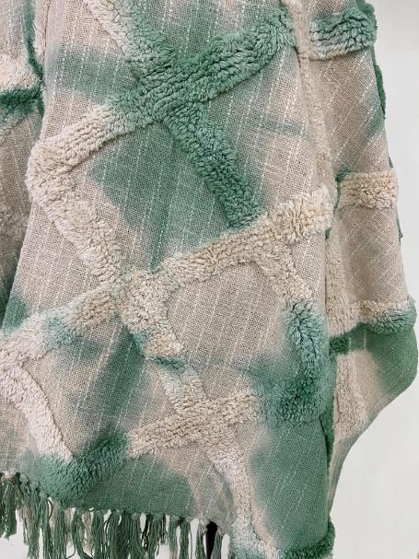
ARTICLE :Tufted Throw with Tye Dye
SIZE: 125 x 150 cm
COMPOSITION : Cotton Slub
MOQ: 300 PCS
GSM:
CLOSE VIEW

