Slide 1

CUSHIONS

Slide 2
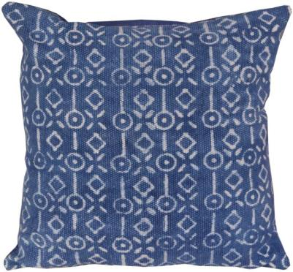
STYLE NO- CC-172344
SIZE- 45X45 CM
DESCRIPTION- INDIGO PATTERN CUSHION
TECHNIQUE-PRINTED
MATERIAL-COTTON

Slide 3
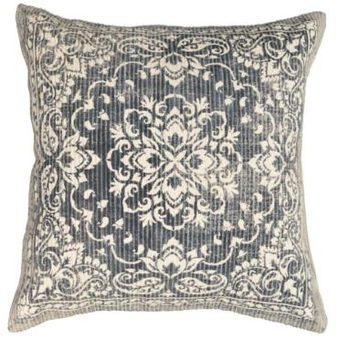
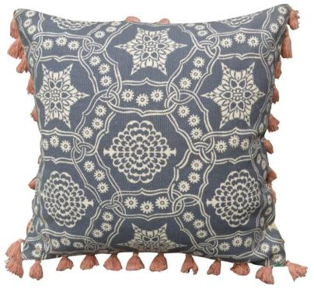
STYLE NO- CC-21-376
SIZE- 45X45 CM
DESCRIPTION- ETHNIC PATTERN CUSHION
TECHNIQUE-PRINTED
MATERIAL-COTTON
STYLE NO- CC-21-262
SIZE- 45X45 CM
DESCRIPTION- TILE PATTERN CUSHION
TECHNIQUE-PRINTED
MATERIAL-COTTON

Slide 4
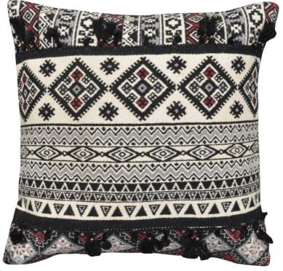
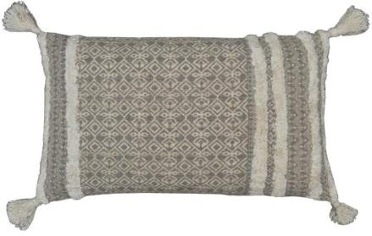
STYLE NO- CC-21-365
SIZE- 45X45 CM
DESCRIPTION- TRIBE PATTERN CUSHION
TECHNIQUE-PRINTED
MATERIAL-COTTON
STYLE NO- CC-21-331
SIZE- 30X50 CM
DESCRIPTION- ETHNO PATTERN CUSHION
TECHNIQUE-PRINTED+TUFTED
MATERIAL-COTTON

Slide 5
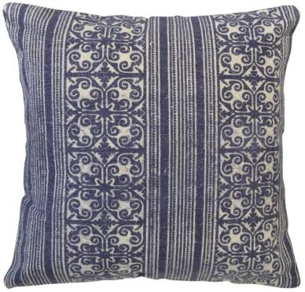
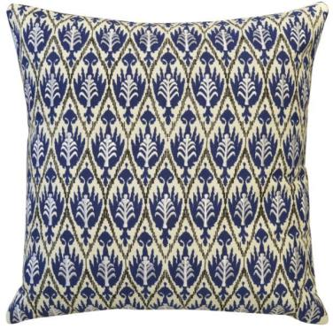
STYLE NO- CC-18-1391
SIZE- 45X45 CM
DESCRIPTION- TILE STRIPE PATTERN CUSHION
TECHNIQUE-PRINTED
MATERIAL-COTTON
STYLE NO- CC-18-1898
SIZE- 45X45 CM
DESCRIPTION- AZTEC PATTERN CUSHION
TECHNIQUE-PRINTED+EMBROIDERED
MATERIAL-COTTON

Slide 6
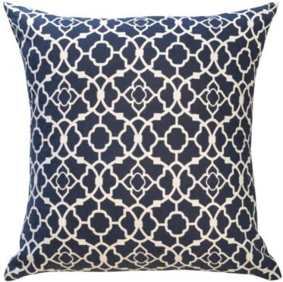
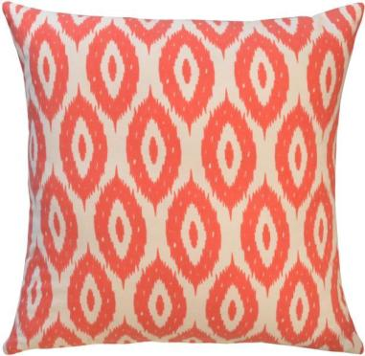
STYLE NO- CC-18-212
SIZE- 45X45 CM
DESCRIPTION- GEO FRET CUSHION
TECHNIQUE-PRINTED
MATERIAL-COTTON
STYLE NO- CC-18-213
SIZE- 45X45 CM
DESCRIPTION- DIAMOND PATTERN CUSHION
TECHNIQUE-PRINTED
MATERIAL-COTTON

Slide 7
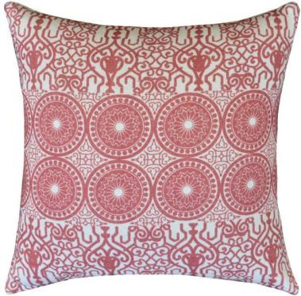
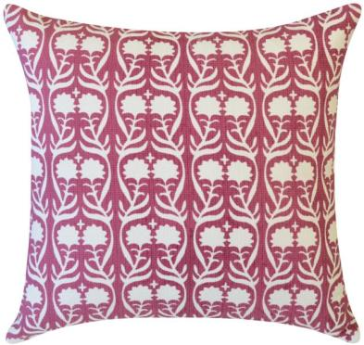
STYLE NO- CC-18-2808
SIZE- 45X45 CM
DESCRIPTION- CIRCLE PATTERN CUSHION
TECHNIQUE-PRINTED
MATERIAL-COTTON
STYLE NO- CC-18-1717
SIZE- 45X45 CM
DESCRIPTION- FLORAL PATTERN CUSHION
TECHNIQUE-PRINTED
MATERIAL-COTTON

Slide 8
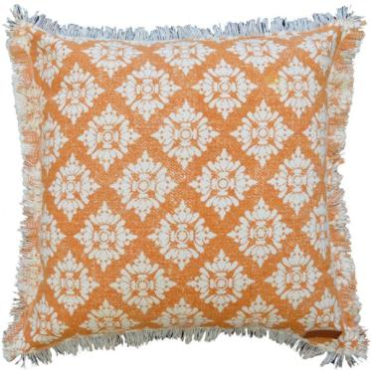
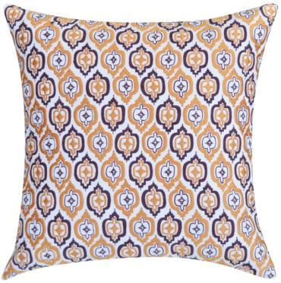
STYLE NO- CC-18-2515
SIZE- 45X45 CM
DESCRIPTION- ETHNO PATTERN CUSHION
TECHNIQUE-PRINTED
MATERIAL-COTTON
STYLE NO- CC-18-1838
SIZE- 45X45 CM
DESCRIPTION- GEO FRET PATTERN CUSHION
TECHNIQUE-PRINTED+EMBROIDERED
MATERIAL-COTTON

Slide 9
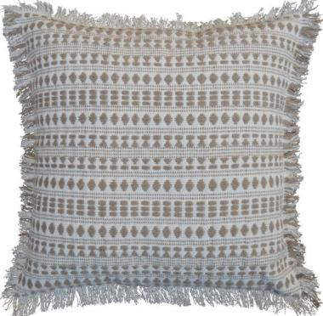
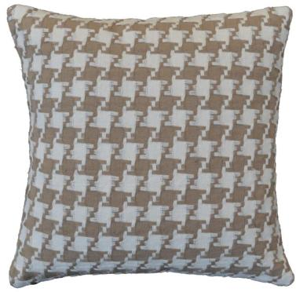
STYLE NO- CC-19-3503
SIZE- 45X45 CM
DESCRIPTION- MULTI PATTERN STRIPE PATTERN CUSHION
TECHNIQUE-WOVEN
MATERIAL-COTTON
STYLE NO- CC-19-3465
SIZE- 45X45 CM
DESCRIPTION- TWEED PATTERN CUSHION
TECHNIQUE-WOVEN
MATERIAL-COTTON

Slide 10
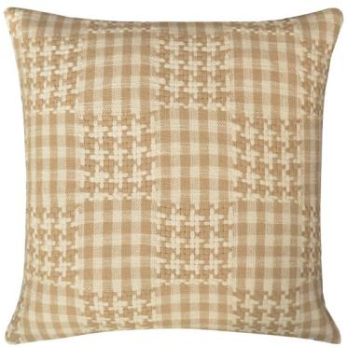
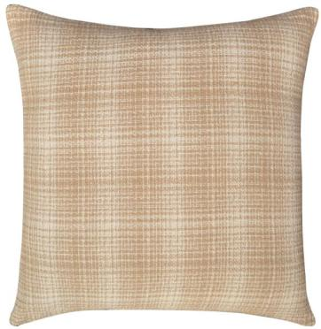
STYLE NO- CC-21-217
SIZE- 45X45 CM
DESCRIPTION- BLCOK PATTERN CUSHION
TECHNIQUE-WOVEN
MATERIAL-COTTON
STYLE NO- CC-21-225
SIZE- 45X45 CM
DESCRIPTION- DISTRESS PATTERN CUSHION
TECHNIQUE-WOVEN
MATERIAL-COTTON

Slide 11
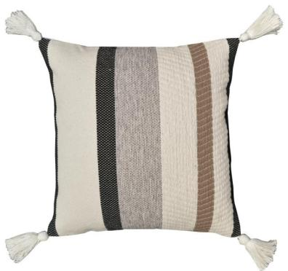
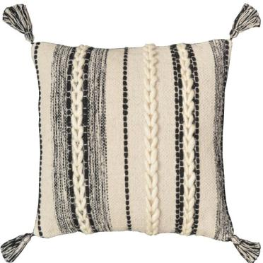
STYLE NO- CC-21-235
SIZE- 45X45 CM
DESCRIPTION- STRIPE PATTERN CUSHION
TECHNIQUE-WOVEN
MATERIAL-COTTON
STYLE NO- CC-21-237
SIZE- 45X45 CM
DESCRIPTION- BRAIDED STRIPE PATTERN CUSHION
TECHNIQUE-WOVEN
MATERIAL-COTTON

Slide 12
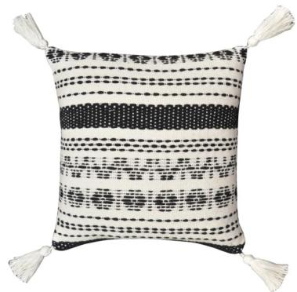
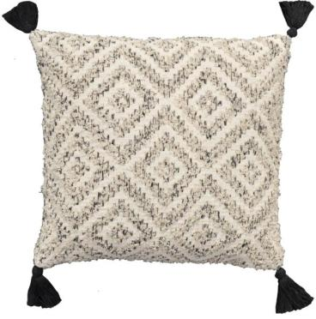
STYLE NO- CC-21-236
SIZE- 45X45 CM
DESCRIPTION- BROKEN ETHNO PATTERN CUSHION
TECHNIQUE-WOVEN
MATERIAL-COTTON
STYLE NO- CC-21-266
SIZE- 45X45 CM
DESCRIPTION- DIAMOND PATTERN CUSHION
TECHNIQUE-WOVEN
MATERIAL-COTTON

Slide 13
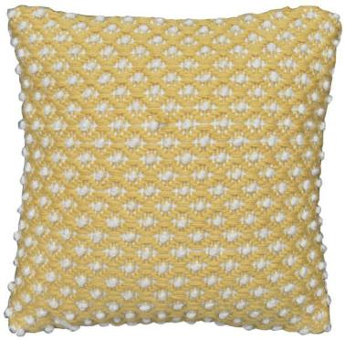
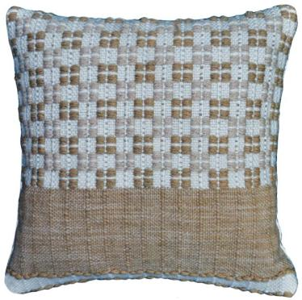
STYLE NO- CC-21-288
SIZE- 45X45 CM
DESCRIPTION- DIAMOND PATTERN CUSHION
TECHNIQUE-WOVEN
MATERIAL-PET
STYLE NO- CC-21-277
SIZE- 45X45 CM
DESCRIPTION- BLOCK PATTERN CUSHION
TECHNIQUE-WOVEN
MATERIAL-PET

Slide 14
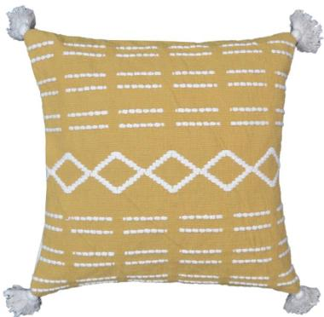
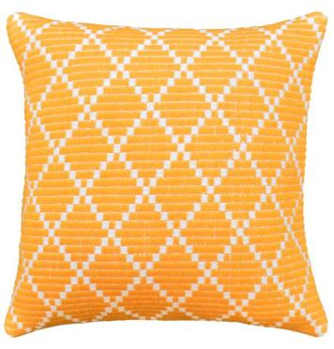
STYLE NO- CC-21-350
SIZE- 45X45 CM
DESCRIPTION- BOHO PATTERN CUSHION
TECHNIQUE-WOVEN
MATERIAL-COTTON
STYLE NO- CC-21-83
SIZE- 45X45 CM
DESCRIPTION- DIAMOND PATTERN CUSHION
TECHNIQUE-WOVEN
MATERIAL-COTTON

Slide 15
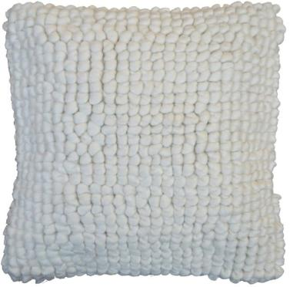
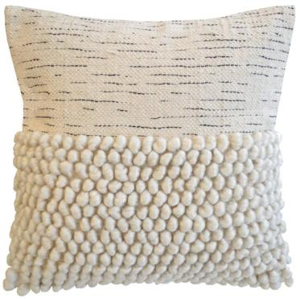
STYLE NO- CC-19-3505
SIZE- 45X45 CM
DESCRIPTION-LOOP PATTERN CUSHION
TECHNIQUE-WOVEN
MATERIAL-COTTON
STYLE NO- CC-18-473
SIZE- 45X45 CM
DESCRIPTION- LOOP WITH IRRGULAR PATTERN CUSHION
TECHNIQUE-WOVEN
MATERIAL-COTTON

Slide 16
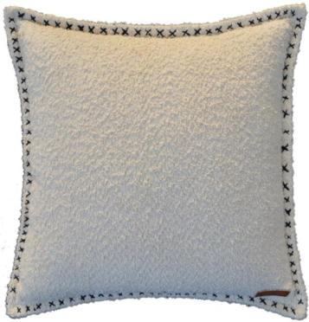
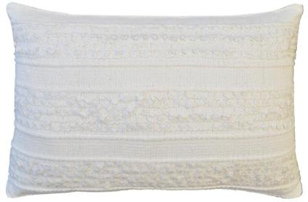
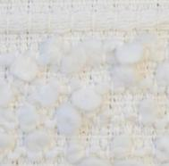
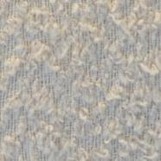
STYLE NO- CC-19-3280
SIZE- 45X45 CM
DESCRIPTION-BOUCLE CUSHION WITH CROSS STITCH ON FLANGE
TECHNIQUE-EMBROIDERD ON FLANGE
MATERIAL-COTTON
STYLE NO- CC-19-3385
SIZE- 30X50 CM
DESCRIPTION- LOOP STRIPE PATTERN CUSHION
TECHNIQUE-WOVEN
MATERIAL-COTTON

Slide 17
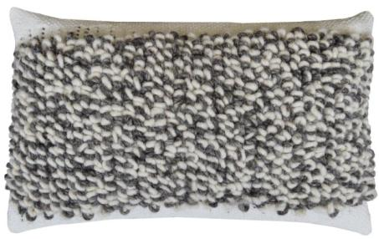
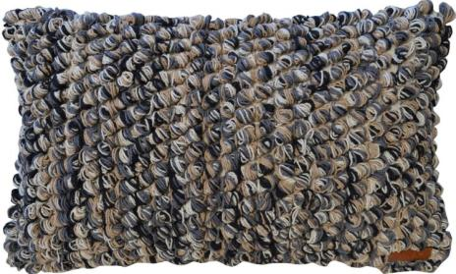
STYLE NO- CC-19-3205
SIZE- 30X50 CM
DESCRIPTION- LOOP PATTERN CUSHION
TECHNIQUE-WOVEN
MATERIAL-COTTON+WOOL
STYLE NO- CC-18-1506
SIZE- 30X50 CM
DESCRIPTION- LOOP PATTERN CUSHION
TECHNIQUE-WOVEN
MATERIAL-COTTON

Slide 18
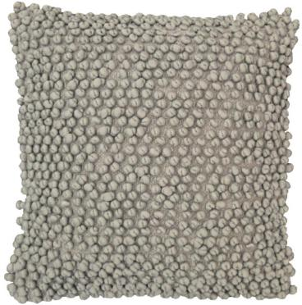
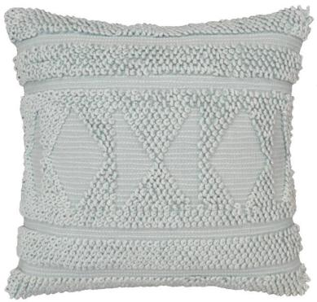
STYLE NO- CC-21-338
SIZE- 45X45 CM
DESCRIPTION- FUGGA CUSHION
TECHNIQUE-WOVEN
MATERIAL-COTTON+POLYESTER
STYLE NO- CC-21-344
SIZE- 45X45 CM
DESCRIPTION- LOOP DIAMOND PATTERN CUSHION
TECHNIQUE-WOVEN
MATERIAL-COTTON+POLYESTER

Slide 19
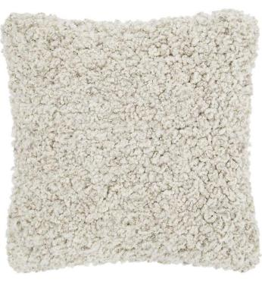
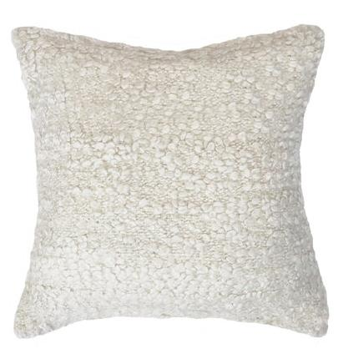
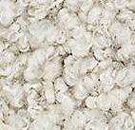
STYLE NO- CC-NT-22-01
SIZE- 45X45 CM
DESCRIPTION- BOUCLE PATTERN THROW
TECHNIQUE-WOVEN
MATERIAL-COTTON
STYLE NO- CC-NT-22-02
SIZE- 45X45 CM
DESCRIPTION-BOUCLE PATTERN THROW
TECHNIQUE-WOVEN
MATERIAL-COTTON

Slide 20
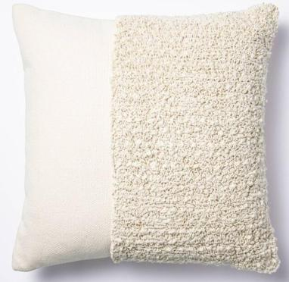
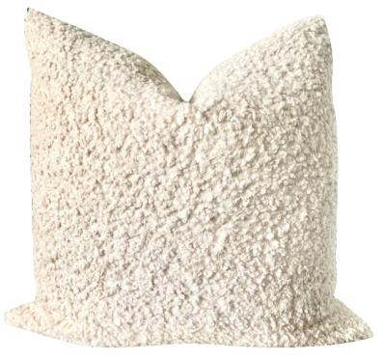
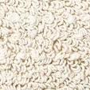
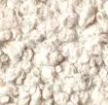
STYLE NO- CC-NT-22-03
SIZE- 45X45 CM
DESCRIPTION- HALF LOOP PATTERN CUSHION
TECHNIQUE-WOVEN
MATERIAL-COTTON
STYLE NO- CC-NT-22-04
SIZE- 45X45 CM
DESCRIPTION- SELF TETURE CUSHION
TECHNIQUE-WOVEN
MATERIAL-COTTON

Slide 21
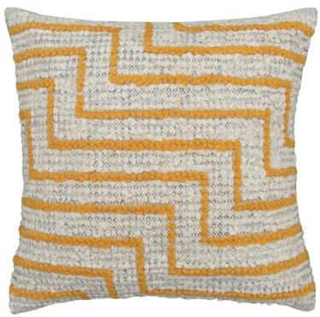
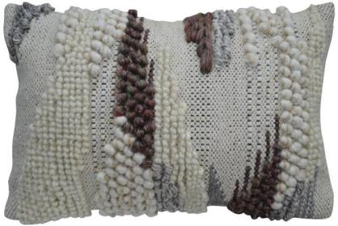
STYLE NO- CC-21-285
SIZE- 45X45 CM
DESCRIPTION- ABSTRCAT LOOP PATTERN CUSHION
TECHNIQUE-WOVEN
MATERIAL-COTTON
STYLE NO- CC-21-187
SIZE- 30X50 CM
DESCRIPTION- ABSTRCAT LOOP PATTERN CUSHION
TECHNIQUE-WOVEN
MATERIAL-COTTON+WOOL

Slide 22
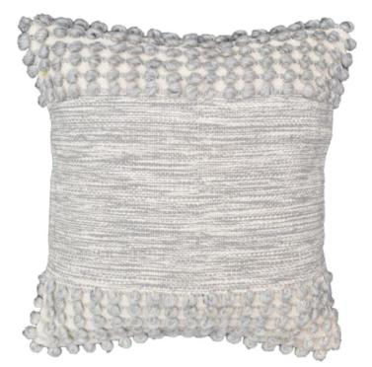
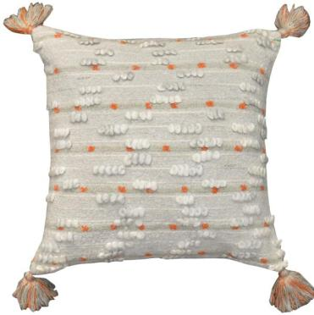
STYLE NO- CC-21-358
SIZE- 45X45 CM
DESCRIPTION-MELANGE TEXTURE WITH LOOP STRIPE CUSHION
TECHNIQUE-WOVEN
MATERIAL-COTTON
STYLE NO- CC-21-261
SIZE- 45X45 CM
DESCRIPTION- APSTRACT LOOP PATTERN CUSHION
TECHNIQUE-WOVEN
MATERIAL-COTTON

Slide 23
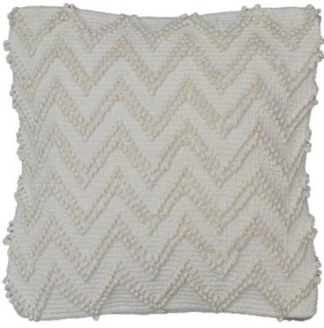
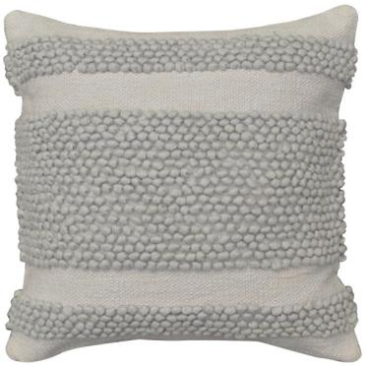
STYLE NO- CC-21-352
SIZE- 45X45 CM
DESCRIPTION-LOOP CHEVRON PATTERN CUSHION
TECHNIQUE-WOVEN
MATERIAL-COTTON
STYLE NO- CC-21-367
SIZE- 45X45 CM
DESCRIPTION-LOOP STRIPE PATTERN CUSHION
TECHNIQUE-WOVEN
MATERIAL-POLYESTER+COTTON

Slide 24
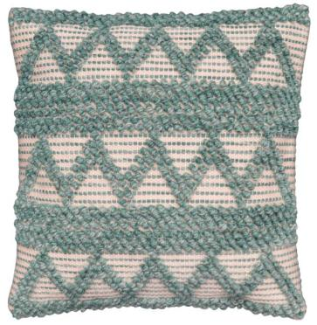
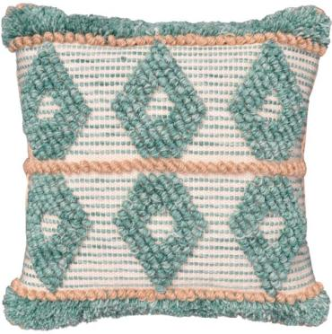
STYLE NO- CC-21-383
SIZE- 45X45 CM
DESCRIPTION- LOOP CHEVRON STRIPE PATTERN CUSHION
TECHNIQUE-WOVEN
MATERIAL-PET
STYLE NO- CC-21-384
SIZE- 45X45 CM
DESCRIPTION- LOOP DIAMOND PATTERN CUSHION
TECHNIQUE-WOVEN
MATERIAL-PET

Slide 25


STYLE NO- CC-19-3341
SIZE- 45X45 CM
DESCRIPTION-LOOP TRIANGLE CUSHION
TECHNIQUE-TUFTED
MATERIAL-POLYESTER
STYLE NO- CC-18-1792
SIZE- 45X45 CM
DESCRIPTION- ALL OVER LOOP PATTERN CUSHION
TECHNIQUE-TUFTED
MATERIAL-POLYESTER

Slide 26


STYLE NO- CC-19-3507
SIZE- 45X45 CM
DESCRIPTION- LOOP PATTERN CUSHION
TECHNIQUE-TUFTED
MATERIAL-COTTON
STYLE NO- CC-18-2343
SIZE- 45X45 CM
DESCRIPTION- IRREGULAR LOOP PATTERN CUSHION
TECHNIQUE-TUFTED
MATERIAL-COTTON

Slide 27


STYLE NO- CC-19-3180
SIZE- 30X50 CM
DESCRIPTION- STRIPE PATTERN CUSHION
TECHNIQUE-WOVEN
MATERIAL-COTTON
STYLE NO- CC-19-3182
SIZE- 45X45 CM
DESCRIPTION- ABSTRCAT PATTERN CUSHION
TECHNIQUE-WOVEN
MATERIAL-COTTON+WOOL

Slide 28


STYLE NO- CC-19-3107
SIZE- 45X45 CM
DESCRIPTION- DIAMOND LOOP PATTERN CUSHION
TECHNIQUE-WOVEN
MATERIAL-COTTON
STYLE NO- CC-21-08
SIZE- 45X45 CM
DESCRIPTION- MELANGE PATTER STRIPE CUSHION
TECHNIQUE-WOVEN
MATERIAL-COTTON

Slide 29


STYLE NO- CC-19-3386
SIZE- 45X45 CM
DESCRIPTION- DIAMOND LOOP PATTERN CUSHION
TECHNIQUE-WOVEN
MATERIAL-COTTON
STYLE NO- CC-19-3394
SIZE- 45X45 CM
DESCRIPTION- LOOP PATTERN CUSHION
TECHNIQUE- WOVEN
MATERIAL- POLYESTER+COTTON

Slide 30


STYLE NO- CC-21-263
SIZE- 45X45 CM
DESCRIPTION- MELANGE TEXTURE PATTERN CUSHION
TECHNIQUE-WOVEN
MATERIAL- COTTON
STYLE NO- CC-21-332
SIZE- 30X50 CM
DESCRIPTION- IRREGULAR PATTERN CUSHION
TECHNIQUE-WOVEN
MATERIAL- COTTON

Slide 31


STYLE NO- CC-21-340
SIZE- 45X45 CM
DESCRIPTION- BROKEN STRIPE PATTERN CUSHION
TECHNIQUE-WOVEN
MATERIAL- COTTON
STYLE NO- CC-21-238
SIZE- 45X45 CM
DESCRIPTION- STRIPE PATTERN CUSHION
TECHNIQUE-WOVEN
MATERIAL- COTTON+POLYESTER

Slide 32


STYLE NO- CC-21-337
SIZE- 45X45 CM
DESCRIPTION- STRIPE PATTERN CUSHION
TECHNIQUE-WOVEN
MATERIAL-COTTON
STYLE NO- CC-21-283
SIZE- 45X45 CM
DESCRIPTION- BRAIDED ABSTRACT PATTERN CUSHION
TECHNIQUE-DORI APPLIQUE
MATERIAL-COTTON

Slide 33


STYLE NO- CC-21-342
SIZE- 45X45 CM
DESCRIPTION- DISTRESS PATTERN CUSHION
TECHNIQUE-WOVEN
MATERIAL-COTTON
STYLE NO- CC-21-341
SIZE- 45X45 CM
DESCRIPTION- IRREGULAR PATTERN CUSHON
TECHNIQUE-WOVEN
MATERIAL-COTTON

Slide 34


STYLE NO- CC-21-156
SIZE- 45X45 CM
DESCRIPTION- CHEVRON PATTERN CUSHION
TECHNIQUE-DORI APPLIQUE
MATERIAL-COTTON
STYLE NO- CC-21-178
SIZE- 45X45 CM
DESCRIPTION- DIAMOND LOOP PATTERN CUSHION
TECHNIQUE-WOVEN
MATERIAL-COTTON

Slide 35


STYLE NO- CC-21-203
SIZE- 45X45 CM
DESCRIPTION-AZTEC PATTERN CUSHION
TECHNIQUE-WOVEN
MATERIAL-COTTON+JUTE
STYLE NO- CC-19-3499
SIZE- 45X45 CM
DESCRIPTION- STRIPE PATTERN CUSHION
TECHNIQUE-WOVEN
MATERIAL-COTTON+JUTE

Slide 36


STYLE NO- CC-21-339
SIZE- 45X45 CM
DESCRIPTION-GEO FRET PATTERN CUSHION
TECHNIQUE-EMBROIDERED+TUFTED
MATERIAL-COTTON
STYLE NO- CC-21-346
SIZE- 45X45 CM
DESCRIPTION- BOHO PATTERN CUSHION
TECHNIQUE-WOVEN
MATERIAL-COTTON

Slide 37


STYLE NO- CC-21-363
SIZE- 45X45 CM
DESCRIPTION- AZTEC PATTERN CUSHION
TECHNIQUE-WOVEN
MATERIAL-COTTON
STYLE NO- CC-21-327
SIZE- 30X50 CM
DESCRIPTION- AZTEC PATTERN CUSHION
TECHNIQUE-EMBROIDERED
MATERIAL-COTTON

Slide 38


STYLE NO- CC-21-326
SIZE- 30X50 CM
DESCRIPTION- AZTEC PATTERN CUSHION
TECHNIQUE-WOVEN
MATERIAL-COTTON CHENILLE
STYLE NO- CC-21-323
SIZE- 30X50 CM
DESCRIPTION- AZTEC PATTERN CUSHION
TECHNIQUE-EMBROIDERED
MATERIAL-COTTON

Slide 39


STYLE NO- CC-21-325
SIZE- 30X50 CM
DESCRIPTION- AZTEC PATTERN CUSHION
TECHNIQUE-WOVEN
MATERIAL-COTTON
STYLE NO- CC-21-324
SIZE- 30X50 CM
DESCRIPTION- BRAIDED DIAMOND PATTERN CUSHION
TECHNIQUE-WOVEN
MATERIAL-COTTON+PLYESTER

Slide 40


STYLE NO- CC-19-3412
SIZE- 45X45 CM
DESCRIPTION- TUFTED STRIPE PATTERN CUSHION
TECHNIQUE-WOVEN
MATERIAL-COTTON+PLYESTER
STYLE NO- CC-19-3411
SIZE- 45X45 CM
DESCRIPTION- ABSTRACT PATTERN CUSHION
TECHNIQUE-WOVEN
MATERIAL-COTTON+PLYESTER

Slide 41


STYLE NO- CC-19-3398
SIZE- 45X45 CM
DESCRIPTION-LOOP STRIPE PATTERN CUSHION
TECHNIQUE-WOVEN
MATERIAL-COTTON+PLYESTER
STYLE NO- CC-21-198D
SIZE- 45X45 CM
DESCRIPTION- LOOP STRIPE PATTERN CUSHION
TECHNIQUE-WOVEN
MATERIAL-COTTON+PLYESTER

Slide 42


STYLE NO- CC-18-2612
SIZE- 45X45 CM
DESCRIPTION- LOOP STRIPE CHEVRON PATTERN CUSHION
TECHNIQUE-WOVEN
MATERIAL-COTTON+PLYESTER
STYLE NO- CC-18-2595
SIZE- 30X50 CM
DESCRIPTION-LOOP DIAMOND PATTERN CUSHION
TECHNIQUE-WOVEN
MATERIAL-COTTON+PLYESTER

Slide 43


STYLE NO- CC-18-2600
SIZE- 45X45 CM
DESCRIPTION-LOOP STRIPE AND DIAMOND PATTERN CUSHION
TECHNIQUE-WOVEN
MATERIAL-COTTON+PLYESTER
STYLE NO- CC-18-2601
SIZE- 45X45 CM
DESCRIPTION- LOOP STRIPE PATTERN CUSHION
TECHNIQUE-WOVEN
MATERIAL-COTTON+PLYESTER

Slide 44


STYLE NO- CC-21-67
SIZE- 45X45 CM
DESCRIPTION- IRREGULAR CHEVRON PATTERN CUSHION
TECHNIQUE- DORI APPLIQUE
MATERIAL- COTTON
STYLE NO- CC-21-157
SIZE- 45X45 CM
DESCRIPTION- BOHO PATTERN CUSHION
TECHNIQUE- DORI APPLIQUE
MATERIAL- COTTON

Slide 45


STYLE NO- CC-21-153
SIZE- 45X45 CM
DESCRIPTION- GEO FRET PATTERN CUSHION
TECHNIQUE- DORI APPLIQUE
MATERIAL- COTTON
STYLE NO- CC-21-144
SIZE- 45X45 CM
DESCRIPTION- BOHO PATTERN CUSHION
TECHNIQUE- DORI APPLIQUE
MATERIAL- COTTON

Slide 46


STYLE NO- CC-21-164
SIZE- 45X45 CM
DESCRIPTION- BROKEN STRIPE BLOCK PATTERN CUSHION
TECHNIQUE- DORI APPLIQUE
MATERIAL- COTTON VELVET
STYLE NO- CC-21-163
SIZE- 45X45 CM
DESCRIPTION- ABSTRACT LEAF CUSHION
TECHNIQUE- DORI APPLIQUE
MATERIAL- COTTON VELVET

Slide 47


STYLE NO- CC-21-391
SIZE- 45X45 CM
DESCRIPTION- DISTRESS PATTERN CUSHION
TECHNIQUE-WOVEN
MATERIAL-JUTE
STYLE NO- CC-21-392
SIZE- 45X45 CM
DESCRIPTION- CHEVRON PATTERN CUSHION
TECHNIQUE-WOVEN
MATERIAL-JUTE+COTTON

Slide 48


STYLE NO- CC-21-289
SIZE- 45X45 CM
DESCRIPTION- STRIPE PATTERN CUSHION
TECHNIQUE-WOVEN
MATERIAL-JUTE
STYLE NO- CC-21-390
SIZE- 45X45 CM
DESCRIPTION- GEO FRET PATTREN CUSHION
TECHNIQUE-WOVEN
MATERIAL-COTTON+JUTE

Slide 49


STYLE NO- CC-21-432
SIZE- 45X45 CM
DESCRIPTION- BROKEN DIAMOND PATTERN CUSHION
TECHNIQUE-WOVEN
MATERIAL-COTTON
STYLE NO- CC-21-398
SIZE- 45X45 CM
DESCRIPTION- SEMI CIRCLE PATTERN CUSHION
TECHNIQUE-WOVEN
MATERIAL-COTTON

Slide 50


STYLE NO- CC-21-293
SIZE- 45X45 CM
DESCRIPTION- DIAMOND PATTERN CUSHION
TECHNIQUE-WOVEN
MATERIAL-COTTON
STYLE NO- CC-21-310
SIZE- 45X45 CM
DESCRIPTION- CHEVRON PATTERN CUSHION
TECHNIQUE-WOVEN
MATERIAL-COTTON

Slide 51


STYLE NO- CC-21-370
SIZE- 45X45 CM
DESCRIPTION-ETHNO PATTERN CUSHION
TECHNIQUE-WOVEN
MATERIAL-COTTON
STYLE NO- CC-21-349
SIZE- 45X45 CM
DESCRIPTION- DIAMOND STRIPE PATTERN CUSHION
TECHNIQUE-WOVEN
MATERIAL-COTTON

Slide 52


STYLE NO- CC-21-381
SIZE- 45X45 CM
DESCRIPTION- ETHNO PATTERN CUSHION
TECHNIQUE-WOVEN
MATERIAL-COTTON
STYLE NO- CC-21-395
SIZE- 45X45 CM
DESCRIPTION- BROKEN STRIPE PATTERN CUSHION
TECHNIQUE-WOVEN
MATERIAL-COTTON

Slide 53


STYLE NO- CC-21-407
SIZE- 45X45 CM
DESCRIPTION- ABSTRACT PATTERN CUSHION
TECHNIQUE-WOVEN
MATERIAL-PET
STYLE NO- CC-21-454
SIZE- 30X50 CM
DESCRIPTION- ABSTRACT PATTERN CUSHION
TECHNIQUE-WOVEN
MATERIAL-PET

Slide 54


STYLE NO- CC-21-260
SIZE- 45X45 CM
DESCRIPTION- CHEVRON PATTERN CUSHION
TECHNIQUE- WOVEN
MATERIAL-JUTE
STYLE NO- CC-21-274B
SIZE- 30X50 CM
DESCRIPTION- LOOP PATTERN CUSHION
TECHNIQUE- WOVEN
MATERIAL-COTTON

Slide 55


STYLE NO- CC-21-142
SIZE- 45X45 CM
DESCRIPTION- IRREGULAR STRIPE PATTERN CUSHION
TECHNIQUE-TUFTED
MATERIAL-COTTON
STYLE NO- CC-21-143
SIZE- 45X45 CM
DESCRIPTION- BOHO PATTERN CUSHION
TECHNIQUE-TUFTED
MATERIAL-COTTON

Slide 56


STYLE NO- CC-21-68
SIZE- 45X45 CM
DESCRIPTION-IRREGULAR STRIPE PATTERN CUSHION
TECHNIQUE-TUFTED
MATERIAL-COTTON
STYLE NO- CC-21-201
SIZE- 45X45 CM
DESCRIPTION- ABSTRCAT PATTERN CUSHION
TECHNIQUE-TUFTED
MATERIAL-COTTON

Slide 57


STYLE NO- CC-18-1904
SIZE- 30X50 CM
DESCRIPTION-GRAIDEND PATTERN CUSHION
TECHNIQUE-WOVEN
MATERIAL- COTTON
STYLE NO- CC-18-1914
SIZE- 45X45 CM
DESCRIPTION- WASEN CUSHION
TECHNIQUE-WASHED
MATERIAL- COTTON

Slide 58


STYLE NO- CC-21-444
SIZE- 45X45 CM
DESCRIPTION- BLOCK PATTREN CUSHION TECHNIQUE-WOVEN
MATERIAL- COTTON
STYLE NO- CC-21-445
SIZE- 45X45 CM
DESCRIPTION- CHECK PATTERN CUSHION
TECHNIQUE-WOVEN
MATERIAL- COTTON

Slide 59


STYLE NO- CC-21-448
SIZE- 45X45 CM
DESCRIPTION- STRIPE PATTERN CUSHION
TECHNIQUE-WOVEN
MATERIAL- COTTON
STYLE NO- CC-21-450
SIZE- 45X45 CM
DESCRIPTION- STRIPE PATTERN CUSHION
TECHNIQUE-WOVEN
MATERIAL- COTTON

Slide 60


STYLE NO- CC-21-452
SIZE- 45X45 CM
DESCRIPTION- CHECK PATTERN CUSHION
TECHNIQUE-PRINTED
MATERIAL- COTTON
STYLE NO- CC-21-451
SIZE- 45X45 CM
DESCRIPTION- BLOCK PATTERN CUSHION
TECHNIQUE-WOVEN
MATERIAL- COTTON

Slide 61


STYLE NO- CC-21-199
SIZE- 45X45 CM
DESCRIPTION- STRIPE PATTERN CUSHION
TECHNIQUE-WOVEN
MATERIAL- COTTON
STYLE NO- CC-21-443
SIZE- 45X45 CM
DESCRIPTION- BLOCK PATTERN CUSHION
TECHNIQUE-WOVEN
MATERIAL- COTTON

Slide 62


STYLE NO- CC-21-389
SIZE- 45X45 CM
DESCRIPTION-STRIPE PATTERN CUSHION
TECHNIQUE-WOVEN
MATERIAL- COTTON+JUTE
STYLE NO- CC-21-388
SIZE- 45X45 CM
DESCRIPTION-STRIPE PATTERN CUSHION
TECHNIQUE-WOVEN
MATERIAL- COTTON+JUTE

Slide 63


STYLE NO- CC-19-3399
SIZE- 45X45 CM
DESCRIPTION-STRIPE PATTERN CUSHION
TECHNIQUE-WOVEN
MATERIAL-COTTON
STYLE NO- CC-19-3400
SIZE- 45X45 CM
DESCRIPTION-STRIPE PATTERN CUSHION
TECHNIQUE-WOVEN
MATERIAL-COTTON

Slide 64


STYLE NO- CC-18-1859
SIZE- 45X45 CM
DESCRIPTION-STRIPE PATTERN CUSHION
TECHNIQUE-PRINT
MATERIAL-JUTE
STYLE NO- CC-18-1863
SIZE- 30X50 CM
DESCRIPTION-STRIPE PATTERN CUSHION
TECHNIQUE-PRINT
MATERIAL-LINEN

Slide 65


STYLE NO- CC-21-410
SIZE- 45X45 CM
DESCRIPTION-STRIPE PATTERN CUSHION
TECHNIQUE-WOVEN
MATERIAL- COTTON
STYLE NO- CC-21-301
SIZE- 45X45 CM
DESCRIPTION-STRIPE PATTERN CUSHION
TECHNIQUE-WOVEN
MATERIAL-COTTON+POLYESTER

Slide 66


STYLE NO- CC-19-3001
SIZE- 30X50 CM
DESCRIPTION- DIAMOND PATTERN CUSHION
TECHNIQUE-WOVEN
MATERIAL- COTTON
STYLE NO- CC-19-2998
SIZE- 30X50 CM
DESCRIPTION-DIAMOND STRIPE PATTERN CUSHION
TECHNIQUE-WOVEN
MATERIAL- COTTON

Slide 67


STYLE NO- CC-19-3005
SIZE- 30X50 CM
DESCRIPTION- STRIPE PATTERN CUSHION
TECHNIQUE-WOVEN
MATERIAL- COTTON
STYLE NO- CC-19-3006
SIZE- 30X50 CM
DESCRIPTION- STRIPE PATTERN CUSHION
TECHNIQUE-WOVEN
MATERIAL- COTTON

Slide 68


STYLE NO- CC-19-3033
SIZE- 30X50 CM
DESCRIPTION- STRIPE PATTERN CUSHION
TECHNIQUE-WOVEN
MATERIAL- COTTON
STYLE NO- CC-19-3029
SIZE- 30X50 CM
DESCRIPTION- STRIPE CUSHION
TECHNIQUE-WOVEN
MATERIAL- COTTON

Slide 69


STYLE NO- CC-21-13
SIZE- 45X45 CM
DESCRIPTION- TUFTED CUSHION
TECHNIQUE-WOVEN
MATERIAL-WOOL
STYLE NO- CC-21-41
SIZE- 45X45 CM
DESCRIPTION- BRAIDED STRIPE PATTERN CUSHION
TECHNIQUE-WOVEN
MATERIAL-COTTON+WOOL

Slide 70


STYLE NO- CC-21-254
SIZE- 45X45 CM
DESCRIPTION-CHEVRON PATTERN CUSHION
TECHNIQUE-TUFETD
MATERIAL-COTTON
STYLE NO- CC-21-317
SIZE- 45X45 CM
DESCRIPTION- STRIPE PATTERN CUSHION
TECHNIQUE-TUFETD
MATERIAL-COTTON

Slide 71


STYLE NO- CC-21-252
SIZE- 45X45 CM
DESCRIPTION- DIAMOND PATTERN CUSHION
TECHNIQUE-TUFETD
MATERIAL-COTTON
STYLE NO- CC-21-405
SIZE- 45X45 CM
DESCRIPTION-DIAMOND STRIPE CUSHION
TECHNIQUE-TUFETD
MATERIAL-COTTON

Slide 72


STYLE NO- CC-21-275
SIZE- 45X45 CM
DESCRIPTION-DIAMOND PATTERN CUSHION
TECHNIQUE-TUFTED
MATERIAL-COTTON
STYLE NO- CC-21-307
SIZE- 45X45 CM
DESCRIPTION- BOHO PATTERN CUSHION
TECHNIQUE-EMBROIDERED
MATERIAL-COTTON

Slide 73


STYLE NO- CC-19-3523
SIZE- 45X45 CM
DESCRIPTION- DIAMOND PATTERN CUSHION
TECHNIQUE-TUFTED
MATERIAL-COTTON
STYLE NO- CC-21-196
SIZE- 45X45 CM
DESCRIPTION- SEMI CIRCLE PATTERN CUSHION
TECHNIQUE-TUFTED
MATERIAL-COTTON

Slide 74


STYLE NO- CC-18-1566
SIZE- 45X45 CM
DESCRIPTION- DIAMOND PATTERN CUSHION
TECHNIQUE-TUFTED
MATERIAL-WOOL
STYLE NO- CC-18-2043
SIZE- 45X45 CM
DESCRIPTION- BOHO PATTERN CUSHION
TECHNIQUE-WOVEN
MATERIAL-COTTON

Slide 75


STYLE NO- CC-21-09
SIZE- 45X45 CM
DESCRIPTION- ABSTRACT PATTERN CUSHION
TECHNIQUE-WOVEN+TUFTED
MATERIAL-COTTON
STYLE NO- CC-19-3500
SIZE- 30X50 CM
DESCRIPTION- GEO PATTERN CUSHION
TECHNIQUE-TUFTED
MATERIAL-COTTON

Slide 76


STYLE NO- CC-21-133
SIZE- 45X45 CM
DESCRIPTION- FLORAL PATTERN CUSHION TECHNIQUE-PRINTED
MATERIAL-COTTON
STYLE NO- CC-21-147
SIZE- 45X45 CM
DESCRIPTION- FLORAL PATTERN CUSHION
TECHNIQUE-PRINTED
MATERIAL-COTTON

Slide 77


STYLE NO- CC-21-139
SIZE- 30X50 CM
DESCRIPTION- LEAF PATTERN CUSHION TECHNIQUE-PRINTED+EMBROIDERED
MATERIAL-COTTON
STYLE NO- CC-21-138
SIZE- 30X50 CM
DESCRIPTION- LEAF PATTERN CUSHION TECHNIQUE-PRINTED+EMBROIDERED
MATERIAL-COTTON

Slide 78


STYLE NO- CC-21-89B
SIZE- 45X45 CM
DESCRIPTION- ABSTRCAT PATTERN CUSHION
TECHNIQUE-PRINTED+TUFTED
MATERIAL-COTTON
STYLE NO- CC-21-88A
SIZE- 45X45 CM
DESCRIPTION- ABSTRCAT PATTERN CUSHION
TECHNIQUE-PRINTED+EMBROIDERED
MATERIAL-COTTON

Slide 79


STYLE NO- CC-21-457
SIZE- 45X45 CM
DESCRIPTION- ABSTRCAT PATTERN CUSHION
TECHNIQUE-PRINTED+EMBROIDERED
MATERIAL-COTTON
STYLE NO- CC-21-458
SIZE- 45X45 CM
DESCRIPTION- ABSTRCAT PATTERN CUSHION
TECHNIQUE-TUFTED+EMBROIDERED
MATERIAL-COTTON

Slide 80


STYLE NO- CC-21-435
SIZE- 45X45 CM
DESCRIPTION- ABSTRCAT PATTERN CUSHION
TECHNIQUE-PRINTED+TUFTED
MATERIAL-COTTON
STYLE NO- CC-21-422
SIZE- 45X45 CM
DESCRIPTION- ABSTRCAT PATTERN CUSHION
TECHNIQUE-PRINTED+TUFTED
MATERIAL-COTTON

Slide 81


STYLE NO- CC-21-456
SIZE- 45X45 CM
DESCRIPTION- ABSTRCAT PATTERN CUSHION
TECHNIQUE-PRINTED+EMBROIDERED
MATERIAL-COTTON
STYLE NO- CC-21-436
SIZE- 45X45 CM
DESCRIPTION- ABSTRCAT PATTERN CUSHION
TECHNIQUE- TUFTED
MATERIAL- COTTON

Slide 82


STYLE NO- CC-18-1037
SIZE- 45X45 CM
DESCRIPTION- STRIPE PATTERN CUSHION
TECHNIQUE-WOVEN
MATERIAL- COTTON
STYLE NO- CC-18-1192
SIZE- 45X45 CM
DESCRIPTION- FRINGES KNOT PATTERN CUSHION
TECHNIQUE-EMBROIDERED
MATERIAL- COTTON

Slide 83


STYLE NO- CC-18-1387
SIZE- 45X45 CM
DESCRIPTION- SELF TEXURE CUSHION
TECHNIQUE-WOVEN
MATERIAL- WOOL
STYLE NO- CC-18-1373
SIZE- 45X45 CM
DESCRIPTION- DIAMOND PATTERN CUSHION
TECHNIQUE-WOVEN
MATERIAL- WOOL

Slide 84


STYLE NO- CC-18-1275
SIZE- 45X45 CM
DESCRIPTION- SELF TEXTURED CUSHION
TECHNIQUE-WOVEN
MATERIAL- WOOL
STYLE NO- CC-18-1380
SIZE- 45X45 CM
DESCRIPTION- SELF TEXTURED CUSHION
TECHNIQUE-WOVEN
MATERIAL- WOOL

Slide 85


STYLE NO- CC-18-1523
SIZE- 45X45 CM
DESCRIPTION- STRIPE PATTERN CUSHION
TECHNIQUE-WOVEN
MATERIAL- JUTE+COTTON
STYLE NO- CC-18-1565
SIZE- 45X45 CM
DESCRIPTION- DIAMOND PATTERN CUSHION
TECHNIQUE-WOVEN
MATERIAL- JUTE+COTTON

Slide 86


STYLE NO- CC-18-2421
SIZE- 45X45 CM
DESCRIPTION- BLOCK PATTERN CUSHION
TECHNIQUE-WOVEN
MATERIAL-WOOL
STYLE NO- CC-18-2493
SIZE- 45X45 CM
DESCRIPTION- TWEED PATTERN CUSHION
TECHNIQUE-WOVEN
MATERIAL-WOOL

Slide 87


STYLE NO- CC-18-2438
SIZE- 30X50 CM
DESCRIPTION- STRIPE PATTERN CUSHION
TECHNIQUE- WOVEN
MATERIAL-LINEN
STYLE NO- CC-18-2434
SIZE- 30X50 CM
DESCRIPTION- STRIPE PATTERN CUSHION
TECHNIQUE- WOVEN
MATERIAL-LINEN

Slide 88


STYLE NO- CC-18-2433
SIZE- 45X45 CM
DESCRIPTION- STRIPE PATTERN CUSHION
TECHNIQUE-FLANGE
MATERIAL-LINEN
STYLE NO- CC-18-2443
SIZE- 30X50 CM
DESCRIPTION- STRIPE PATTERN CUSHION
TECHNIQUE-WOVEN
MATERIAL-LINEN

Slide 89


STYLE NO- CC-18-2195
SIZE- 45X45 CM
DESCRIPTION- SOLID PLAIN CUSHION
TECHNIQUE-WOVEN
MATERIAL-LINEN
STYLE NO- CC-18-2287
SIZE- 45X45 CM
DESCRIPTION- BLOCK PATTERN CUSHION
TECHNIQUE-WOVEN
MATERIAL-LINEN

Slide 90


STYLE NO- CC-18-2432
SIZE- 45X45 CM
DESCRIPTION- STRIPE PATTERN CUSHION
TECHNIQUE-WOVEN
MATERIAL-COTTON
STYLE NO- CC-18-2168
SIZE- 45X45 CM
DESCRIPTION-DISTRESS PATTERN CUSHION
TECHNIQUE-WOVEN
MATERIAL-COTTON+JUTE

Slide 91


STYLE NO- CC-18-1367
SIZE- 45X45 CM
DESCRIPTION- MATTY PATTERN CUSHION WITH FLANGE ON EMBROIDERED
TECHNIQUE- FLANGE ON EMBROIDERED
MATERIAL-COTTON
STYLE NO- CC-18-1503
SIZE- 45X45 CM
DESCRIPTION- SOLID PALIN CUSHION WITH FLANGE ON EMBROIDERED
TECHNIQUE- FLANGE ON EMBROIDERED
MATERIAL-COTTON

Slide 92


STYLE NO- CC-18-1132
SIZE- 45X45 CM
DESCRIPTION- SOLID PALIN CUSHION WITH FLANGE ON EMBROIDERED
TECHNIQUE- PRINTED WITH FLNAGE BLANKET EMBROIDERED
MATERIAL- COTTON
STYLE NO- CC-18-1505
SIZE- 45X45 CM
DESCRIPTION- SOLID PALIN CUSHION WITH FLANGE
TECHNIQUE- WOVEN WITH FLANGE
MATERIAL-COTTON

Slide 93


STYLE NO- CC-18-2719
SIZE- 45X45 CM
DESCRIPTION- STRIPE PATTERN CUSHION
TECHNIQUE-EMBROIDERED
MATERIAL- COTTON
STYLE NO- CC-18-2724
SIZE- 45X45 CM
DESCRIPTION- CROSS PATTERN CUSHION
TECHNIQUE-EMBROIDERED
MATERIAL- COTTON VELVET

Slide 94


STYLE NO- CC-19-3409
SIZE- 45X45 CM
DESCRIPTION- BOHO PATTERN CUSHION
TECHNIQUE- EMBROIDERED
MATERIAL- COTTON
STYLE NO- CC-19-3504
SIZE- 45X45 CM
DESCRIPTION- BOHO PATTERN CUSHION
TECHNIQUE- EMBROIDERED
MATERIAL- COTTON

Slide 95


STYLE NO- CC-21-65
SIZE- 45X45 CM
DESCRIPTION- BOHO PATTERN CUSHION
TECHNIQUE- EMBROIDERED WITH FRINGES
MATERIAL- COTTON
STYLE NO- CC-19-3383
SIZE- 45X45 CM
DESCRIPTION- BOHO PATTERN CUSHION
TECHNIQUE- EMBROIDERED WITH FRINGES
MATERIAL- COTTON

Slide 96


STYLE NO- CC-19-2887
SIZE- 45X45 CM
DESCRIPTION- BOHO PATTERN CUSHION
TECHNIQUE- EMBROIDERED WITH FRINGES
MATERIAL- COTTON
STYLE NO- CC-19-2888
SIZE- 45X45 CM
DESCRIPTION- BOHO PATTERN CUSHION
TECHNIQUE- EMBROIDERED WITH FLANGE
MATERIAL- COTTON

Slide 97


STYLE NO- CC-19-3083
SIZE- 45X45 CM
DESCRIPTION- EMB TRIBE PATTERN CUSHION
TECHNIQUE-EMBROIDERED
MATERIAL-COTTON
STYLE NO- CC-18-2551 a
SIZE- 30X50 CM
DESCRIPTION- EMB STRIPE DIAMOND PATTERN CUSHION
TECHNIQUE-EMBROIDERED
MATERIAL-COTTON

Slide 98


STYLE NO- CC-18-2560
SIZE- 45X45 CM
DESCRIPTION- EMB STRIPE PATTERN CUSHION
TECHNIQUE-EMBROIDERED
MATERIAL-COTTON
STYLE NO- CC-19-3073
SIZE- 30X50 CM
DESCRIPTION- EMB GEO PATTERN CUSHION
TECHNIQUE-EMBROIDERED
MATERIAL-COTTON

Slide 99


STYLE NO- CC-19-3431
SIZE- 45X45 CM
DESCRIPTION- GEO FRET PATTERN CUSHION
TECHNIQUE- EMBROIDERED
MATERIAL- COTTON
STYLE NO- CC-19-3433
SIZE- 45X45 CM
DESCRIPTION- GEO PATTERN CUSHION
TECHNIQUE- EMBROIDERED
MATERIAL- COTTON

Slide 100


STYLE NO- CC-21-49
SIZE- 45X45 CM
DESCRIPTION- ETHNO PATTERN CUSHION
TECHNIQUE- EMBROIDERED
MATERIAL- COTTON VELVET
STYLE NO- CC-21-48
SIZE- 45X45 CM
DESCRIPTION- ETHNO PATTERN CUSHION
TECHNIQUE- EMBROIDERED
MATERIAL- COTTON VELVET

Slide 101


STYLE NO- CC-21-52
SIZE- 45X45 CM
DESCRIPTION- LEAF PATTERN CUSHION
TECHNIQUE- EMBROIDERED
MATERIAL- COTTON
STYLE NO- CC-21-47
SIZE- 45X45 CM
DESCRIPTION- LEAF PATTERN CUSHION
TECHNIQUE- EMBROIDERED
MATERIAL- COTTON

Slide 102


STYLE NO- CC-21-176
SIZE- 45X45 CM
DESCRIPTION- LEAF PATTERN CUSHION
TECHNIQUE- EMBROIDERED
MATERIAL- COTTON
STYLE NO- CC-21-179
SIZE- 45X45 CM
DESCRIPTION- LEAF PATTERN CUSHION
TECHNIQUE- EMBROIDERED
MATERIAL- COTTON

Slide 103


STYLE NO- CC-21-361
SIZE- 45X45 CM
DESCRIPTION- AZTEC PATTERN CUSHION
TECHNIQUE-EMBROIDERED
MATERIAL-COTTON
STYLE NO- CC-21-351
SIZE- 45X45 CM
DESCRIPTION- TRIANGLE PATTERN CUSHION
TECHNIQUE-EMBROIDERED
MATERIAL-COTTON

Slide 104


STYLE NO- CC-21-184
SIZE- 45X45 CM
DESCRIPTION- ABSTRACT LEAF PATTERN CUSHION
TECHNIQUE-EMBROIDERED
MATERIAL-COTTON
STYLE NO- CC-21-334
SIZE- 30X50 CM
DESCRIPTION- ABSTRACT FLORAL PATTERN CUSHION
TECHNIQUE-EMBROIDERED+PRINTED
MATERIAL-COTTON

Slide 105


STYLE NO- CC-21-368
SIZE- 45X45 CM
DESCRIPTION- IRREGULAR PATTERN CUSHION
TECHNIQUE-EMBROIDERED
MATERIAL-COTTON
STYLE NO- CC-21-308
SIZE- 45X45 CM
DESCRIPTION- GEO PATTERN CUSHION
TECHNIQUE-EMBROIDERED
MATERIAL-COTTON

Slide 106


STYLE NO- CC-171814
SIZE- 45X45 CM
DESCRIPTION- GEO PATTERN CUSHION
TECHNIQUE-WOVEN
MATERIAL-JUTE +WOOL
STYLE NO- CC-171817
SIZE- 45X45 CM
DESCRIPTION- TILE PATTERN CUSHION
TECHNIQUE-WOVEN
MATERIAL-JUTE +WOOL

Slide 107


STYLE NO- CC-171815
SIZE- 45X45 CM
DESCRIPTION- KILIM PATTERN CUSHION
TECHNIQUE-WOVEN
MATERIAL-JUTE +WOOL
STYLE NO- CC-171816
SIZE- 45X45 CM
DESCRIPTION- KILIM PATTERN CUSHION
TECHNIQUE-WOVEN
MATERIAL-JUTE +WOOL

Slide 108


STYLE NO- CC-888
SIZE- 45X45 CM
DESCRIPTION- DIAMOND PATTERN CUSHION
TECHNIQUE-WOVEN
MATERIAL-COTTON
STYLE NO- CC-18-1379
SIZE- 45X45 CM
DESCRIPTION- GEO DIAMOND PATTERN CUSHION
TECHNIQUE-WOVEN
MATERIAL-COTTON

Slide 109


STYLE NO- CC-171644
SIZE- 30X50 CM
DESCRIPTION- KILIM PATTERN CUSHION
TECHNIQUE-WOVEN
MATERIAL-JUTE +WOOL
STYLE NO- CC-171645
SIZE- 30X50 CM
DESCRIPTION- KILIM PATTERN CUSHION
TECHNIQUE-WOVEN
MATERIAL-JUTE +WOOL

Slide 110


STYLE NO- CC-59
SIZE- 30X50 CM
DESCRIPTION- DIAMOND STRIPE PATTERN CUSHION
TECHNIQUE-WOVEN
MATERIAL-COTTON
STYLE NO- CC-531
SIZE- 45X45 CM
DESCRIPTION- DIAMOND FRET CUSHION
TECHNIQUE-WOVEN
MATERIAL-JUTE

Slide 111


STYLE NO- CC-18-2464
SIZE- 45X45 CM
DESCRIPTION- DIAMOND STRIPE PATTERN CUSHION
TECHNIQUE-WOVEN
MATERIAL-COTTON
STYLE NO- CC-18-2465
SIZE- 45X45 CM
DESCRIPTION- DIAMOND STRIPE PATTERN CUSHION
TECHNIQUE-WOVEN
MATERIAL-COTTON

Slide 112


STYLE NO- CC-19-3021
SIZE- 45X45 CM
DESCRIPTION- DIAMOND STRIPE PATTERN CUSHION
TECHNIQUE-WOVEN
MATERIAL-COTTON
STYLE NO- CC-172756
SIZE- 45X45 CM
DESCRIPTION- GEO PATTERN CUSHION
TECHNIQUE-PRINTED
MATERIAL-COTTON

Slide 113


STYLE NO- CC-951
SIZE- 45X45 CM
DESCRIPTION- DISTRESS PATTERN CUSHION
TECHNIQUE- WOVEN
MATERIAL- ACRYLIC
STYLE NO- CC-952
SIZE- 45X45 CM
DESCRIPTION- DISTRESS PATTERN CUSHION
TECHNIQUE- WOVEN
MATERIAL- ACRYLIC

Slide 114


STYLE NO- CC-976
SIZE- 45X45 CM
DESCRIPTION- STRIPE PATTERN CUSHION
TECHNIQUE- WOVEN
MATERIAL-COTTON+POLYESTER
STYLE NO- CC-1018
SIZE- 45X45 CM
DESCRIPTION- BLOCK PATTERN CUSHION
TECHNIQUE- WOVEN
MATERIAL-WOOL

Slide 115


STYLE NO- CC-171697
SIZE- 45X45 CM
DESCRIPTION-BRAIDED PATTERN CUSHION
TECHNIQUE- WOVEN
MATERIAL- COTTON
STYLE NO- CC-171698
SIZE- 45X45 CM
DESCRIPTION-BRAIDED PATTERN CUSHION
TECHNIQUE- WOVEN
MATERIAL- COTTON

Slide 116


STYLE NO- CC-21-78 B
SIZE- 30X50 CM
DESCRIPTION- TYPO PATTERN CUSHION
TECHNIQUE-EMBROIDERED
MATERIAL-COTTON
STYLE NO- CC-21-77 B
SIZE- 45X45 CM
DESCRIPTION- TYPO PATTERN CUSHION
TECHNIQUE-EMBROIDERED
MATERIAL-COTTON

Slide 117


STYLE NO- CC-21-148
SIZE- 45X45 CM
DESCRIPTION- SNOWFLAKE CUSHION
TECHNIQUE-TUFTED
MATERIAL-COTTON
STYLE NO- CC-21-149
SIZE- 45X45 CM
DESCRIPTION- TYPO PATTERN CUSHION
TECHNIQUE-FOIL PRINT+EMBROIDERED
MATERIAL-COTTON

Slide 118


STYLE NO- CC-21-150
SIZE- 45X45 CM
DESCRIPTION- LEAF PATTERN CUSHION
TECHNIQUE-EMBROIDERED
MATERIAL-COTTON
STYLE NO- CC-21-146
SIZE- 45X45 CM
DESCRIPTION- TREE CUSHION
TECHNIQUE-EMBROIDERED+TASSELS
MATERIAL-COTTON

Slide 119


STYLE NO- CC-21-210
SIZE- 45X45 CM
DESCRIPTION-RAINDEER CUSHION
TECHNIQUE-PATCH+EMBROIDERED
MATERIAL-COTTON
STYLE NO- CC-21-211
SIZE- 45X45 CM
DESCRIPTION-RAINDEER CUSHION
TECHNIQUE-PATCHWORK+EMBROIDERED
MATERIAL-COTTON

Slide 120


STYLE NO- CC-21-75
SIZE- 45X45 CM
DESCRIPTION- TYPO CUSHION
TECHNIQUE-TUFTED
MATERIAL-COTTON
STYLE NO- CC-21-209
SIZE- 45X45 CM
DESCRIPTION- SNOW FLAKE PATTERN CUSHION
TECHNIQUE-EMBROIDERED
MATERIAL-COTTON

Slide 121


STYLE NO- CC-22-01
SIZE- 45X45 CM
DESCRIPTION- STAR PATTERN CUSHION
TECHNIQUE-PRINTED+PATCHWORK
MATERIAL- COTTON
STYLE NO- CC-1460
SIZE- 30X50 CM
DESCRIPTION- TYPO CUSHION
TECHNIQUE-EMBROIDERED
MATERIAL- FELT

Slide 122


STYLE NO- CC-546
SIZE- 30X50 CM
DESCRIPTION- TYPO CUSHION
TECHNIQUE-FRENTKNOT+PATCHWORK
MATERIAL- COTTON
STYLE NO- CC-18-1957
SIZE- 30X50 CM
DESCRIPTION- CHEVRON PATTERN CUSHION
TECHNIQUE-EMBROIDERED+PATCHWORK
MATERIAL- COTTON

Slide 123


STYLE NO- CC-176
SIZE- 45X45 CM
DESCRIPTION- RETRO PATTERN CUSHION
TECHNIQUE-PRINTED+PATCHWORK WITH FLANGE
MATERIAL- COTTON
STYLE NO- CC-177
SIZE- 45X45 CM
DESCRIPTION- RETRO PATTERN CUSHION
TECHNIQUE-PRINTED+PATCHWORK
MATERIAL- COTTON

Slide 124


STYLE NO- CC-18-1310
SIZE- 45X45 CM
DESCRIPTION- TRIBE PATTERN CUSHION
TECHNIQUE-PRINTED
MATERIAL- COTTON
STYLE NO- CC-18-1311
SIZE- 45X45 CM
DESCRIPTION- TRIBE PATTERN CUSHION
TECHNIQUE-PRINTED
MATERIAL- COTTON

Slide 125


STYLE NO- CC-18-1309
SIZE- 45X45 CM
DESCRIPTION- TRIBE PATTERN CUSHION
TECHNIQUE-PRINTED
MATERIAL- COTTON
STYLE NO- CC-18-1768
SIZE- 30X50 CM
DESCRIPTION- TRIBE PATTERN CUSHION
TECHNIQUE-PRINTED
MATERIAL- COTTON

