Slide 1

BATHMATS

Slide 2
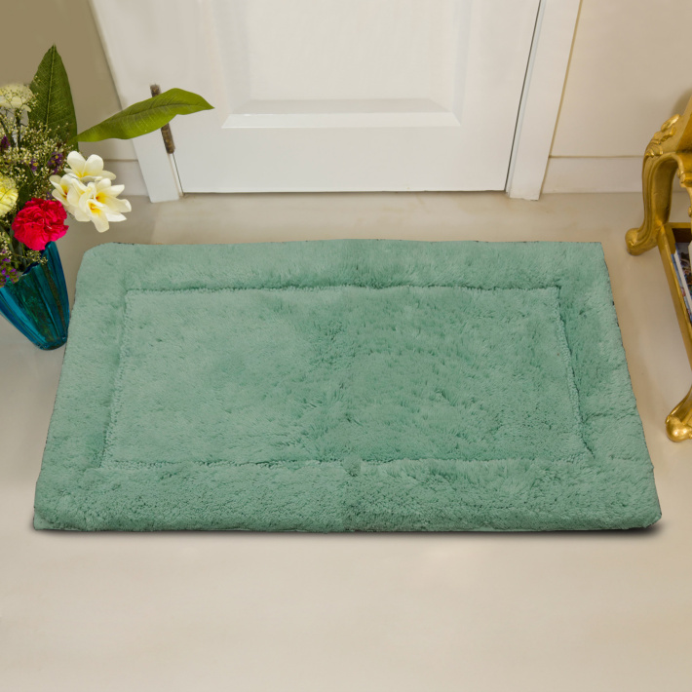
Article No : RT-BM-1234
Article : Tufted Bathmat
Size: 50 x 80 cm
Composition : Cotton
Weight : 220 GSF
MOQ: 300 PCS

Slide 3
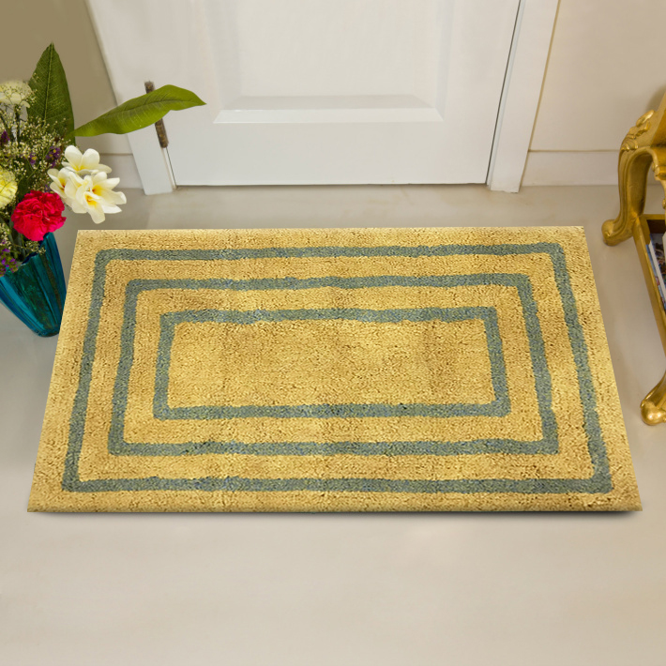
Article No : RT-BM-1235
Article : Tufted Bathmat
Size: 50 x 80 cm
Composition : Cotton
Weight : 220 GSF
MOQ: 300 PCS

Slide 4
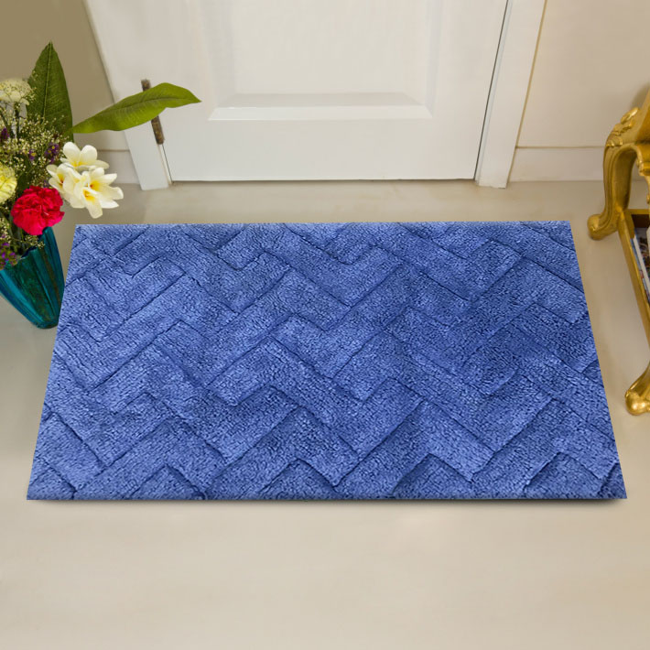
Article No : RT-BM-1236
Article : Tufted Bathmat
Size: 50 x 80 cm
Composition : Cotton
Weight : 220 GSF
MOQ: 300 PCS

Slide 5
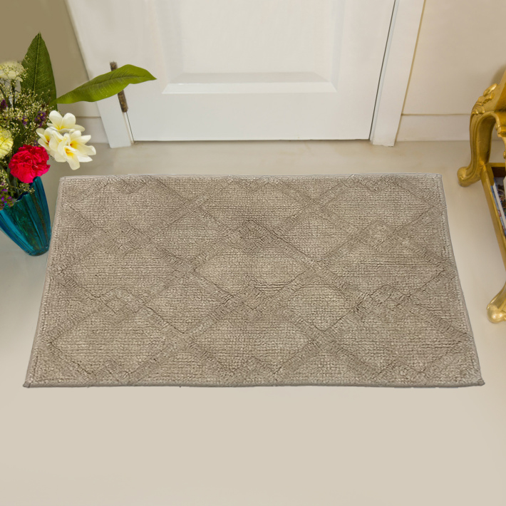
Article No : RT-BM-1237
Article : Tufted Bathmat
Size: 50 x 80 cm
Composition : Cotton
Weight : 220 GSF
MOQ: 300 PCS

Slide 6
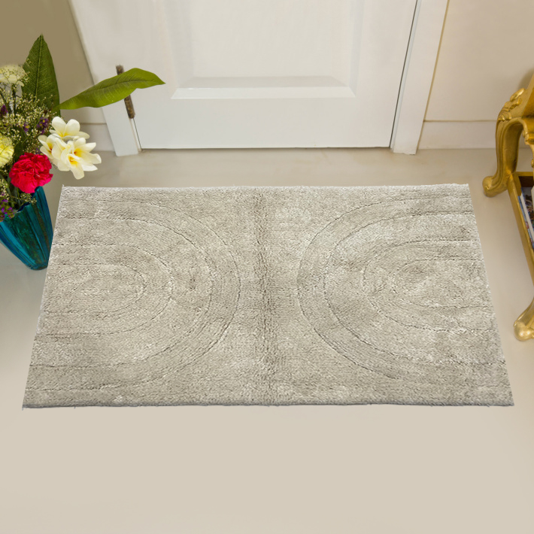
Article No : RT-BM-1238
Article : Tufted Bathmat
Size: 50 x 80 cm
Composition : Cotton
Weight : 220 GSF
MOQ: 300 PCS

Slide 7
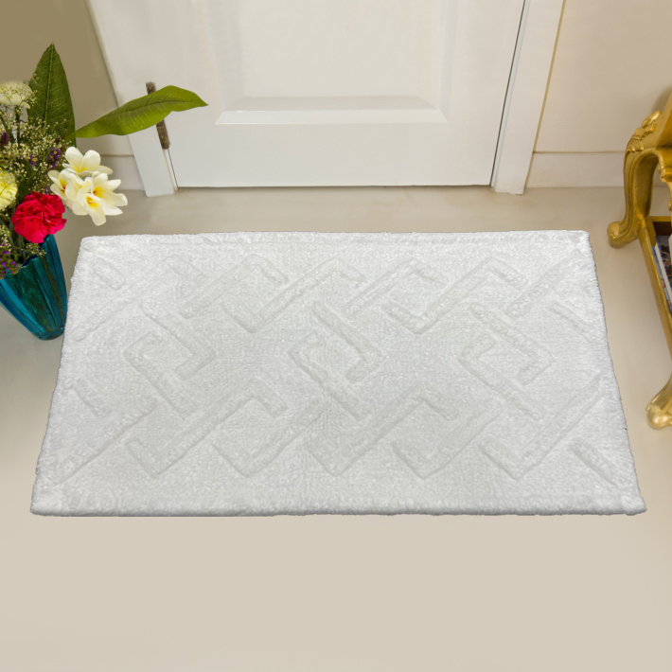
Article No : RT-BM-1239
Article : Tufted Bathmat
Size: 50 x 80 cm
Composition : Cotton
Weight : 220 GSF
MOQ: 300 PCS

Slide 8
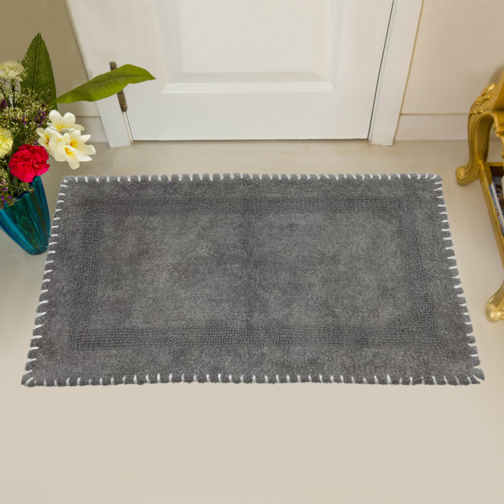
Article No : RT-BM-1240
Article : Tufted Bathmat
Size: 50 x 80 cm
Composition : Cotton
Weight : 220 GSF
MOQ: 300 PCS

Slide 9
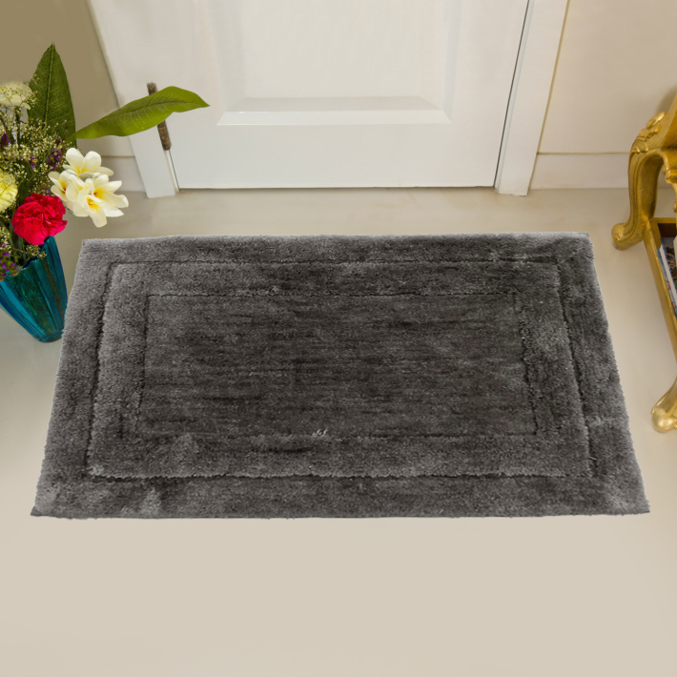
Article No : RT-BM-1241
Article : Tufted Bathmat
Size: 50 x 80 cm
Composition : Cotton
Weight : 220 GSF
MOQ: 300 PCS

Slide 10
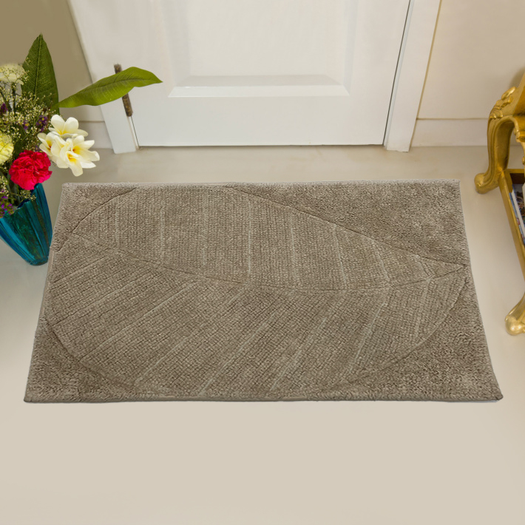
Article No : RT-BM-1242
Article : Tufted Bathmat
Size: 50 x 80 cm
Composition : Cotton
Weight : 220 GSF
MOQ: 300 PCS

Slide 11
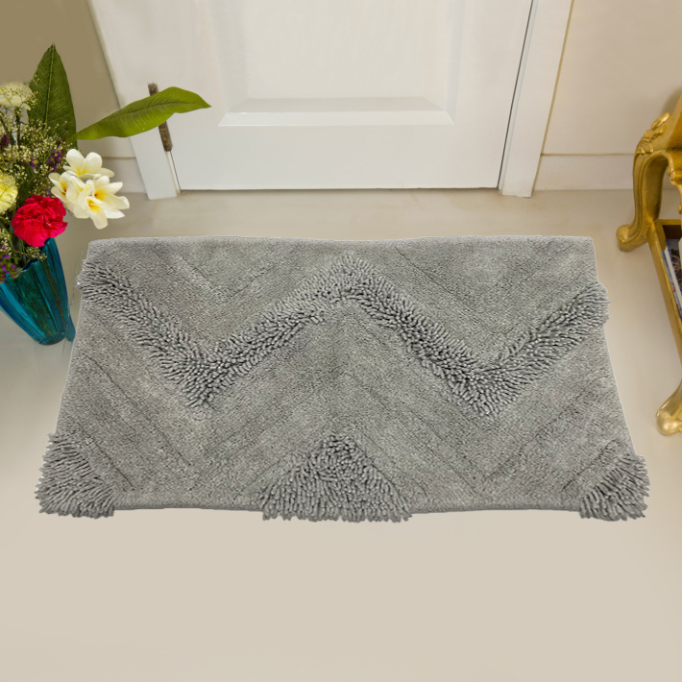
Article No : RT-BM-1243
Article : Tufted Bathmat
Size: 50 x 80 cm
Composition : Cotton
Weight : 220 GSF
MOQ: 300 PCS

