Slide 1
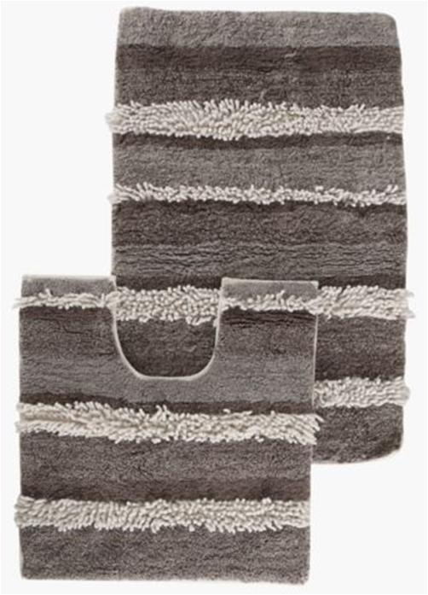
RT- BTR-3488

Slide 2
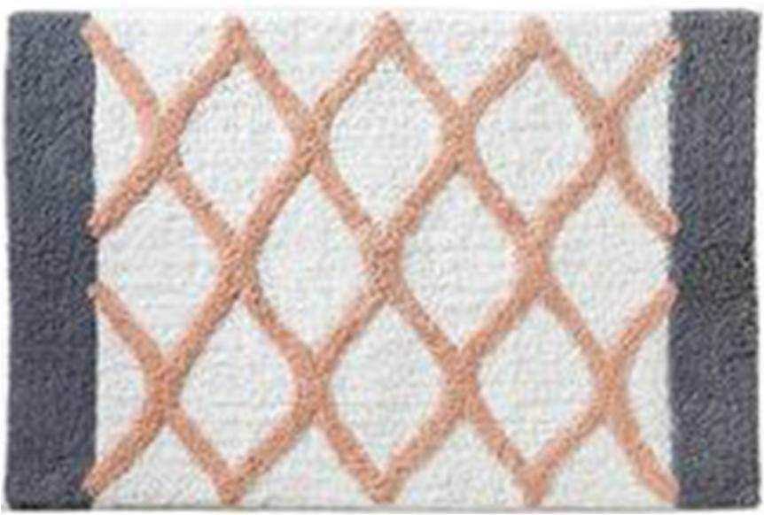
RT- BTR-3489

Slide 3
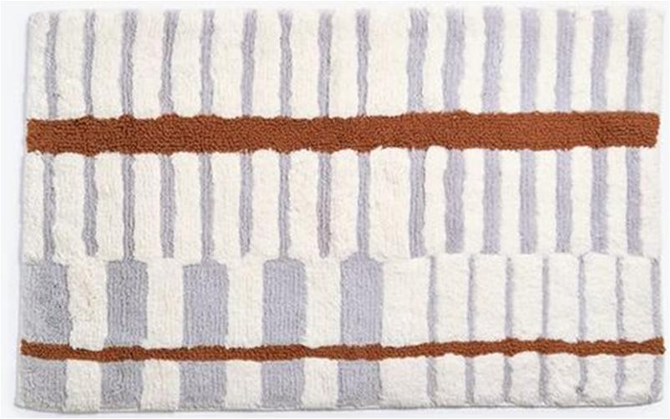
RT- BTR-3490

Slide 4
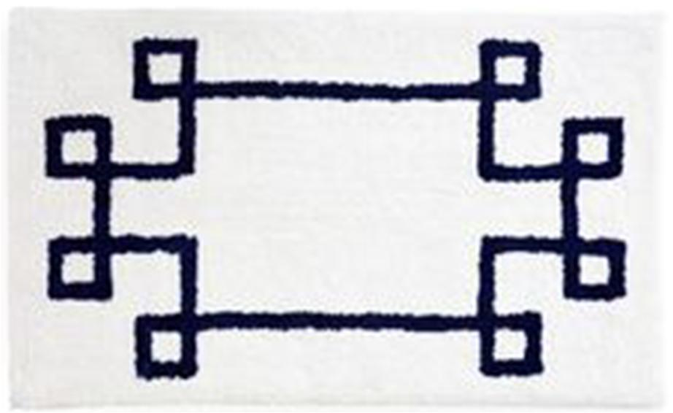
RT- BTR-3491

Slide 5

RT- BTR-3492

Slide 6
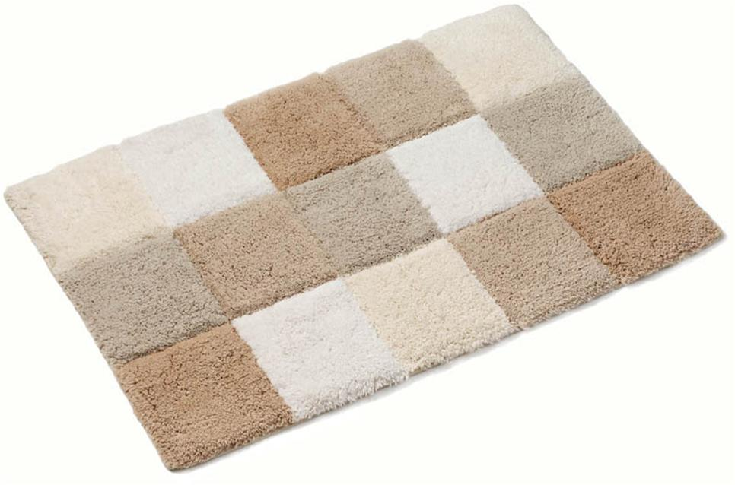
RT- BTR-3493

Slide 7
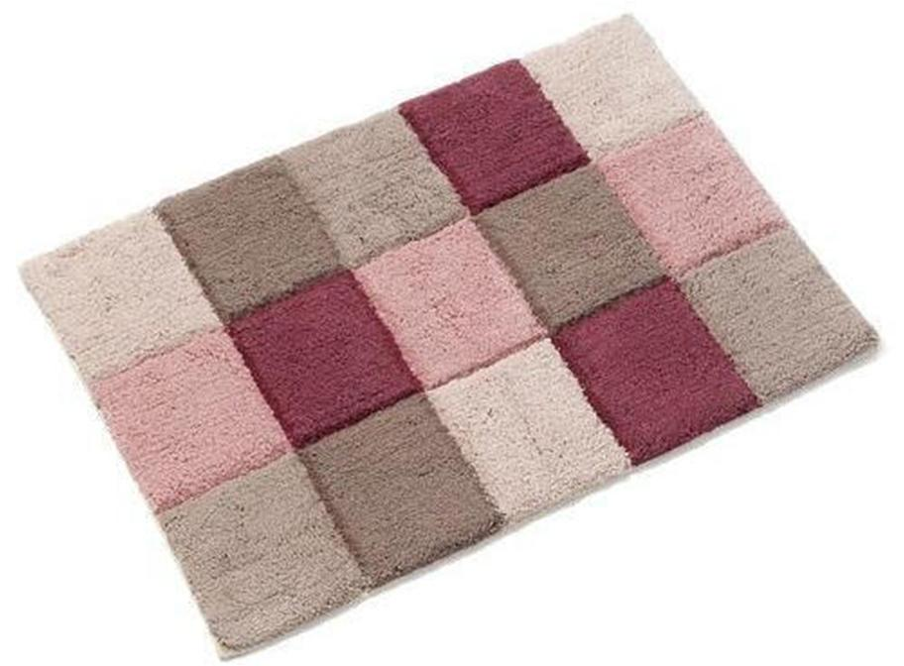
RT- BTR-3494

Slide 8
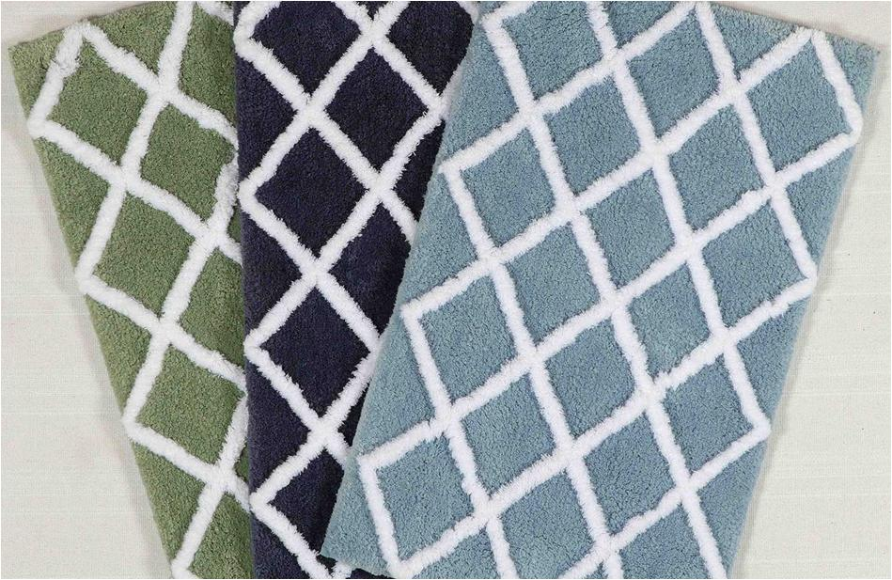
RT- BTR-3495

Slide 9
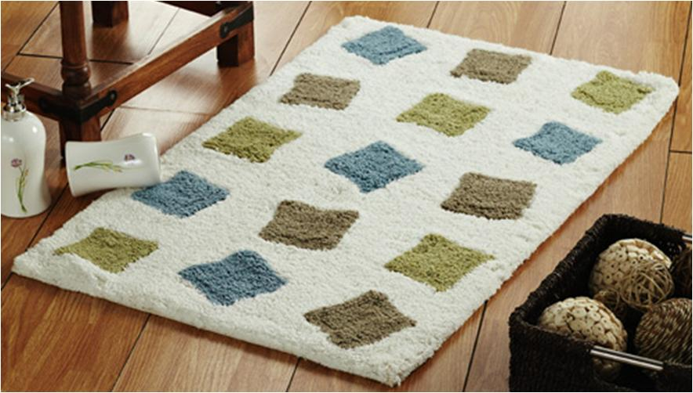
RT- BTR-3496

Slide 10
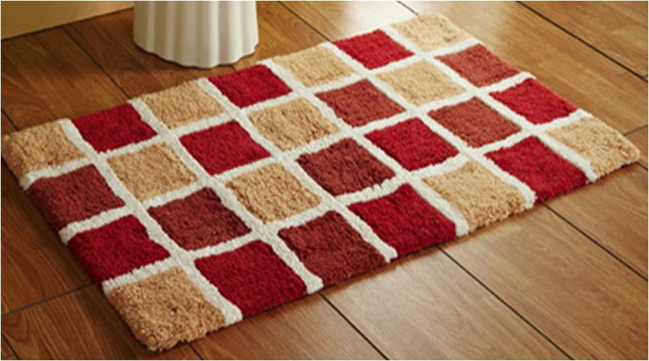
RT- BTR-3497

Slide 11
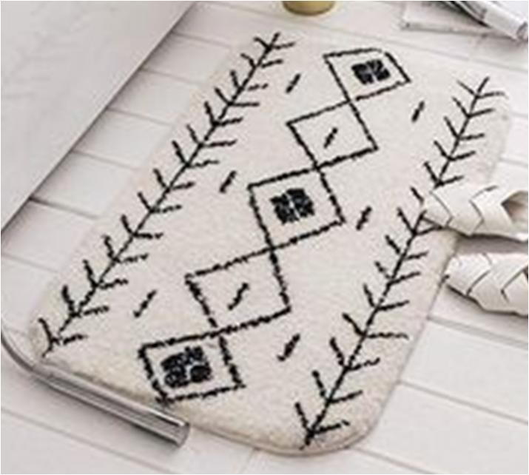
RT- BTR-3498

Slide 12
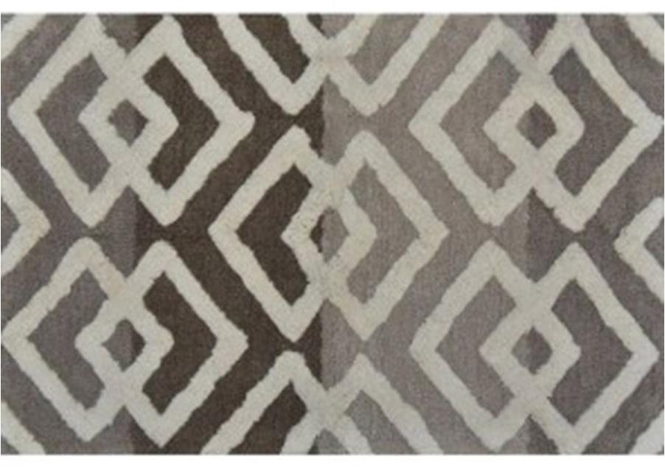
RT- BTR-3499

Slide 13
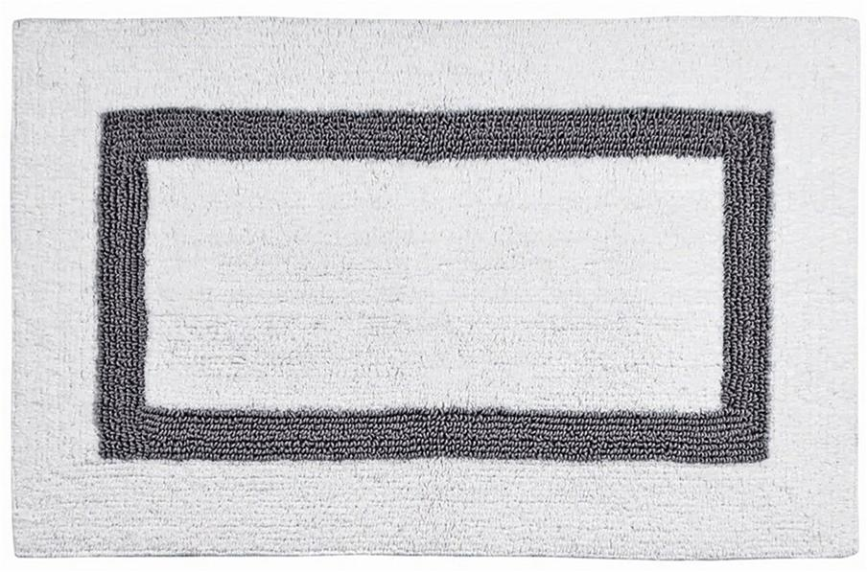
RT- BTR-3500

Slide 14
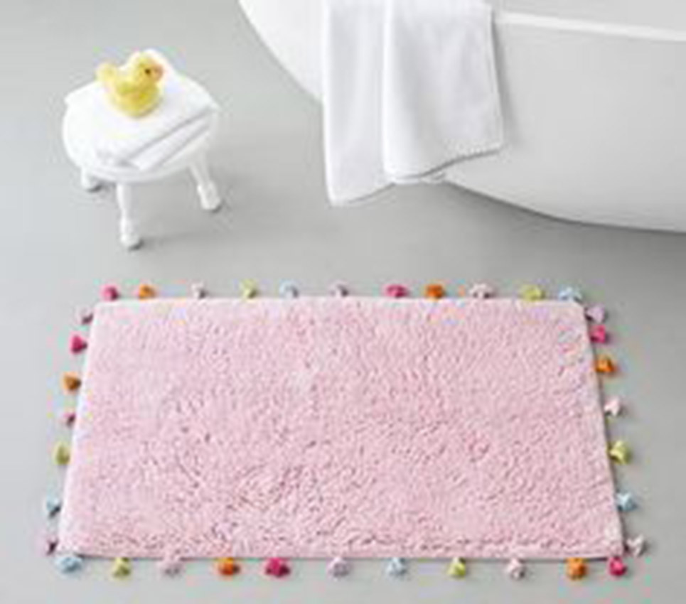
RT- BTR-3501

Slide 15

RT- BTR-3502

Slide 16
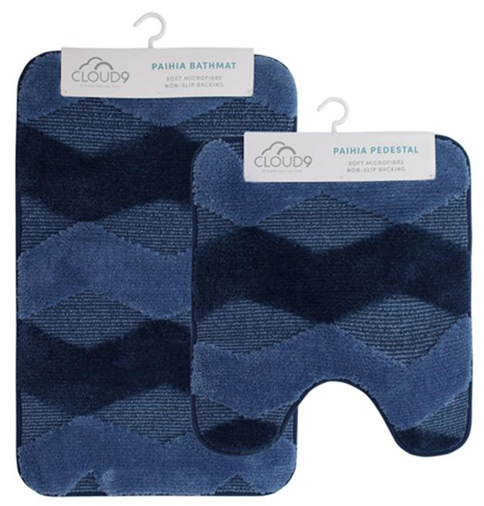
RT- BTR-3503

Slide 17
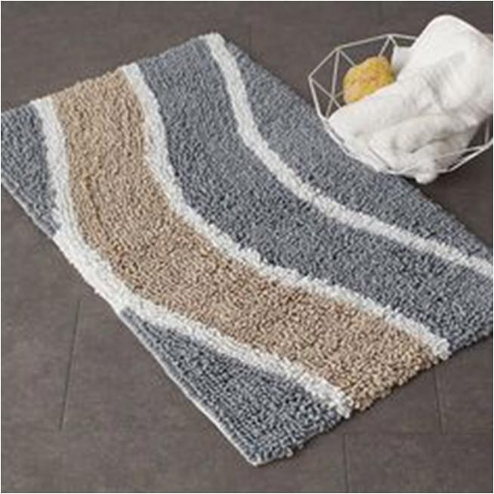
RT- BTR-3504

Slide 18

RT- BTR-3505

Slide 19

RT- BTR-3506

Slide 20
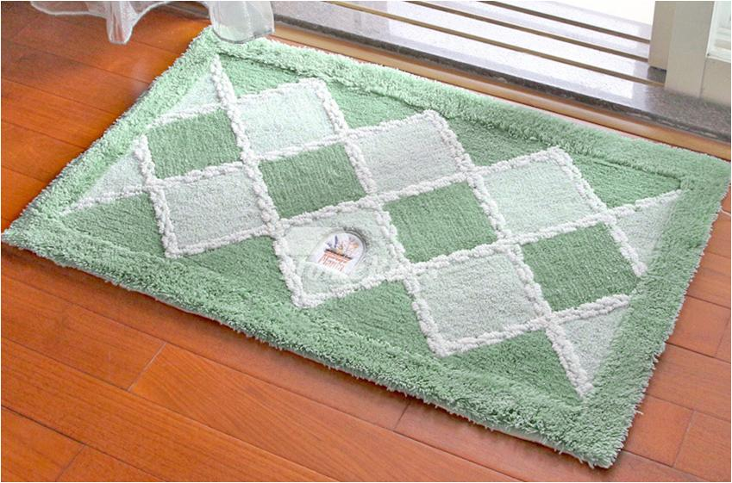
RT- BTR-3507

Slide 21

RT- BTR-3508

Slide 22
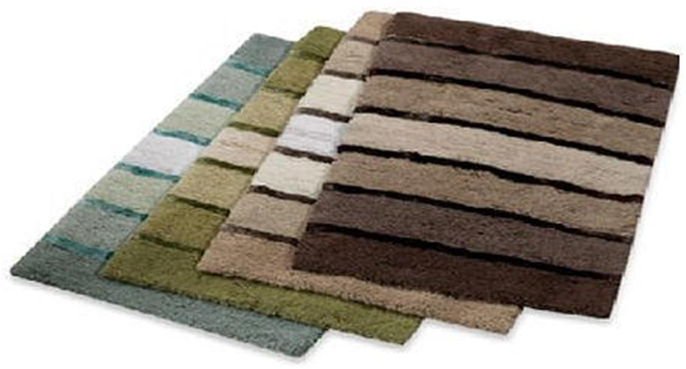
RT- BTR-3509

Slide 23
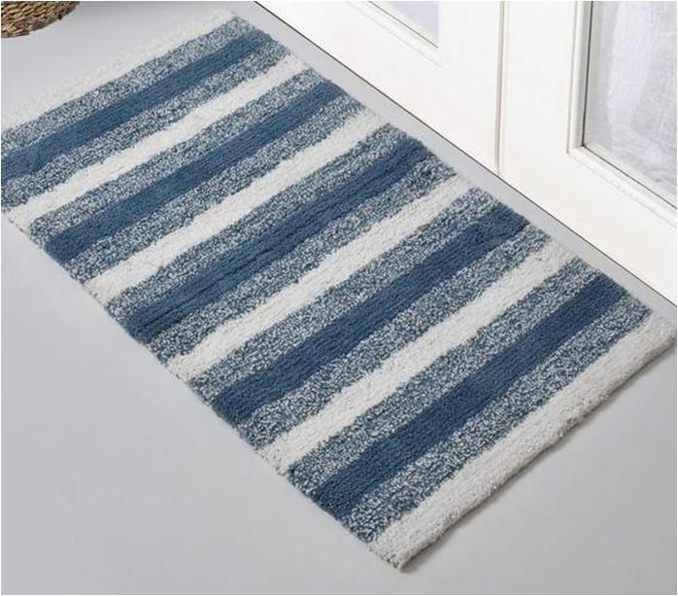
RT- BTR-3510

Slide 24
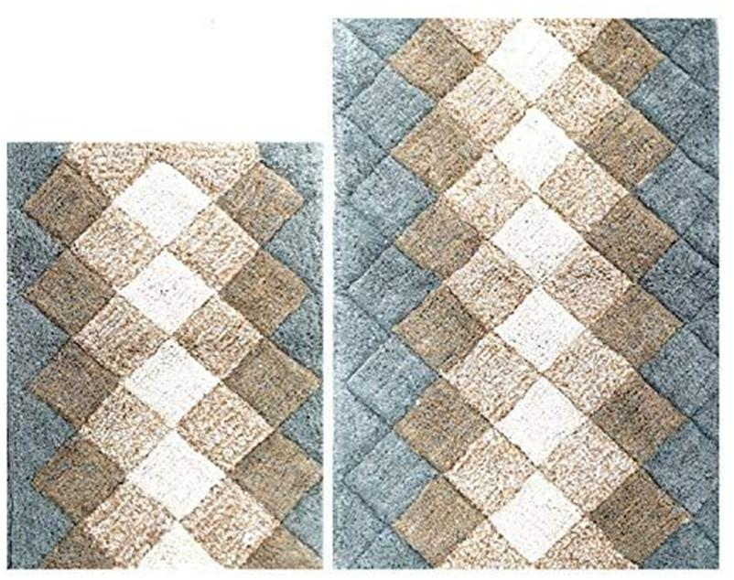
RT- BTR-3511

Slide 25
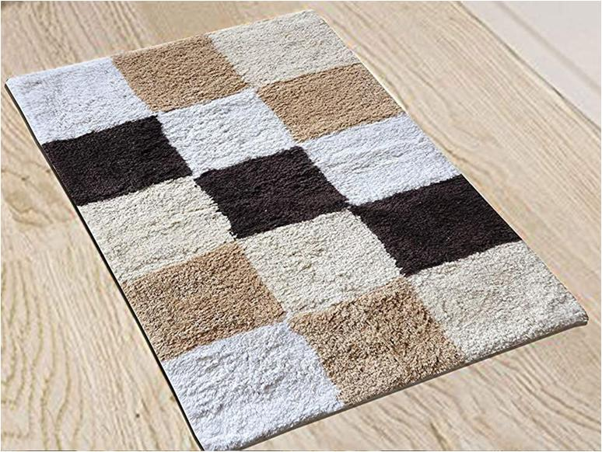
RT- BTR-3512

Slide 26
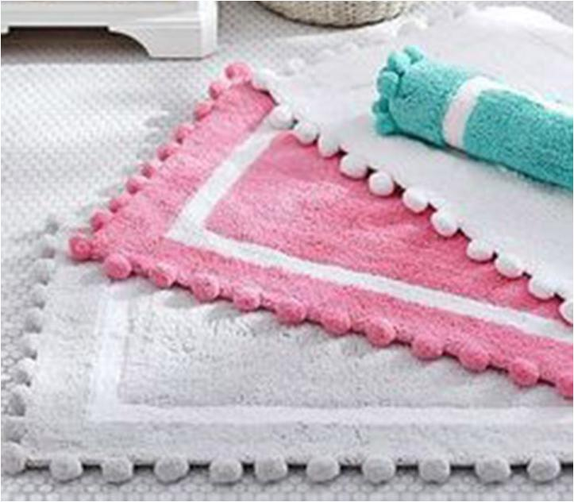
RT- BTR-3513

Slide 27
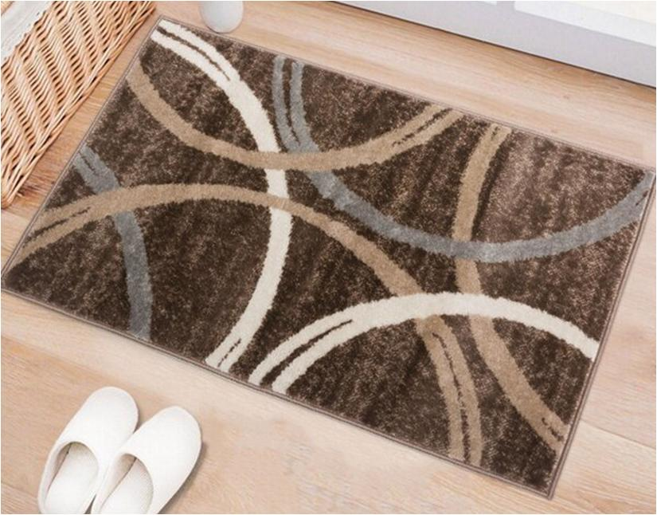
RT- BTR-3514

Slide 28
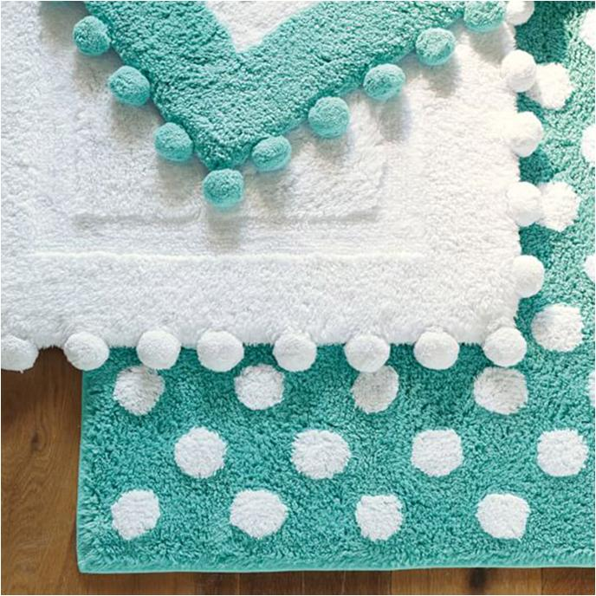
RT- BTR-3515

Slide 29
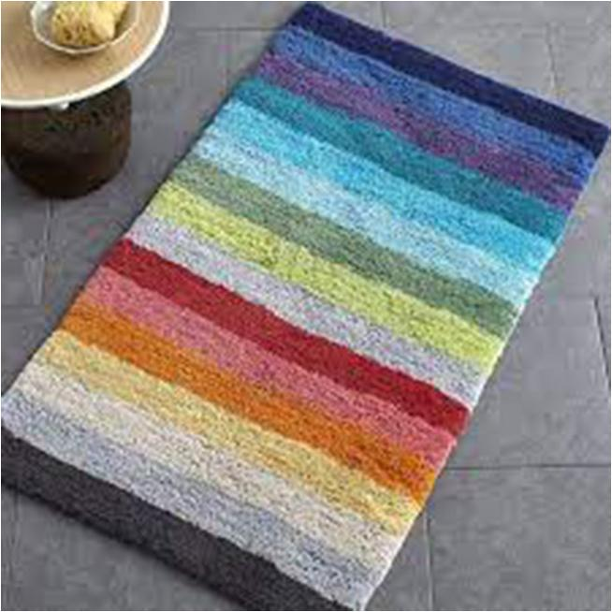
RT- BTR-3516

Slide 30
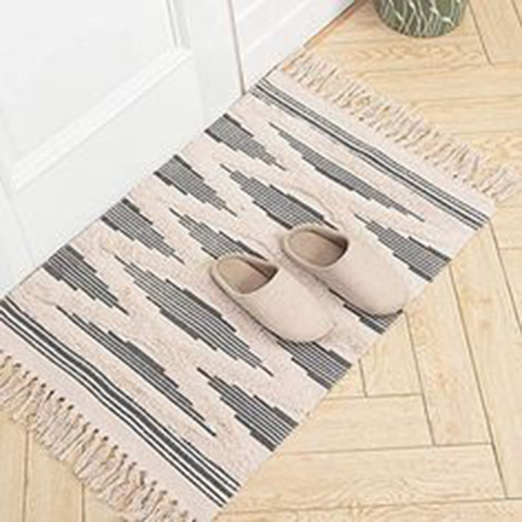
RT- BTR-3517

Slide 31
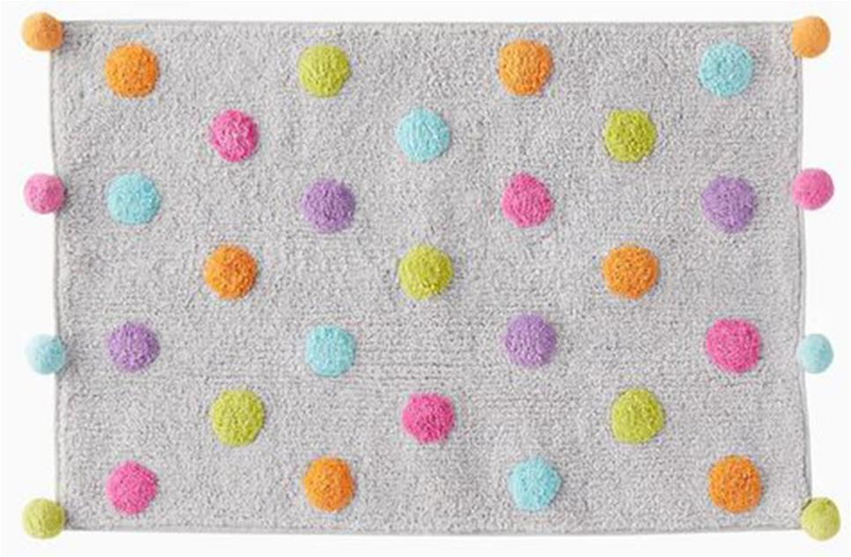
RT- BTR-3518

Slide 32
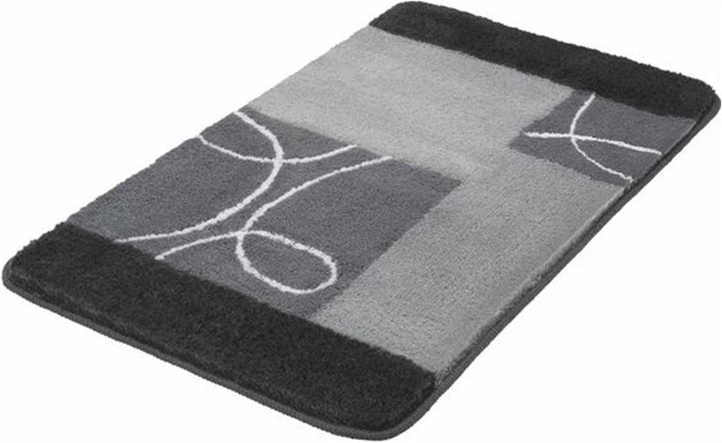
RT- BTR-3519

Slide 33
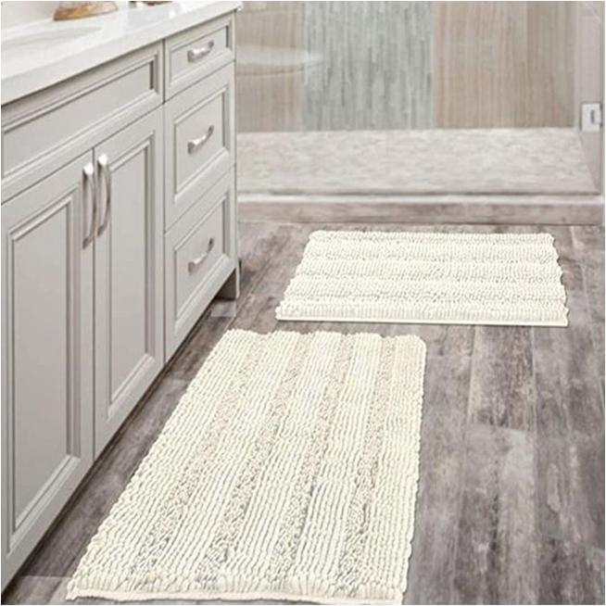
RT- BTR-3520

Slide 34

RT- BTR-3521

Slide 35
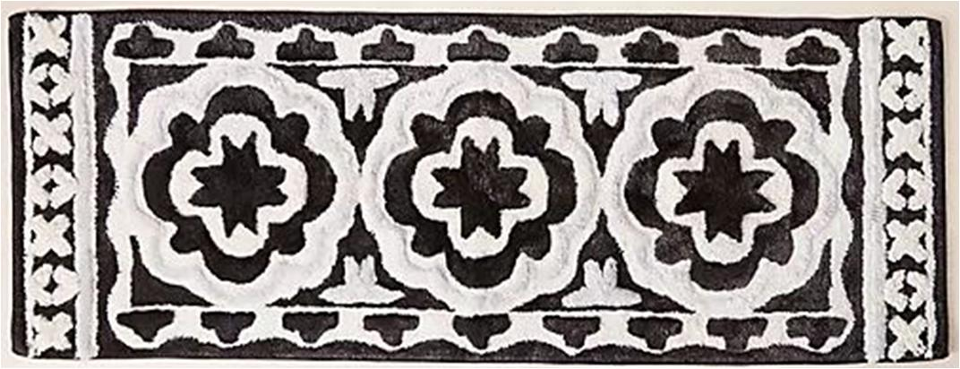
RT- BTR-3522

Slide 36
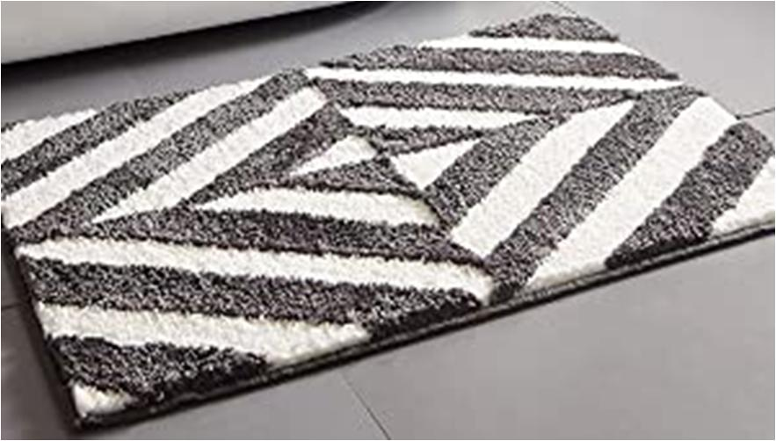
RT- BTR-3523

Slide 37
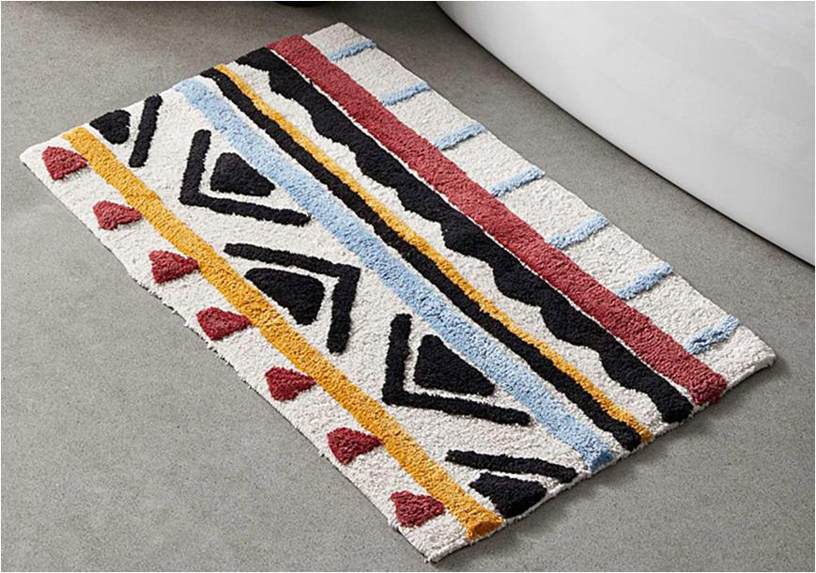
RT- BTR-3524

Slide 38
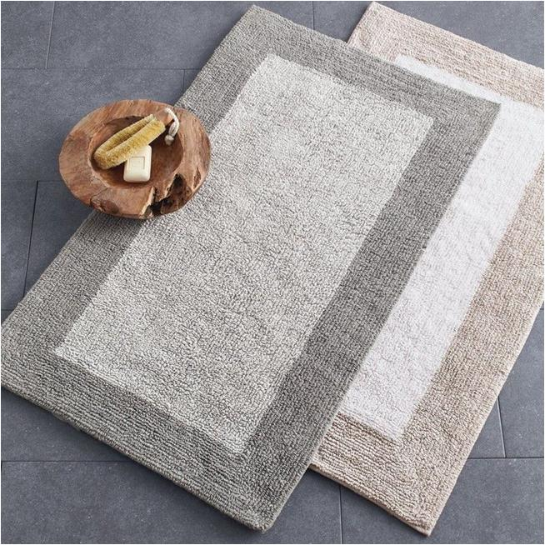
RT- BTR-3525

Slide 39
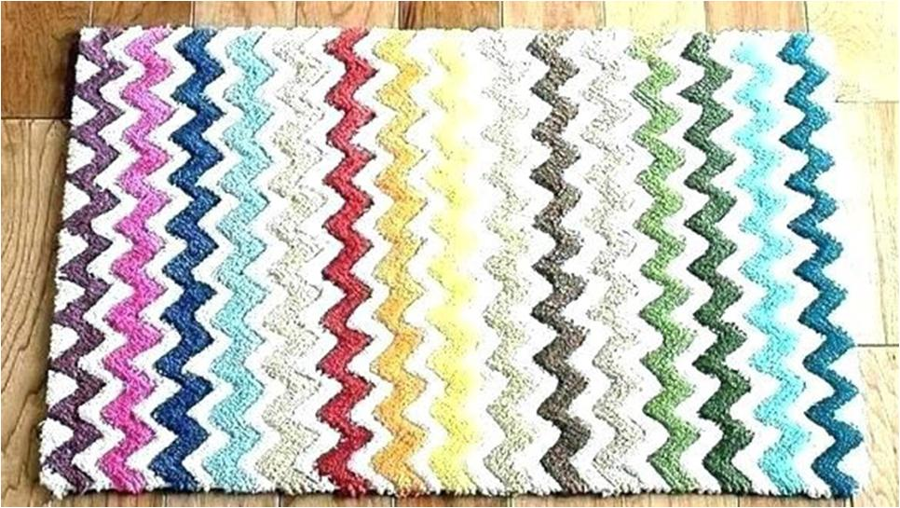
RT- BTR-3526

Slide 40
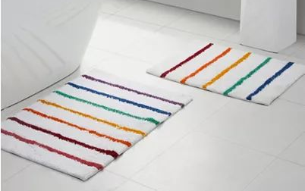
RT- BTR-3527

Slide 41

RT- BTR-3528

Slide 42
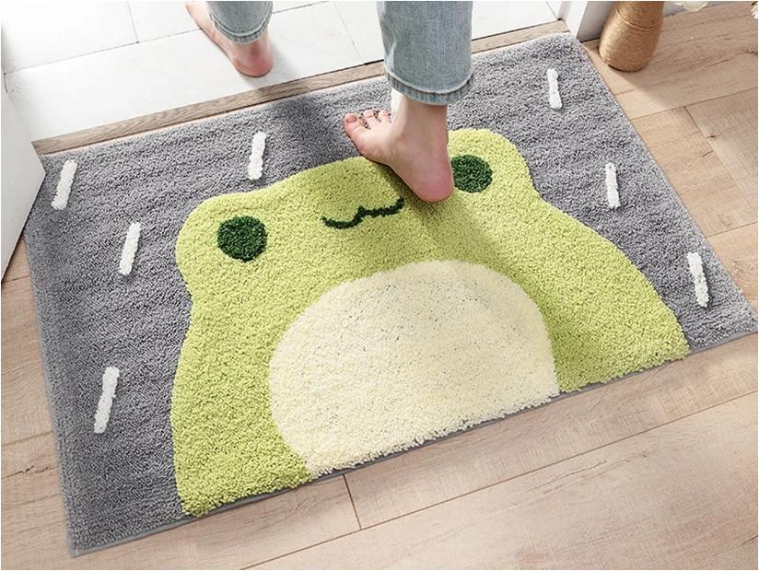
RT- BTR-3529

Slide 43
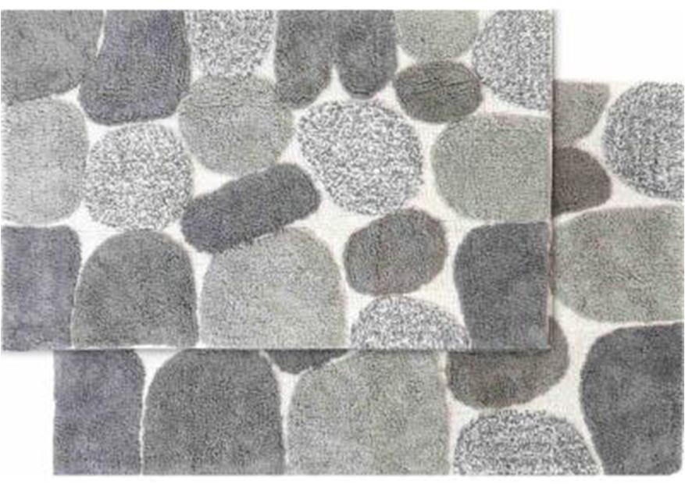
RT- BTR-3530

Slide 44
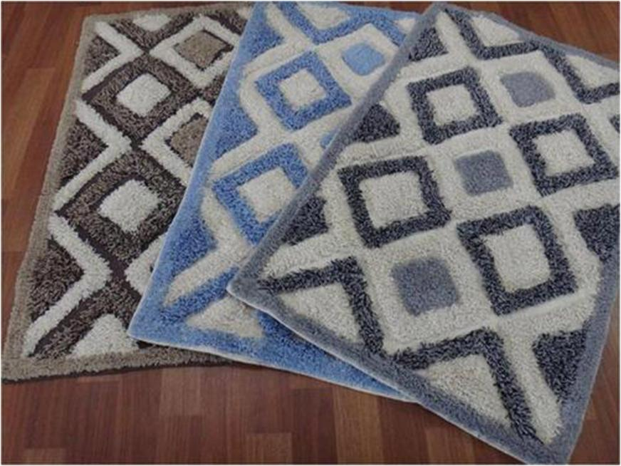
RT- BTR-3531

